Slide 1

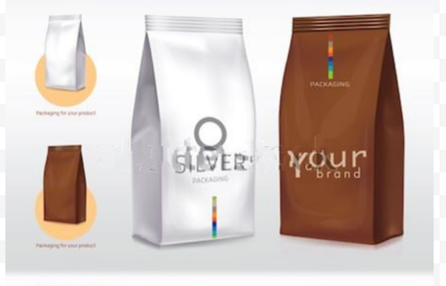
SAMPLE LANDSCAPE STUDY
Smart Food Packaging

Slide 2

Contents
Introduction to Smart Food Packaging
Growth Prospects of Smart Food Packaging Materials
Key Developments – Smart & Active Food Packaging
Objectives of the Landscape Study
Trend Analysis and Graphical Representation
Key Technology Trends
Patent Portfolio Analysis – Technological Dissection of Patent Portfolio and Analysis of Key Granted Patents/ Patent Applications
Analysis of Key Granted Patents/ Patent Applications Assigned to Educational Institutes and Universities
Appendix A – Sources
Appendix B – Definition of IPC Classes

Slide 3
Introduction to Smart Food Packaging
Active packaging refers to the incorporation of additives into the package to perform some desired function other than mere barrier properties of traditional packaging to extend the product quality and shelf life.
Smart packaging systems refers to active and intelligent packaging concepts based on the useful interaction between packaging environment and the food.
Smart packaging helps in the prevention of food spoilage, enhancement of product attributes such as taste, flavor, and odor of the food, tracking of changes in products or package environment; easy communication of product information, product history, or condition to consumer; assurance of seal integrity; confirmation of product authenticity.
The intelligent systems are those that monitor the condition of packaged food to give information regarding the quality of the packaged food during transportation and storage. Also it informs if the packaging has been damaged or if the product was not cooled sufficiently at a certain stage in the logistics chain.
Radiofrequency identification (RFID) is one such example of intelligent packing available in the market which helps in automatic identification of items in supply chain. Mountable sensor based RFID tags are available in the market that enables to monitor the temperature, relative humidity, light exposure, pressure and pH of the food material inside the package.
For sources of information, please refer to Appendix 1

Slide 4

Growth Prospects of Smart Food Packaging Materials
The global smart packaging market was valued at USD 33.19 billion in 2017, and is expected to reach USD 42.75 billion by 2023, registering a CAGR of 4.15% over the forecast period of 2018-2023.
The smart packaging market comprises of active, intelligent, and modified atmosphere packaging (MAP) technology and offers exciting opportunities for food safety, quality, and convenience.
The demand for longer shelf life of food products, increasing emphasis on reducing use of preservatives in food products and need for minimum processed products resulted high demand for smart packaging solutions.
Smart packaging is also utilized in other industries like automotive, healthcare, personal care, and others. The rising demand for healthy, safe, and hygienic food products is expected to drive this market. The market associated with smart packaging is poised to witness tremendous growth.
It is a critical time to understand the global competitive environment of smart packaging materials from a patent perspective and in-depth patent analysis of key technologies and players can help anticipate changes, detect business opportunities, mitigate risks and make strategic decisions to strengthen one’s market position and maximize return on one’s IP portfolio.
For sources of information, please refer to Appendix 1

Slide 5
Key Developments – Smart & Active Packaging Materials
David Edwards, a Harvard Professor invented Edible Food Packaging
The term “Active Packaging” was introduced by Labuza
The Kellogg Company was the first to use card board for cereal packaging
2012
2011
1987
1959
1926
1906
1817
Intelligent Packaging was first developed at University of Strathclyde by Prof. Williams
Eckert and Ziegler patent was granted on the first commercial modern plastics injection moulding machine
Ermal C.Fraze produced the first pop-top aluminum can
First commercial paper board was born
For sources of information, please refer to Appendix 1

Slide 6
Objectives of the Landscape Study
To understand technology and prepare patent landscape
To understand major patent holders, geographical distribution of patents, top sub-technologies based on IPC codes
Analysis of patent filing trends over the years, top assignees, top patent classifications, among others
To conduct Patent Portfolio based study of patents relating to core focus area of Smart, Active and Intelligent food packaging materials
The instant sample report provides patent analysis for Smart, Active and Intelligent packaging materials for food & beverages market, which includes different types of technical or functional features of advance packaging materials along with manufacturing techniques and advanced technology based patents.
Assumptions:
The landscape study focuses on patents pertaining to smart packaging materials published between 2008-2018.

Slide 7
Trend Analysis and Graphical Representation
Patent Searching | Research and Analytics | Patent Prosecution/Preparation Support | Litigation and E-Discovery | IP Valuation | Patent Portfolio Watch

Slide 8
Filing Trends – Last 10 Years
Number of Patent Families
Application Year
Insights
Global patent filing trend analysis shows an overall rise in the number of patent applications filed during the last 10 years. There is significant rise in the number of patents filed from the year 2015 onwards with highest filing in the year 2016. Maximum number of patent applications were filed from CN, followed by US and KR jurisdictions.
# Filing trends for year 2017-2018 may be higher than that reflected in the above graph, attributed to unpublished patent applications.

Slide 9
Publication Trends - Last 10 Years
Number of Patent Families
Publication Year
Insights
Global patent publication trend presents an overall rise in the number of publications during last 10 years with its peak during 2017, which suggests significant filing during 2015-2016.
# Graphs were prepared based on the publication year of the priority application

Slide 10
Top Assignee
No of patent families
Insights
Assignee
Anhui Yingmei Color Printing & Packaging Co. Ltd. is the leading patent applicant in smart food packaging materials followed by Jiangsu University and Cryovac Inc.

Slide 11
Top International Patent Classifications (IPCs)
Insights
Highest number of applications filed during 2008-2018 corresponds to IPC class C08L relating to ‘Compositions of Macromolecular Compounds’ followed by B65D which is relating to ‘Containers for Storage or Transport of Articles or Materials’, and B32B i.e. further relating to ‘Layered Products’.
# For IPC sub-class definitions please refer to Appendix 2.

Slide 12
Top International Patent Classifications (IPCs)
Insights
Amongst applications filed in C08L, majority of the applications were filed in technology of sub-class C08L 23/06 which relates to ‘Polyethene’.
# For IPC sub-class definitions please refer to Appendix 2.

Slide 13
Top International Patent Classifications (IPCs)
Insights
Amongst applications filed in B65D, significant number of the applications were filed in technology of sub-class B65D 81/24 relating to ‘Adaptations for preventing deterioration or decay of contents’ and sub-class B65D 81/26 related to ‘with provision for draining away, or absorbing, or removing by ventilation, fluids’.
# For IPC sub-class definitions please refer to Appendix 2.

Slide 14
Geographical Origin of Innovation
Jurisdiction
Number of Patent Families
Insights
Analysis of Geographical Origin of Innovation (i.e. Priority Country) demonstrates that maximum number of innovations originated from CN followed by US , KR and JP jurisdictions.
# The graph representing Geographic origin of innovation was prepared based on the analysis of priority country member

Slide 15
Key Technological Trends
Patent Searching | Research and Analytics | Patent Prosecution/Preparation Support | Litigation and E-Discovery | IP Valuation | Patent Portfolio Watch

Slide 16
Technical/ Functional Feature of Food Packaging Material
Insights
Highest percentage of applications (46%) were focused on Anti-Microbial packaging flexible films. 18% of the material features Oxygen absorption property while 8% of the material are containing smart tags or indicators or sensors.

Slide 17
Type of Food Packaging Material
Insights
Highest percentage of applications (69%) were focused on materials which are Flexible or Films. 18% of the applications were focused on Rigid or Semi rigid container followed by edible packaging materials which accounts for 5%. Others (8%) include specific kind of materials like pouch, bag, or any designed container etc.

Slide 18
Applications of Food Packaging Material
Insights
Highest percentage of applications (77%) were related to packaging materials for General food packaging, 8% of the applications disclosed materials for Meat packaging followed by Beverages (6%) and Vegetables (4%). Others (5%) include cereals, cheese etc.

Slide 19
Manufacturing Process of Food Packaging Materials
Insights
Highest percentage of applications (38%) disclosed Extrusion method of material manufacturing followed by Casting (31%) and Lamination (15%) process. 31% of applications disclosed other process like electrospinning, spray drying and other chemical procedures.

Slide 20
Patent Portfolio Analysis
Patent Searching | Research and Analytics | Patent Prosecution/Preparation Support | Litigation and E-Discovery | IP Valuation | Patent Portfolio Watch

Slide 21
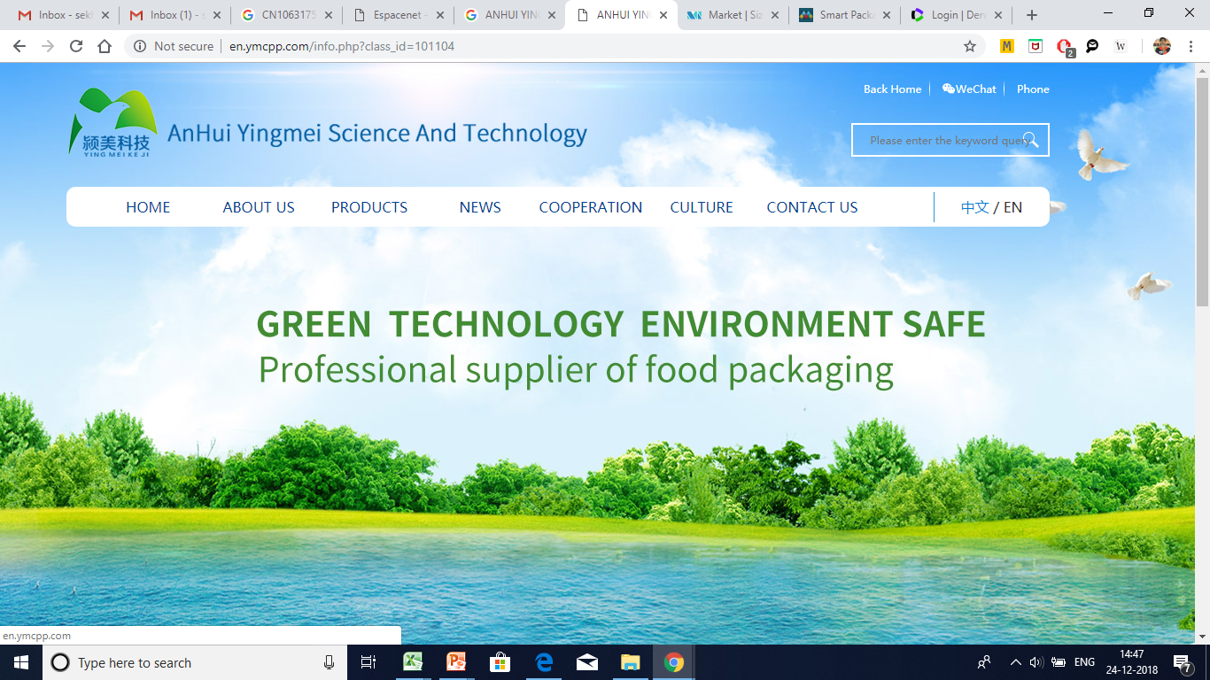
Patent Portfolio Analysis – Anhui Yingmei Color Printing & Packaging Co Ltd
Company Profile
Anhui Yingmei Color Printing Packaging Co. Ltd., is a professional producer of various kinds of food packaging materials on large-scale.
The company's dynamic variable multiple anti-counterfeiting or code technology, paper-plastic 5-in-1 number residue and reverse printing technology, positioning technology such as safety in intelligent information technology, green environmental protection, novel and fashionable and beautiful, etc have leading position in the industry.

Slide 22
Patent Portfolio Analysis – Anhui Yingmei Color Printing & Packaging Co Ltd
Key Patents
Patent No. | Key Features
CN106317556A | The patent document discloses a method of manufacturing of a mosquito repellent anti bacterial food packaging material . The method involves that the ingredients are homogenized into a twin-screw extruder melt and co compounded, pelletized to obtain pellets packing. The obtained pellets blown into film with a thickness of approximately 70-90μπι .
CN106146991A | The patent document discloses an anti-ultraviolet transparent antibacterial food packaging material and it’s method of manufacturing. The ingredients low-density polyethylene, zinc oxide, spice essential oil, hexadecyl trimethyl ammonium bromide, negative ion powder, dry orange peel, citric acid, coffee shell fiber, polyvinyl alcohol, aluminate coupling agent DL-4117 are mixed in appropriated proportion and homogenized into a twin-screw extruder to obtain pellets packaging. The obtained pellets blown into film with a thickness of 70-90μm.
CN106279896A | The patent document discloses a flame retardant anti bacterial food packaging material made from the following raw materials low density polyethylene, nano zinc oxide, anise oil, sepiolite activated carbon, stearate zinc, silane coupling agent, petrolatum , red phosphorus, softwood fibers. The method involves that the ingredients are homogenized into a twin-screw extruder melt and co compounded, pelletized to obtain pellets packing. The obtained pellets blown into film with a thickness of approximately 70-90μm.
US7741389B2
Resin composition containing a polyalkylene furan dicarboxylate resin and a porphyrin compound
US8981037B2
PEF used in preparation of a polyester resin
US20120258299
PEF is used in preparation of a polyester resin
CANON

Slide 23
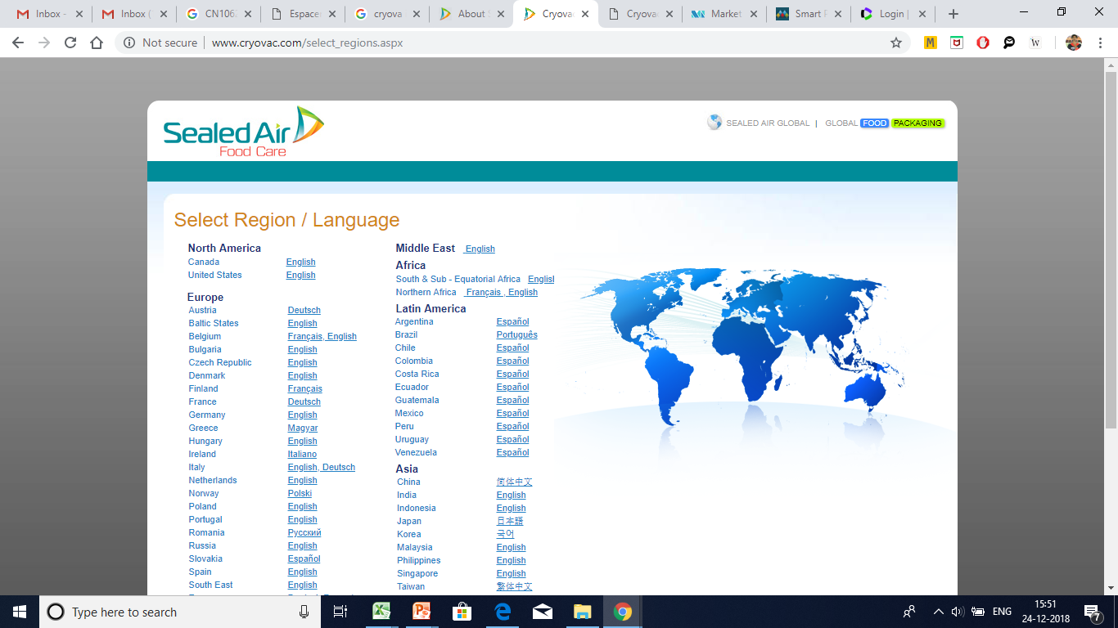
Patent Portfolio Analysis – Cryovac Inc.
Company Profile
Cryovac, Inc. was founded in 1946 and is based in Duncan, South Carolina. Cryovac. Inc. operates as a subsidiary of Sealed Air Corporation.
Cryovac, Inc. manufactures and markets food packaging products and offers vacuum shrink bags, multi-ply bags, barrier trays, absorbent pads, case liners, laminates, rigid packaging, and oxygen-absorbing sachets.

Slide 24
Patent Portfolio Analysis – Cryovac Inc.
Key Patents
Patent No. | Key Features
US20150251814A1 | The Patent document relates to a coextruded blown film comprising high density polyethylene for use in packaging, such as food packaging, such as in aseptic, hot-fill, or retort packaging environments. The another aspect of the invention is a package comprises a food product, and a hermetic pouch in which the food product is disposed, the hermetic pouch having a longitudinal seal and two transverse heat seals, the pouch comprising a laminate of a coextruded multilayer blown film comprising a core layer comprising a blend of ethylene vinyl alcohol copolymer, and an active oxygen barrier composition wherein from 20% to 65% by weight of the coextruded multilayer blown film comprises high density polyethylene; and a trap-printed film comprising polyethylene terephthalate, the trap-printed film adhesively joined to the first outer layer of the coextruded multilayer blown film.
US20180134013A1 | The Patent document relates to a manufacturing process of multilayer oxygen scavenging films for their use in food packaging materials. The oxygen scavenging layers of the films comprising a blend of ethylene/methyl acrylate/cyclohexene methyl acrylate copolymer (EMCM) as oxygen scavenger resin and a catalyst in a carrier resin, and an outer substrate layer. The invention disclosed co extrusion process for manufacturing of such films to be used in food packaging and to the packages obtained therefrom.
US7741389B2
Resin composition containing a polyalkylene furan dicarboxylate resin and a porphyrin compound
US8981037B2
PEF used in preparation of a polyester resin
CANON

Slide 25
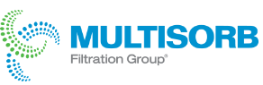
Patent Portfolio Analysis – Multisorb
Company Profile
Multisorb Technologies Inc. manufactures and supplies Active Food Packaging materials that provide protection against moisture, odor, oxygen, and other gases to customers in the United States and internationally.
The company offers healthcare desiccants, oxygen absorbers, and dispensers/inserter systems, as well as spill controls; and food and beverage oxygen absorbers, moisture and odor management products, and dispensing/inserter systems.

Slide 26
Patent Portfolio Analysis – Multisorb
Key Patents
Patent No. | Key Features
US20140087034A1 | The Patent document discloses a package material for protein containing foods like fish which comprise a sealable food covering and the interior of the covering has a permeable container wherein an oxidizer or an unreactive absorbent can be placed in the permeable container which substantially irreversibly reacts or absorb biogenic amines within the covering to form compounds without objectionable odor or toxicity.
EP3089875A1 | The Patent document discloses a food packaging material containing an iron iron-based oxygen scavenger and moisture regulator. The polymer films having oxygen scavenger and moisture regulator are extruded into a single and multilayer form. It is observed that the presence of moisture regulator enhance the oxygen scavenging rate. The single or multilayer film can be used as a base film or sealant film to be laminated on a substrate and can be converted into food packages for keeping the food fresh for longer time.
US7741389B2
Resin composition containing a polyalkylene furan dicarboxylate resin and a porphyrin compound
US8981037B2
PEF used in preparation of a polyester resin
US20120258299
PEF is used in preparation of a polyester resin
CANON

Slide 27
Analysis of Key Granted Patents/Patent Applications Assigned to Educational Institutes and Other Companies
Patent Searching | Research and Analytics | Patent Prosecution/Preparation Support | Litigation and E-Discovery | IP Valuation | Patent Portfolio Watch

Slide 28
Granted Patents/Patent Applications – Institutes & Universities
Patent No. | Key Features
CN107034585A University of Jiangsu | The Patent document related to antibacterial food packaging material and its preparation method using a g-C3N4 nano – fiber anti bacterial film. g-C3N4 nano film synthesized through a high temperature calcination method using urea as raw material. the synthesized g-C3N4 nano-particles are added into an electrostatic spinning solution and prepared into the nano-fiber film which is excellent in performance. g-C3N4 nano-particles are uniformly distributed in the film and good in stability and antibacterial property.
CN106317477A University of Jiangsu | The Patent document discloses an edible nano SiO2- lemongrass essential oil antibacterial alginate film for food packaging and preparation method. The film material is prepared by dispersing and mixing the lemongrass essential oil and the nanometer SiO2 to make the lemongrass essential oil adsorbed on to the SiO2 nano particles. The above compound added into sodium alginate solution and degassed to get an edible antibacterial solution. The solution is flow casted to get antimicrobial film and dried. The edible sodium alginate antibacterial coating has good mechanical property, stability and antimicrobial activity..
US7741389B2
Resin composition containing a polyalkylene furan dicarboxylate resin and a porphyrin compound
US8981037B2
PEF used in preparation of a polyester resin
US20120258299
PEF is used in preparation of a polyester resin
EP2257596B1
Resin composition containing polyethylene furandicarboxylate
CANON
EP2235100B1
Resin composition containing polyethylene furandicarboxylate
US20090124763Method of synthesis, PEF having a furan ring

Slide 29
Granted Patents/ Patent Application – Other Companies
Patent No. | Key Features
CN105907067A Tongling Founder Plastics Tech Co Ltd | The Patent document discloses a biodegradable plastics cyano bacterial technology, and particularly relates to a high oxidation resistance chitosan-based composite bio film for food packaging applications and preparation method. According to the invention, cyanobacteria fermentation products are adopted and combined with chitosan, silk fibroin and epoxidized soybean oil for preparing the cyanobacteria-based biofilm, and the prepared biofilm has biodegradability and high oxidation resistance and can be applied to the field of food packaging
WO2018043578A1 Toppan Printing Co Ltd | The Patent document provides a food packaging film and food container to guarantee the food freshness even when stored for a long period. To prevent growth of other bacteria the lactic acid bacterial is laminated on the inner surface of the container or the film thereby improving the preservability and freshness of the food. The container is used for food or beverage packaging.
US7741389B2
Resin composition containing a polyalkylene furan dicarboxylate resin and a porphyrin compound
US8981037B2
PEF used in preparation of a polyester resin
EP2257596B1
Resin composition containing polyethylene furandicarboxylate
CANON
EP2235100B1
Resin composition containing polyethylene furandicarboxylate
US20090124763Method of synthesis, PEF having a furan ring
EP2252645B1
Polyester resin used for producing a molded article

Slide 30
Granted Patents/ Patent Application – Other Companies
Patent No. | Key Features
JP6202183B1 Mitsubishi Gas Chemical Co | The Patent document is related to a multi-layer body packaging container for food packaging and preservation. The container is with excellent oxygen absorbing capacity and sufficiently suppress the odor. The multi layer container prepared by laminating the oxygen-absorbing layer containing a thermoplastic resin and iron powder, the odor absorption layer containing a thermoplastic resin and an inorganic base .
US20180027829A1 Dow Global Technologies LLC | The Patent document is related to food packaging material that comprise antimicrobial properties. The material is used for packaging meat products. The material comprises a substrate, and an antimicrobial composition that comprising an active antimicrobial agent and carrier.
US7741389B2
Resin composition containing a polyalkylene furan dicarboxylate resin and a porphyrin compound
US8981037B2
PEF used in preparation of a polyester resin
US20120258299
PEF is used in preparation of a polyester resin
EP2257596B1
Resin composition containing polyethylene furandicarboxylate
CANON
EP2235100B1
Resin composition containing polyethylene furandicarboxylate
EP2252645B1
Polyester resin used for producing a molded article

Slide 31
Appendix 1: Sources
http://www.preventpack.be/sites/default/files/publications/active_and_intelligent.pdf
https://www.ncbi.nlm.nih.gov/pmc/articles/PMC4573137/
http://www.logforum.net/pdf/4_4_3_2008.pdf
https://www.sciencedirect.com/science/article/pii/B9780123116321500371
https://www.bloomberg.com/research//stocks/private/snapshot.asp?privcapId=532764
https://multisorb.com/en-US/resources/research-and-development
https://www.bloomberg.com/research/stocks/private/snapshot.asp?privcapid=3023962
https://www.azonano.com/article.aspx?ArticleID=3035
https://us.vocuspr.com/Newsroom/MultiQuery.aspx?SiteName=DupontEMEA&Entity=PRAsset&SF_PRAsset_PRAssetID_EQ=119596&XSL=NewsRelease&IncludeChildren=True&Lang=English
http://nirvanacph.com/2017/07/material-monday-food-packaging-local-materials-production/
https://www.indiamart.com/proddetail/food-packaging-material-12185643312.html
https://www.marketsandmarkets.com/Market-Reports/smart-packaging-market-196217014.html?gclid=CjwKCAiA3vfgBRB9EiwAkfpd3CFnEhteSsUXE3IkifhvqBI96j_LqLeCWKp7FrAd1tsFh1RXA0YoChoCpfkQAvD_BwE
https://www.graphicpkgeurope.com/know-how/packaging-history-timeline/#18
https://www.mordorintelligence.com/industry-reports/smart-packaging-market?gclid=CjwKCAiA3vfgBRB9EiwAkfpd3Kaz8ODsmVSWP6HsegsAykCr0rwbwO4a6lgFx9G7LmYW--TCGvF7IRoCf84QAvD_BwE

Slide 32
Appendix 2: Definition of IPC Classes
IPC CLASS | DEFINITIONS
C08L | Compositions Of Macromolecular Compounds
C08L 23/06 | Polyethene
C08L 67/04 | Polyesters derived from hydroxy carboxylic acids, e.g. lactones
C08L 29/04 | Polyvinyl alcohol; Partially hydrolysed homopolymers or copolymers of esters of unsaturated alcohols with saturated carboxylic acids
C08L 89/00 | Compositions of proteins; Compositions of derivatives thereof
B65D | Containers For Storage Or Transport Of Articles Or Materials, E.G. Bags, Barrels, Bottles, Boxes, Cans, Cartons, Crates, Drums, Jars, Tanks, Hoppers, Forwarding Containers; Accessories, Closures, Or Fittings Therefor; Packaging Elements; Packages
B65D 81/24 | Adaptations for preventing deterioration or decay of contents; Applications to the container or packaging material of food preservatives, fungicides, pesticides or animal repellants
B65D 81/28 | Applications of food preservatives, fungicides, pesticides, or animal repellents
B65D 81/34 | for packaging foodstuffs intended to be cooked or heated within the package
B65D 65/40 | Applications of laminates for particular packaging purposes
B32B | Layered Products, I.E. Products Built-up Of Strata Of Flat Or Non-flat, E.G. Cellular Or Honeycomb, Form
C08J | Working-up; General Processes Of Compounding; After-treatment Not Covered By Subclasses C08B, C08C, C08F, C08G Or C08H
US7741389B2
Resin composition containing a polyalkylene furan dicarboxylate resin and a porphyrin compound
US8981037B2
PEF used in preparation of a polyester resin
US20120258299
PEF is used in preparation of a polyester resin
EP2257596B1
Resin composition containing polyethylene furandicarboxylate
CANON
EP2235100B1
Resin composition containing polyethylene furandicarboxylate
US20090124763Method of synthesis, PEF having a furan ring
EP2252645B1
Polyester resin used for producing a molded article
Patent Searching | Research and Analytics | Patent Prosecution/Preparation Support | Litigation and E-Discovery | IP Valuation | Patent Portfolio Watch

Slide 33
Disclaimer
IIPRD has prepared this sample report as an exemplary report, wherein the content of the report is based on internal evaluation of Patents and Non-Patent Literature that is conducted based on Databases and Information sources that are believed to be reliable by IIPRD. A complete list of patent documents retrieved is not disclosed herein as the report is exemplary but can be shared if desired based on terms and conditions of IIPRD. IIPRD disclaims all warranties as to the accuracy, completeness or adequacy of such information. The above sample report is prepared based on the search conducted on the keywords and other information extracted from the understanding of the Patent Analysts of IIPRD, and subjectivity of the researcher and analyst. Neither IIPRD nor its affiliates nor any of its proprietors, employees (together, "personnel") are intending to provide legal advice in this matter.

Slide 34
Contact Details
CONTACT DETAILS
Contact Details
Noida (NCR) Office – Head Office
E-13, UPSIDC Site-IV, Behind Grand Venice, Greater Noida, 201310
Contact Person: Tarun Khurana
Contact No(s):+91-(120) 4296878, 4909201, 4516201
E-Mail: iiprd@iiprd.com, info@khuranaandkhurana.com
Website: www.iiprd.com | www.khuranaandkhurana.com
Delhi | Noida | Mumbai | Pune | Bangalore | Hyderabad | Indore
US | Bangladesh | Myanmar | Vietnam | Nepal | Sri Lanka | Malaysia

Slide 35
About IIPRD
IIPRD is a premier Intellectual Property Consulting and Commercialization/ Licensing Firm with a diversified business practice providing services in the domain of Commercialization, Valuation, Licensing, Transfer of Technology and Due-Diligence of Intellectual Property Assets along with providing complete IP and Patent Analytics and Litigation Support Services to International Corporate and Global IP Law Firms.
Office- E-13, UPSIDC, Site-IV, Kasna Road, Greater Noida, National Capital Region - 201310, India ,Phone: +91.120. 4296878, 4909201, 4516201 Fax: 2342011, Website: www.iiprd.com, Email: iiprd@iiprd.com

