Slide 1
Landscape Study -
Protein and Amino Acid Nutraceutical

Slide 2
Introduction

Slide 3
Introduction
Protein is one powerful nutrient. It is part of every living cell, and plays a major role in our body — from building our body tissues to making important hormones. An adequate protein intake in the diet is important across the life cycle, especially as we age.
Amino acids (AA) are the building blocks of protein. There are 22 different amino acids required by the body. These amino acids join together to make all different kinds of protein. Apart from protein biosynthesis, amino acid also act as precursor for many other biomolecules. Nine amino acids which are considered essential amino acids are not made by the body and therefore obtained from food. The other amino acids are synthesized by the body and thus are considered nonessential amino acids.
The proteins in our bodies are constantly broken down and replaced. The body does not store amino acids like it stores carbohydrates and fats, so a daily supply of amino acids is required to make new proteins. The protein in the foods we eat is digested into amino acids that can be used to replace the proteins in our bodies.

Slide 4
Introduction
Most official nutrition organizations recommend a fairly modest protein intake. The DRI (Dietary Reference Intake) is 0.8 grams of protein per kilogram of body weight, or 0.36 grams per pound.
The protein requirement is based on several parameter(s) for e.g., whole-body protein mass, muscle mass, physical function, immune function, or metabolic function. Additionally, the protein requirement depends on quality—that is AA composition and digestibility—and physical activity level.
It is more important than ever to be able to describe appropriately the protein and amino acids supplied by food/diets. The match between dietary supply and human protein and amino acid needs is imperative to support the health and well-being of human populations.
Most people get enough protein. But in certain cases requirement of protein/amino acid is much higher compared to normal individual. Protein supplements are used to provide protein that may otherwise not be consumed in sufficient quantities.

Slide 5
Introduction
Protein supplements are available in form of powder, tablet, jelly, drink, beverages etc. Protein powder dominates protein products and growing rapidly. These supplements are used to address problems associated with heart health, diabetes, weight management, digestion, ageing etc.
Global protein and amino acids market is estimated to grow CAGR of more than 6% by 2020.¹
Major factors driving growth of protein nutraceutical includes: increased health awareness, omnipresent fitness and health maintenance trend, focus on leading active lifestyles and increased participation in sports and fitness activities as measured by higher enrollment in gyms and sports clubs. Further, protein is one of the most marketing claim for the sale of product.
In 2014, North America accounted for the largest share in the protein ingredients, owing to the high consumption of protein-based products. The global market in the Asia-Pacific region is emerging with substantial opportunities.²

Slide 6
Introduction
The top health benefit of protein from consumer point of view is summarized in the table below.¹
Health Benefit | % Consumer
General Health | 84
To keep Active and Agile | 81
Muscle maintenance | 73
Muscle recovery | 71
Kids to grow | 68
Strong bones | 67
Sports performance | 64
Weight management | 58
Supress hunger | 44

Slide 7
Bibliographic Analysis

Slide 8
Geographical Origin of Innovation
Analysis of priority country indicates that maximum number of innovations originated from China (58 patent families) followed by USA (57 Patent Families). Economical growth in China
attributes for the Chinese firms filing more patent in protein and amino acid based nutraceutical sector.

Slide 9
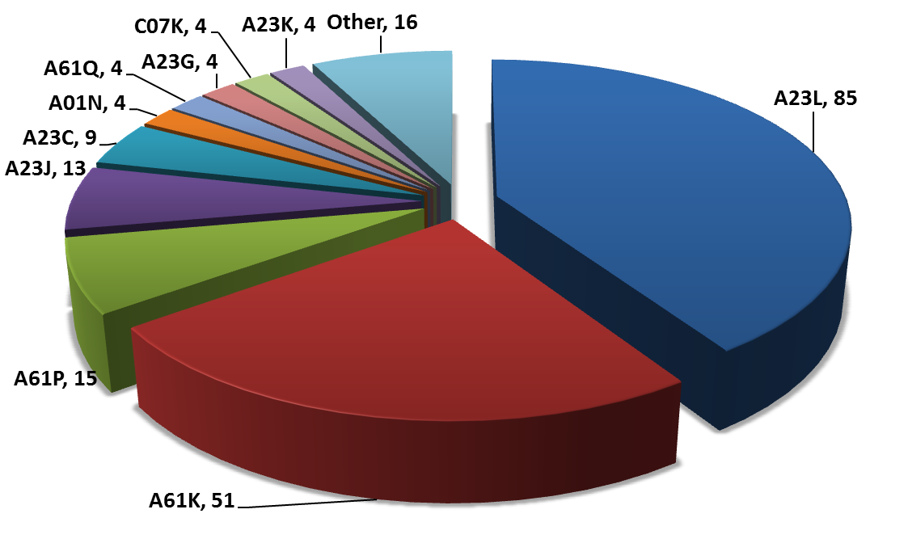
IPC Class Distribution (1/3)
Analysis of IPC Class indicates that 85 Patent families have IPC Class A23L (Foods, foodstuffs, or non-alcoholic beverages), followed by 51 Patent Families having A61K (Preparations for medical, dental, or toilet purposes).

Slide 10
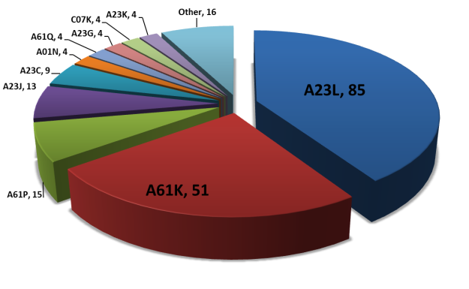
IPC Class Distribution (2/3)
For the IPC Class A23L, 2015 has maximum number of patent filing followed by 2014.
Sub Classes 33/00 (Modifying nutritive qualities of foods; dietetic products; preparation or treatment thereof) and 1/00 (Foods or foodstuffs; their preparation or treatment) have maximum focus.

Slide 11
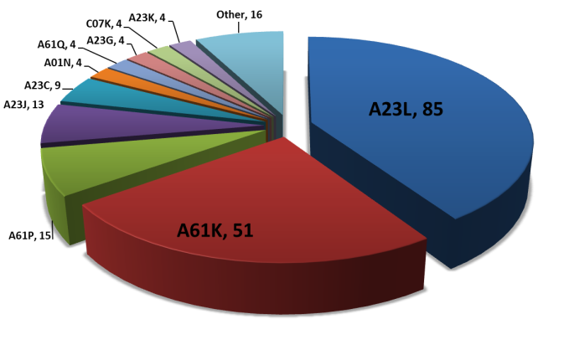
IPC Class Distribution (2/3)
For the IPC Class A61K, 2014 has maximum number of patent filing followed by 2013.
Sub classes 31/00 (Medicinal preparations containing organic active ingredients) and 38/00 (Medicinal preparations containing peptides) have maximum focus.

Slide 12
Priority Year based Filing Trend
2010 was the priority year for maximum number of applications (119) followed by 2013 (97).
Note: For this graph, all family members were taken into consideration.

Slide 13
Taxonomy

Slide 14
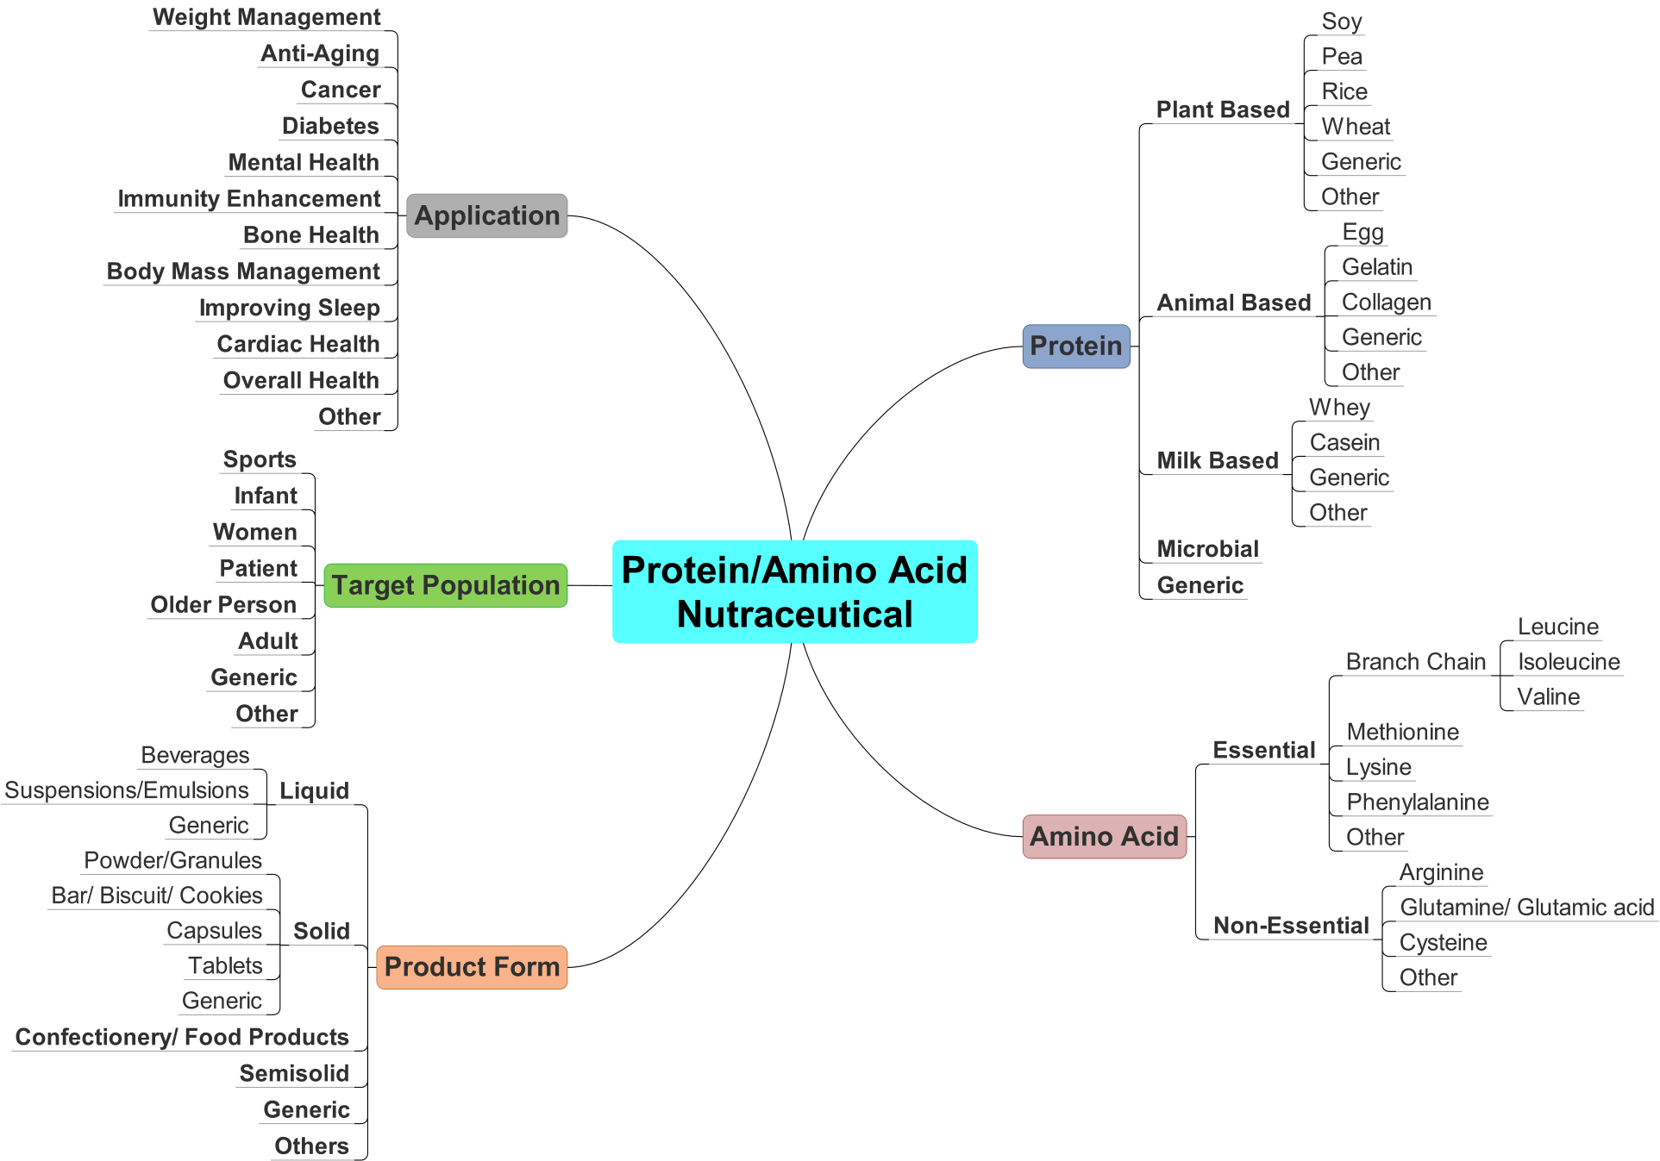
Taxonomy

Slide 15
Technical Data Analysis

Slide 16
Product Form - Distribution
Analysis of product forms indicates that maximum number of patents/published
applications included protein and amino acid based nutraceutical compositions in the form
of powders/granules (81), followed by liquids/solutions (30) and beverages (27).
Note: The data is mutually inclusive and hence the overall count maybe higher than the individual patent families.

Slide 17
Product Form – Filing Trend
Analysis of filing trend of product forms indicates that maximum number of
patents/published applications containing powder/ granule, tablet and beverages based
nutraceutical compositions were filed in the year 2015 (~45, ~12, ~13 respectively),
followed by a dip in 2016 which maybe due to applications not published so far.
Note: The data is mutually inclusive and hence the overall count maybe higher than the individual patent families.

Slide 18
Protein Ingredient - Distribution
Analysis of protein ingredients indicates that maximum number of patents/published
applications included soy based nutraceutical compositions (37), closely followed by
Whey (27) and Collagen (18).
Note: The data is mutually inclusive and hence the overall count maybe higher than the individual patent families.

Slide 19
Protein Ingredient – Filing Trend
Analysis of filing trend of protein ingredients indicates that maximum number
patents/published applications containing soy, whey and collagen based nutraceutical
Composition were filed in the year 2015 (~20, ~19, ~15 respectively), followed by a dip in
2016 which maybe due to applications not published so far.
Note: The data is mutually inclusive and hence the overall count maybe higher than the individual patent families.

Slide 20
Amino Acid - Distribution
Analysis of amino acids indicates that maximum number of patents/published
applications included Leucine based nutraceutical compositions (13), closely followed by
Arginine (11) and Methionine (11).
Note: The data is mutually inclusive and hence the overall count maybe higher than the individual patent families.

Slide 21
Target Population - Distribution
Analysis of target population indicates that maximum number of patents/published
applications included protein and amino acid based nutraceutical compositions directed
towards the treatment of specific patients (26), followed by infant formulas (23).
Note: The data is mutually inclusive and hence the overall count maybe higher than the individual patent families.

Slide 22
Target Population – Filing Trend
Analysis of filing trend of target population indicates that maximum number
patents/published applications containing infant and patient based nutraceutical
compositions were filed in the year 2015 (~11, ~12 respectively), followed by a dip in 2016
which maybe due to applications not published so far.
Note: The data is mutually inclusive and hence the overall count maybe higher than the individual patent families.

Slide 23
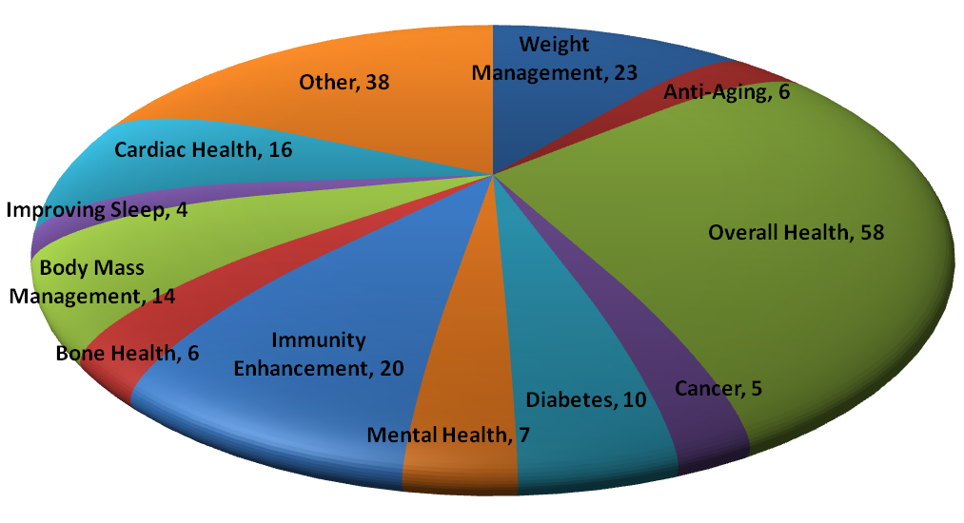
Application - Distribution
Analysis of applications (end-uses) indicates that maximum number of protein and amino
acid based nutraceutical composition containing patents/published applications were
directed towards the overall health benefit (58), followed by weight management (23) and
immunity enhancement (20).
Note: The data is mutually inclusive and hence the overall count maybe higher than the individual patent families.

Slide 24
Application – Filing Trend
Analysis of filing trend of applications (end-uses) indicates that maximum number of
patents/published applications containing protein and amino acid nutraceutical
composition directed towards the overall health benefit, weight management and
immunity enhancement containing were filed in the year 2015 (~33, ~12, ~16 respectively),
followed by a dip in 2016 which maybe due to applications not published so far.
Note: The data is mutually inclusive and hence the overall count maybe higher than the individual patent families.

Slide 25
Competitor Analysis

Slide 26
Top Assignees (1/2)
Abbott Lab and Nestle were found to be top assignees with highest number of innovations (individual patent families), significant patent filing in the technology domain. Abbott leads the pack with highest number of filing (18 patent families), followed by Nestle (11 Patent Families).

Slide 27
Top Assignees (2/2)
Abbott Lab and Nestle were found to be top assignees having 151 and 110 patent publication filed worldwide. Interestingly, Nestle has less number of innovations compared to Abbott but has sought much wider protection for the innovations.
Note: For this graph, all family members were taken into consideration.

Slide 28
Assignee Filing Trend
In 2015, Abbott Lab and Nestle has maximum no. of patent applications, 11 and 4 patent families respectively.

Slide 29
Assignee Vs Protein
Abbott Lab has primary focus on the soy based protein (9 patent families) composition. In many of Abbott’s products (Similac and RCF), soya protein is main protein source.
Nestle has primarily focus on Whey based protein (5 patent families) compared to Soy (2 patent families). Nestle’s product (Good Start) have whey based protein.

Slide 30
Assignee Vs Product Form
Both Abbott (12 patent families) and Nestle (9 patent Families) have primary focus on the powder as product form. Advantages of powder is : (a) Powder is stable and does not enter into reaction in solid state, (b) manufacturing of powder is economic, (C) less incompatibility as compared to liquid dosage form and (D) protein nutraceutical required in larger amount (in grams), conventional dosage of a supplement based requirement of can easily dispensed.

Slide 31
Assignee Vs Target
Abbott Lab has primary focus on infants (10 Patent families). Whereas, Nestle has maximum patents targeting patients (5 patent families).

Slide 32
Assignee Vs Application
Abbott Lab (10 Patent families) and Nestle (4 patent families) have primary focus on overall health.

Slide 33
White Space Analysis

Slide 34
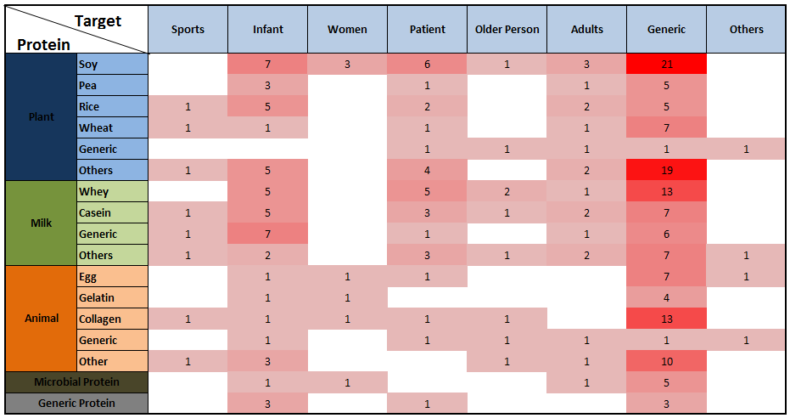
White Space Analysis - Protein Vs Target

Slide 35
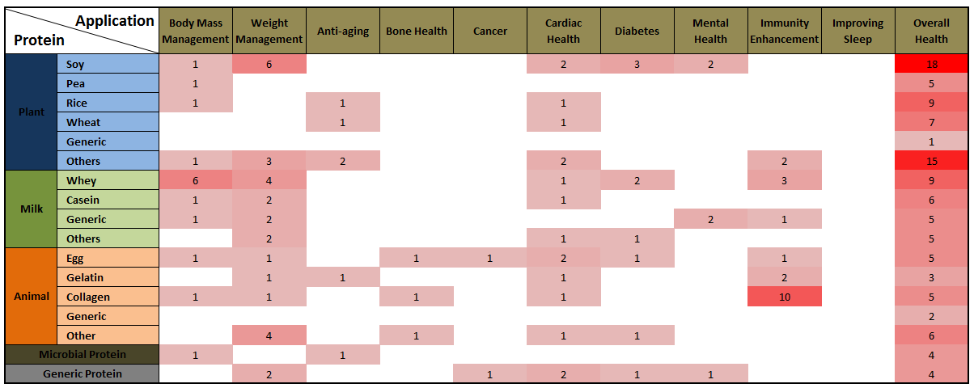
White Space Analysis - Protein Vs Application

Slide 36
Market Analysis

Slide 37
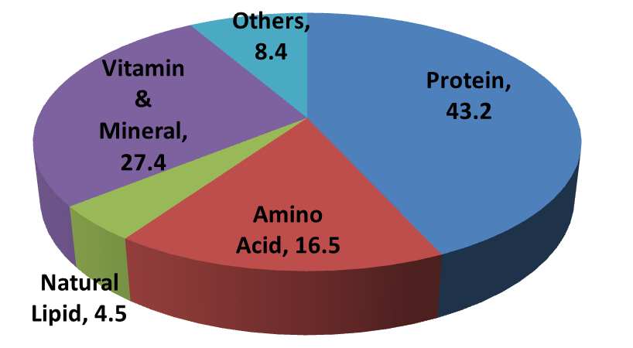
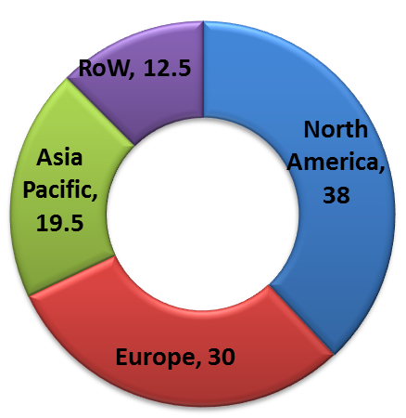
Market Data (1/2)
Dietary supplements are products that are specifically intended help meet recommended dietary requirements and supplement regular diet. The dietary supplement is multi-billion dollar business. Market share for different ingredient is presented in the figure left. Protein and amino acid accounted for more than 55% revenue.¹
Global protein and amino acids market is estimated to grow CAGR of more than 6% by 2020 ² and projected revenue by 2022 is USD 40.8 billion. ¹
% breakdown of revenue for dietary ingredient
For 2014, region wise market share of protein Ingredients presented in image. The North American region accounted for the largest share, owing to the high consumption of protein-based products. The global market in the Asia-Pacific region is emerging with substantial opportunities.³
Protein Market Share by Region

Slide 38
Market Data (2/2)
Protein ingredients are essentially protein extracts from different sources such as plant (soy, pea), animal (egg, collagen), milk (whey, casein), microorganism (spirulina) so on. The demand for particular type of protein is dependent end user.
Protein Ingredients market size in terms of volume¹ and revenue² is presented in the following graphs. There is a paradigm shift in the protein market. plant protein ingredients will dominate the protein ingredients market and is expected to grow at a CAGR of more than 7% by 2020.³
Global protein type by volume
Global protein type by Revenue

Slide 39
Mergers and Acquisitions
Acquirer | Acquiree | Highlight | Year | Source
Nestle | Pfizer Nutrition | To strengthen position in global infant nutrition market nestle acquired Pfizer Nutrition. | 2012 | http://www.nestle.com/media/pressreleases/allpressreleases/pfizer-nutrition-closing
Archer Daniels Midland (ADM) | Harvest Innovations | Archer Daniels Midland (ADM) Enhances Plant Protein, Gluten-Free Ingredient Portfolio with Purchase of Harvest Innovations, an industry leader in minimally processed, expeller-pressed soy proteins, oils and gluten-free ingredients. | 2016 | http://www.adm.com/news/_layouts/PressReleaseDetail.aspx?ID=706
Balchem Corporation | Albion International, Inc. | Strategic expansion of human health and wellness solutions portfolio Balchem Corporation acquired Albion International. | 2016 | http://www.balchem.com/balchem-corporation-acquires-albion-international-inc-1

Slide 40
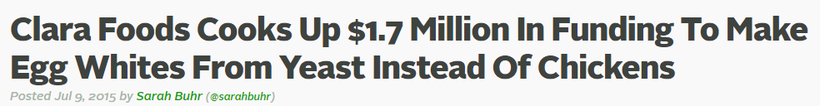

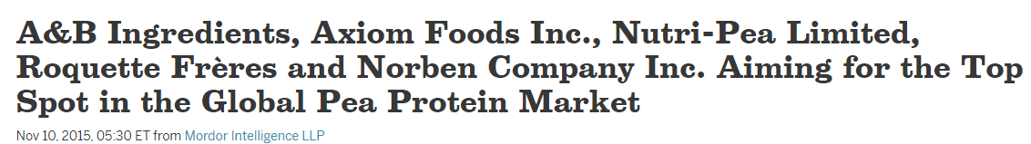
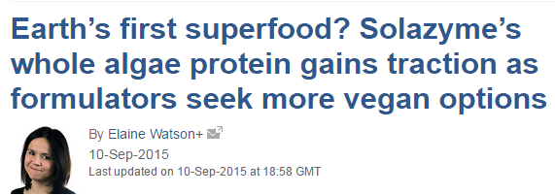
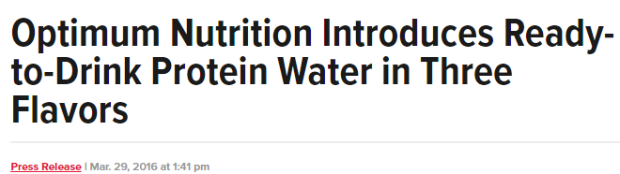
Recent News

Slide 41
Disclaimer

Slide 42
Disclaimer
The information provided in this report is based on database and information sources that are believed to be reliable by the IIPRD. While IIPRD has used the best resources for the commercial evaluation work, IIPRD disclaims all warranties as to the accuracy, completeness or adequacy of such information. The above report is prepared based on the searches conducted on the keywords and other information provided by the client. The comments provided are subject to results identified up to the date of this report and subjectivity of the researcher and analysts. Neither IIPRD nor its affiliates nor any of its proprietors, employees (together, "personnel") are intending to provide legal advice in this matter.

