Slide 1
Technology Landscape - Wearable Health Monitoring Devices

Slide 2
INTRODUCTION

Slide 3
Background
A wearable medical device may be defined as a biosensor that monitors physiological data, usually with a remote/wireless communication, and as a part of any wearable item that is attached to the body.
These devices measure and analyze various vital parameters such as electrocardiogram (ECG), heart rate (HR), blood pressure (BP), body temperature, respiratory rate, glucose level, blood oxygen saturation etc. and provide medical professionals with comprehensive information while making diagnosis or monitoring a chronic medical condition.
Wearable medical devices are facilitated with features such as wireless data transmission, real time feedback, alerting mechanism, and more. They transmit data related to any disease marker and organ function to the user or physicians. Thus, offer an efficient care and reduce hospital based expenditure in the process.
Data generated by wearable devices, enabled with analysis is used by consumers for their better health management. It also helps pharmaceutical companies for conducting efficient clinical trials by gathering data remotely.

Slide 4


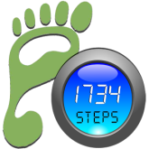
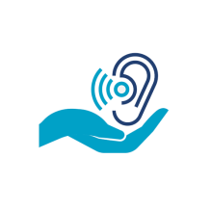
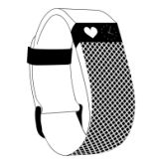
History of Wearable Health Monitoring Devices
Galvanic Skin
Response
Activity trackers, wireless-enabled wearable technology devices that measure data such as the number of steps walked, heart rate, quality of sleep, steps climbed, and other personal metrics involved in fitness.
C Series
Thomas Jefferson introduced the first pedometer to the US
Aurex Corp. developed 1st wearable Hearing Aid
1788
1938
2008
1921
2003
1st machine to include sensors to measure galvanic skin response, pulse rate and BP
Vitatron C series, world’s 1st fully digital pacemaker
Tomish
Meter
Hearing
Aid
Fit-bit
Contd.

Slide 5
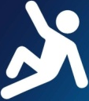
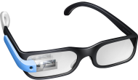
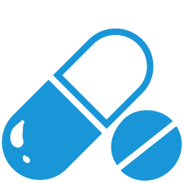
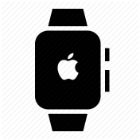
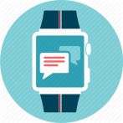
History of Wearable Health Monitoring Devices
Google
Glass
Phillips
Lifeline
Fitness tracking and health-oriented capabilities with integration with iOS
and other Apple products and services.
Wearable computer launched by glacier computers, designed for those in emergency response situations
Proteus digital health developed an ingestible digital health feedback system
2009
2012
2015
2010
2013
Autoalert automatic fall detection technology.
Homesafe and Gosafe systems
Optical head-mounted display designed in the shape of a pair of eyeglasses.
W 200
Wearable
In Medicine
Apple Watch

Slide 6
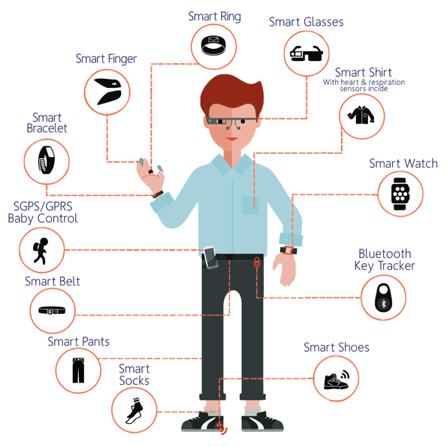
Types of Wearable Medical Devices based on site of Application

Slide 7
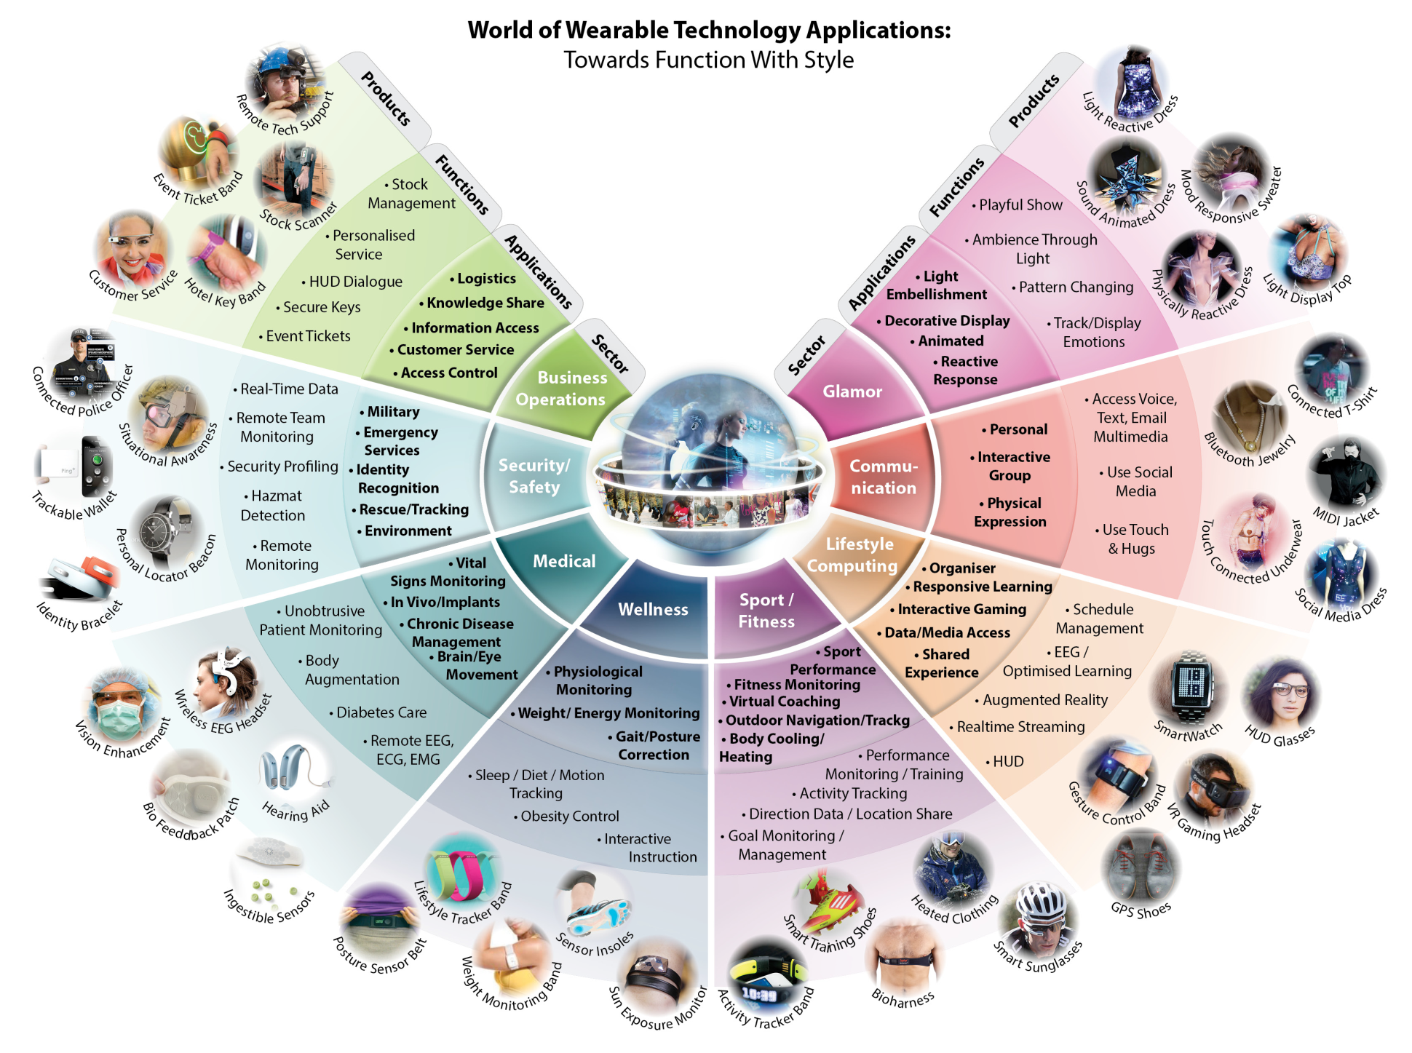
Technology Taxonomy of Wearable Devices
>>

Slide 8
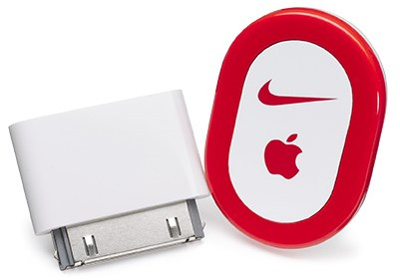
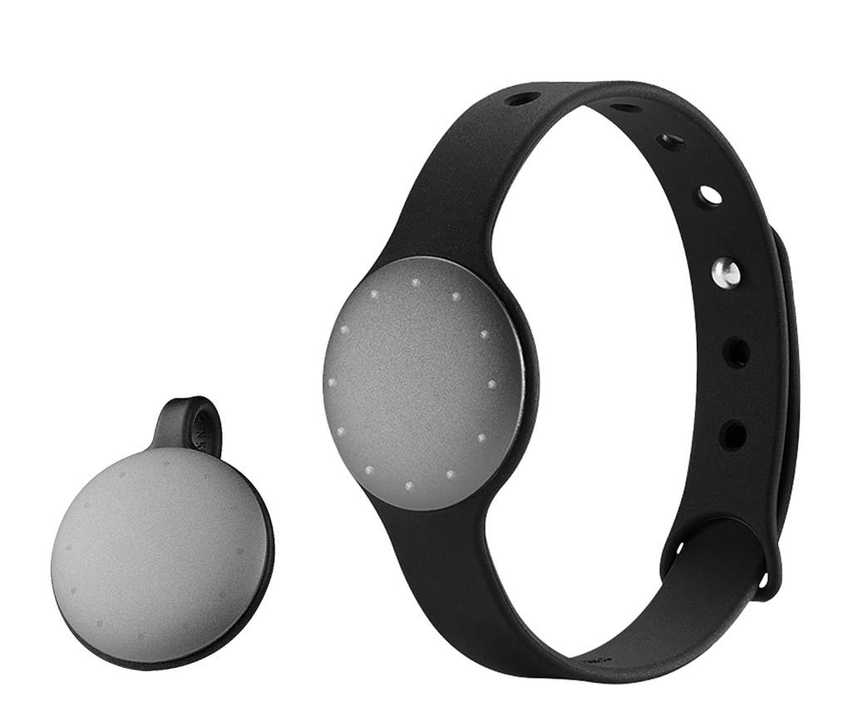
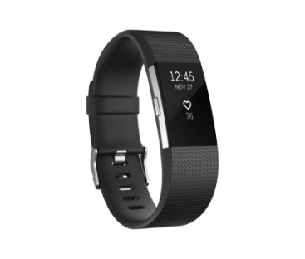
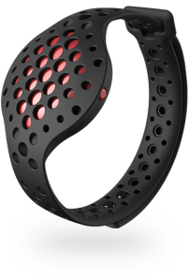
Types of Wearable Medical Devices
The wearable medical devices market includes products that can be broadly segregated in four segments:
Lifestyle and Fitness: The wearable lifestyle and fitness devices segment is the most advanced category of the wearable medical devices market. It includes fitness trackers, activity trackers and sports trackers. Personal health monitoring has been a large contributor to this arena of fitness wearable. Although many of the lifestyle and fitness devices are not technically medical devices; the US FDA has defined them as general wellness devices only.
Nike + iPod Sports Kit Misfit Shine
Moov Now Fitbit Charge 2

Slide 9
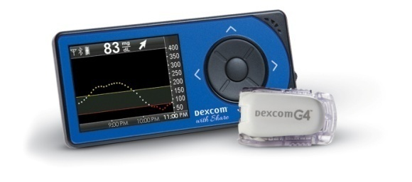
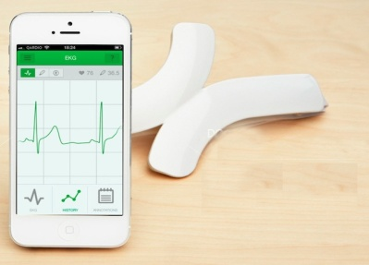
Types of Wearable Medical Devices
Diagnostics and Monitoring: Wearable diagnostic and monitoring devices are non-invasive devices that provide valuable health information. It includes glucose monitoring, cardiovascular monitoring, event recording, pregnancy, obstetrics, fetal and infant monitoring, neurological monitoring, such as electroencephalogram (EEG) tests and sleep monitoring devices.
Dexcom G4 Quardio core

Slide 10
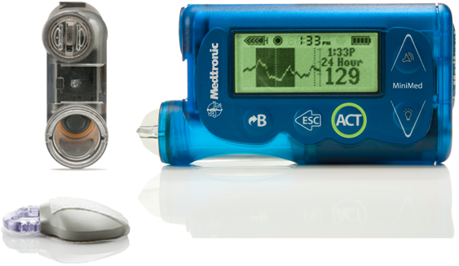
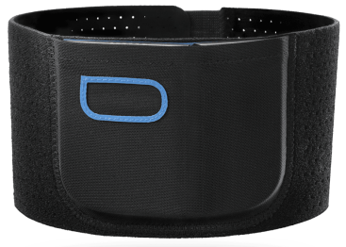
Types of Wearable Medical Devices
Therapeutic: Wearable systems that monitor disease states and track health activity, store data and deliver feedback therapy are the next frontier in personalized medicine and healthcare. This group of devices include respiratory therapy, insulin management, pain management devices, insulin/glucose monitoring devices, rehabilitation devices, and respiratory therapy devices.
Quell Minimed 530 G Insulin Pump

Slide 11
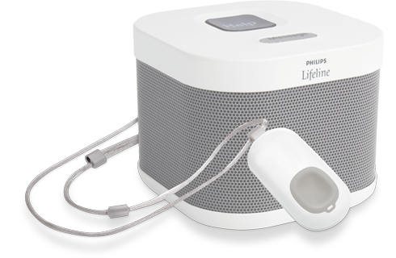
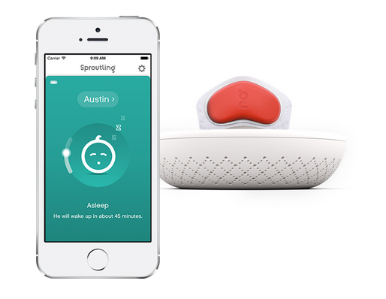
Types of Wearable Medical Devices
Injury prevention and rehabilitation: Wearable injury prevention and rehabilitation devices are the non-invasive devices that provide valuable health information. They include body motion monitoring devices, wearable sensing garments, fall detection devices.>>
Based on the site of application, the wearable devices market is segmented into handheld, shoe sensors, headband, strap/clip/bracelet, and other areas. Strap/clip/bracelet or wrist-worn devices are expected to hold over 40% of the market share in the domain of wearable medical devices.
Wearable Medical Device Market on the basis of application is segmented into remote patient monitoring, sports and fitness, and home healthcare.
Phillips Lifeline Sproutling Baby Monitor

Slide 12
Patent Landscape

Slide 13
Scope and Consideration of Landscape Search
Objective
To Perform Patent Landscape Study directed towards Wearable Health Monitoring Devices (Worldwide coverage for last 5 years i.e. considering patents published between 2012 and 2016)
Research Methodology
Step 1: Detailed analysis of publically available information to perform understanding of the technology domain.
Step 2: Identification of patent databases and keywords, synonyms and variations thereof, patent classification codes (IPC/CPC/US), Key inventors, Key assignees etc. to formulate search strings.
Step 3: Execution of broad search strings to unearth potentially relevant documents followed by their First-Pass Analysis (preliminary analysis) to remove any false positives. It includes data sanity checks to remove any duplicates (family member duplicates – by checking application numbers, family IDs and publication numbers).
Note: All graphs are prepared based on details of one representative member per INPODAC family, and numbers in graphs, therefore, indicate the number of INPADOC patent families.

Slide 14
Scope and Consideration of Landscape Search
Step 4: Detailed analysis and categorization of shortlisted documents into one or more categories provided in the proposed taxonomy
Databases Used
Thomson Innovation
Google Patent
ESPACENET

Slide 15
Filing Trend
Insight
Patent filing trend for the last 5 years (published between 2012-2017) indicates a burgeoning filing pattern with maximum number of patent applications filed in 2015 (184) followed by a subtle decline in 2016 (please note that filing trend for year 2016 may be higher than that reflected in the graph, attributed to unpublished patent applications).

Slide 16
Publication Trend
Insight
As evident from the publication trend depicted above, there has been a steady rise in the number of patent applications published over a period of time. Maximum number of applications (236) were published in 2016 (please note that publication trends for year 2017 may be higher than that reflected in the graph, attributed to unpublished patent applications).

Slide 17
Top Priority Country
Insight
As evident from the data shown above, majority of the patent applications filed in the domain of wearable health monitoring devices took priority from ‘CN’ jurisdiction (351), during 2012-2016.

Slide 18
Top IPC Classes
Insight
As evident from the data shown above, majority of patent applications filed in the domain of wearable health monitoring devices pertains to IPC class “A61B” (209) which stands for “Diagnosis; Surgery; Identification”, followed by IPC class “G06F”(39) which stands for “Electric Digital Data Processing”, during 2012-2016.

Slide 19
Top Assignees
Insight
As evident from the data shown above, Fitbit (21), Boe Technology (12) and Xiaomi(11) were the major assignee/ applicants in wearable health monitoring devices based on their patent filing activity worldwide during 2012-2016.

Slide 20
Distribution of Devices According to Body Part
Insight
As evident from the data shown above, majority of the patent applications were filed for smart watches (223), smart Jewellery (105), and smart garments (78) during 2012-2016, in the domain of wearable health monitoring devices.

Slide 21
Physiological Monitors - Distribution
Insight
As evident from the data shown above, majority of the patent applications were directed towards tracking/monitoring of pulse/heart rate (265), blood pressure (105), and steps/body movements (101) during 2012-2016, in the domain of wearable health monitoring devices.

Slide 22
Application - Distribution
Insight
As evident from the data shown above, majority of the patent applications filed during 2012-2016 were directed towards utilization of wearable health monitoring devices in cardiac monitoring (65), meeting fitness/exercise goals (54), and baby monitoring (37).

Slide 23
Improvement Areas - Distribution
Insight
As evident from the data shown above, majority of the patent applications filed during 2012-2016 were directed towards improvement in comfort/ease of use (22), smart and efficient monitoring (15), and model and design (14) of wearable health monitoring devices.

Slide 24
Beneficiary - Distribution
Insight
As evident from the data shown above, majority of the patent applications filed during 2012-2016 were directed towards benefitting users (130), and doctors/physicians (22), from the use of wearable health monitoring devices.

Slide 25
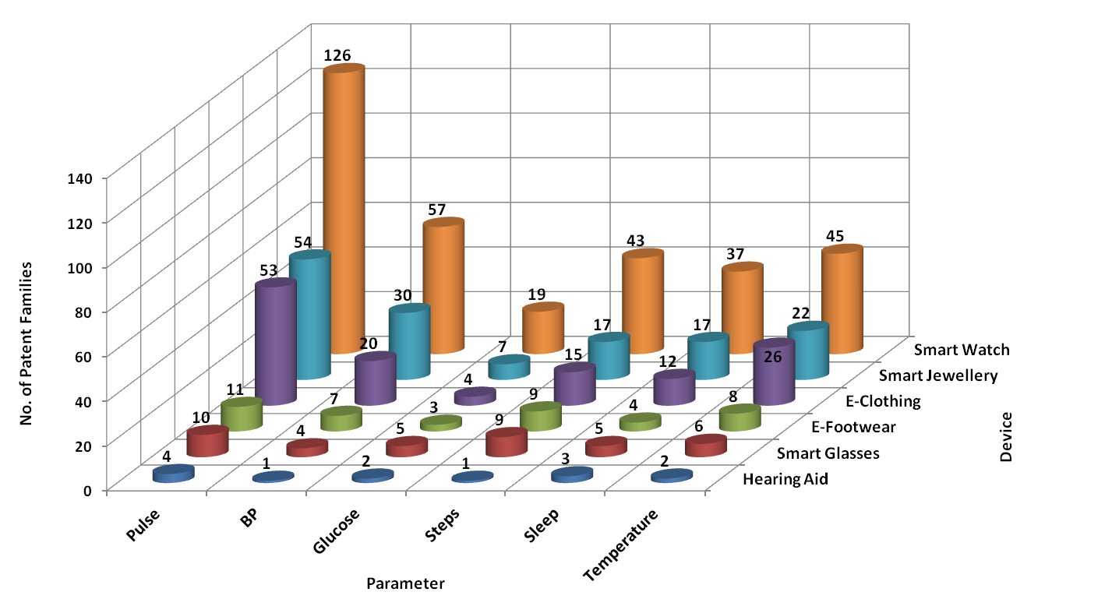
Body Part/Device Vs Physiological Monitors
Insight
Trend analysis depicted above indicates that smart watches or wrist bands were mostly utilized for monitoring of pulse/heart rate (126) of users. Smart jewellery including bracelets and rings were utilized for monitoring of pulse (54) and BP (30) of users. Smart garments were mostly utilized for monitoring of heart rate (53) and temperature (26) of users.

Slide 26
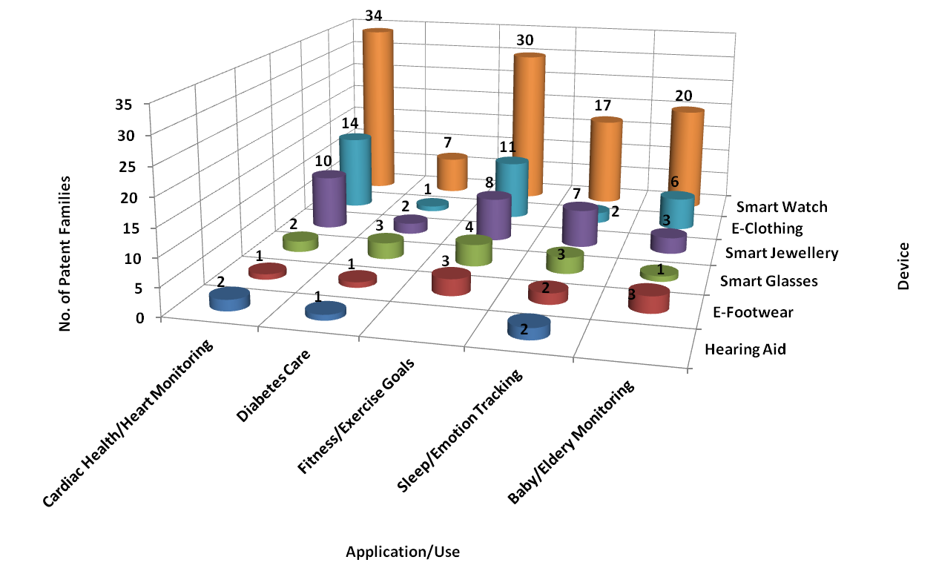
Body Part/Device Vs Application
Insight
Trend analysis depicted above indicates that smart watches or wrist bands were mostly utilized for cardiac health monitoring (34) and meeting fitness goals (30) of users. Smart Jewellery including bracelets and rings were utilized for sleep/emotion tracking (7) of users. Smart garments were mostly utilized for cardiac monitoring (14) and meeting fitness goals (11) of users.

Slide 27
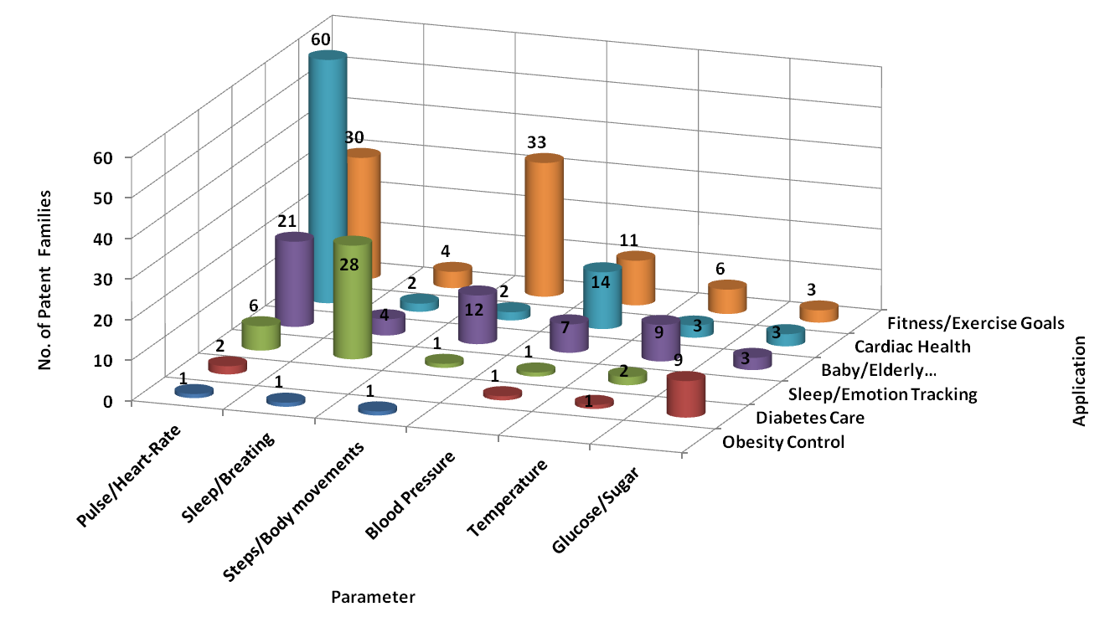
Physiological Monitors Vs Application
Insight
Trend analysis depicted above indicates that pulse (60) and blood pressure (24) were monitored for determining cardiac health of users. Steps and Body movements were monitored for baby monitoring(12) and tracking fitness (33)of users.

Slide 28
Patent Litigation
Patent Number | Patentee | Defendant | Comments
US 8,725,276 | Adidas | Under Armour | In February 2014, Adidas filed a lawsuit against Under Armour for alleged patent infringement of its mobile-app technologies that monitor heart rate, calorie burn and other indicators during workouts
US 5,058,427 US 6,289,238 and US 7,215,991) | Avocet Sports Technology, Body Science LLC | Polar Electro | In 2011 and 2012, Avocet Sports Technology (for patent US 5,058,427) and Body Science LLC (for patents US 6,289,238 and US 7,215,991) sued Polar Electro alleging patent infringement
US 7454002 | SportBrain | Adidas, Fitbit and Nike | SportBrain sued Adidas and Fitbit in 2012, and Nike in 2013, for infringing several of its fitness-related patents.
US 9,031,812, US 8,909,543 and US 9,042,971 | Fitbit | Jawbone | Fitbit filed multiple cases against Jawbone in September 2015, accusing Jawbone of infringing three of its patents on motion and activity sensing

Slide 29
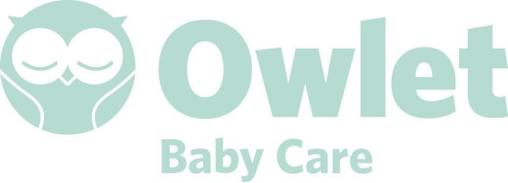
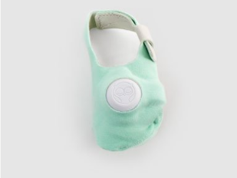

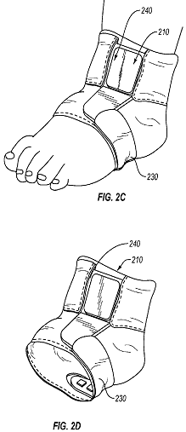
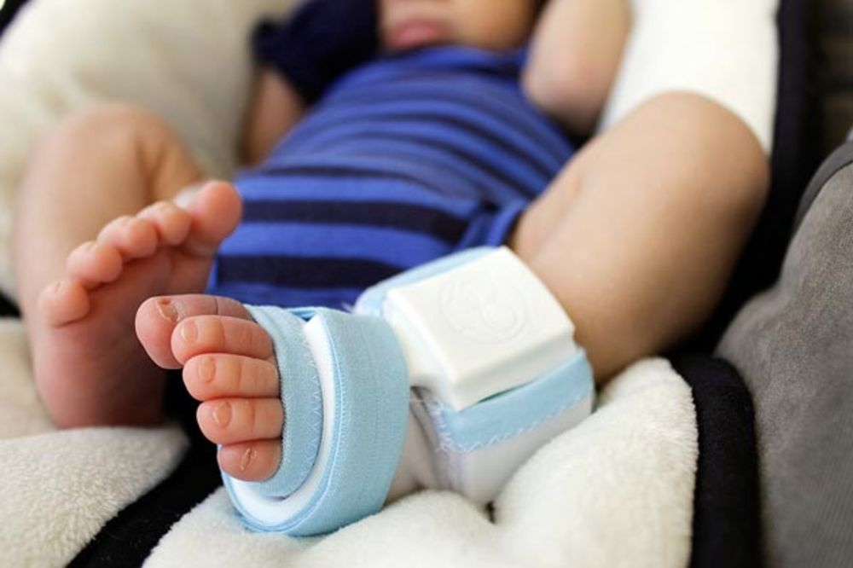
Product to Patent Mapping
http://www.owletcare.com/product/

Slide 30
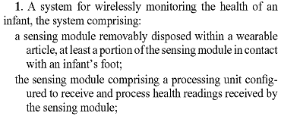
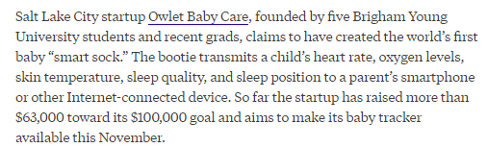
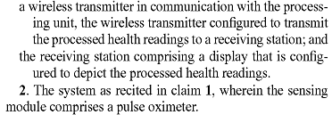
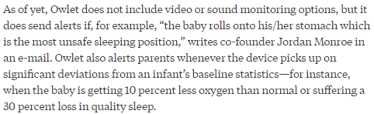
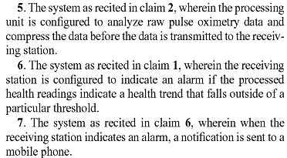
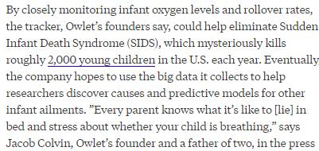

Product to Patent Mapping
US 20150157263
PRODUCT

Slide 31
MARKET SHARE AND TRENDS

Slide 32
Market Overview
Globally, medical wearable devices market was worth more than USD 3.5 billion in revenue in 2014 and is expected to cross USD 7.8 billion in 2020, growing at a healthy CAGR of over 15%. >>
This growth of the wearable technology market is expected to be driven by consumer preference for sophisticated gadgets, increasing growth prospects of next-generation displays in wearable devices, and growing popularity of Internet of Things (IoT) and connected devices.
Global wearable medical devices revenue

Slide 33
Regional Market Overview
In 2016, North America dominated the Wearable medical devices market with share of 32% followed by Europe and Asia-Pacific.
Increasing health awareness among end-users in emerging economies such as India and China is also fuelling the growth of wearable medical devices in the Asia Pacific market. >>

Slide 34
Wearable Health Monitoring Devices Brands
Top wearable brands according to market-measurement firm IDC, in the first quarter of 2016 >>

Slide 35
Key Players in Wearable Health Monitoring Devices Market
Key Players in Market of Wearable Health Monitoring Devices
Omron Corp
Life Watch AG
Polar Electro
Nubbo
Fitbit Inc.
Google Inc.
Sotera Wireless
Phillips Healthcare
Basis Science
Intelesenses Ltd.
Gentag Inc.
Intel

Slide 36
Wearable Preferences
US and European Consumers interested in wearing/using a Sensor Device (2014) >>

Slide 37
Major factors driving growth of wearable health monitoring devices market
Lifestyle-related diseases requiring routine vital statistics analysis
Rising awareness amongst people
Demand for wireless monitoring devices
Increasing incidences of chronic diseases and diabetes patients
Market Penetration of smart phones and smart watches
Technological innovations and advancements leading to introduction of new products
Increasing focus on fitness and a healthy lifestyle
Higher healthcare spending, and supportive government programs
Patient comfort
Ease of use and interpretation

Slide 38
Challenges in wearable health monitoring device market
High cost of the devices
Device connectivity and communication
Need for miniaturized devices with long battery life
Privacy concerns regarding transmitting sensitive patient data
04
03
02
01
>>

Slide 39
Mergers and Acquisitions
Acquirer | Acquiree | Highlights | Year | Source
Polar Electro | Health First Corporation | Polar Electro acquired HealthFirst Corporation, a developer of software and web-based products used for health and fitness assessment, and other education and nutrition programming | 2010 | Source
Jawbone | Massive Health Body Media | In February, Jawbone acquired Massive Health – a developer of apps and big data to foster healthy living. In April, it acquired Bodymedia for over $100 million and earned around 80 patents of Bodymedia that are primarily related to wireless sensors and wearable monitors | 2013 | Source
Intel | Basis Science | Intel completed the acquisition of heath-tracking wearable device maker Basis Science | 2014 | Source
Covidien | Zephyr Technologies | Covidien acquired sports and medical wearable company Zephyr Technology. | 2014 | Source
Medtronic | Covieden | In January 2015, Covidien was acquired by market leader, Medtronic | 2015 | Source

Slide 40
Recent advancement in Wearable Health Monitoring Products
Google Fit Preview SDK arrives to help Android developers build smarter health and fitness apps>>
Apple HealthKit announced: a hub for all your iOS fitness tracking needs>>
Apple releases ResearchKit open source development kit to medical researchers>>
Apple Advances Health Apps with CareKit- New Software Framework Helps Developers Empower People to Take a More Active Role in their Health>>
Under Armour and HTC make a bold move into fitness tech with Health Box >>

Slide 41
Disclaimer
The information provided in this report is based on database and information sources that are believed to be reliable by the IIPRD. While IIPRD has used the best resources for the commercial evaluation work, IIPRD disclaims all warranties as to the accuracy, completeness or adequacy of such information. The comments provided are subject to results identified up to the date of this report and subjectivity of the researcher and analysts. Neither IIPRD nor its affiliates nor any of its proprietors, employees (together, "personnel") are intending to provide legal advice in this matter.

