Slide 1

DELHI. MUMBAI. BANGLORE. HYDERABAD. PUNE. INDORE. CALIFORNIA
Preferential Liquid Line Mechanical Switch Over Device
Identifying Licensee/Buyout Prospects
Indian Patent Application 2678/DEL/2014

Slide 2
INTRODUCTION
Clean water is becoming scarce. Governments worldwide are taking measures to regulating clean water through metered supplies. There is no concept of a 24/7 water supply as it costs a lot of money to the governments to produce fresh supplies of clean water for ever growing populations and therefore, supplies of water are at only fixed times of the day.
In view of metered supply of clean water, it becomes incumbent upon every house owner to not only use the direct supply of clean fresh water for drinking and bathing purposes but store it in overhead tanks for cleaning clothes, utensils, gardening and miscellaneous purposes at different times of the day as per the need and requirement of the users.
Supply of water in a building or a household needs a proper layout of pipelines and plumbing work. However, the supply of water from two different sources requires an elaborate and complicated network of pipelines along with other associated accessories.
This requires higher capital expenditure on account of installation of double piping systems and higher maintenance and labour costs in the long term. Other adverse effects are improper space utilization and loss of aesthetics.

Slide 3
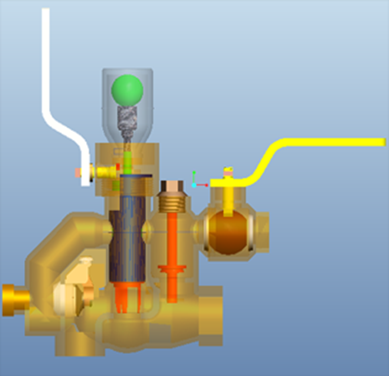
Proposed Technology
Proposed Device comprises: a main body having multiple inlets, an outlet, a transparent indicator with ball and a indicator holder to show that the liquid is flowing through the preferred line. The device allows the liquid to flow through two different preferred paths as per requirement and situation.
The device can be used to give preference to fresh water supply over any other supply for example, from an overhead tank, automatically without any human intervention.
Working Prototype of the product can be seen by clicking here

Slide 4

Proposed Technology (Cont.)
The device functions in such a way that when fresh or preferred water supply is available, the supply from alternate source is stopped and fresh water is allowed to flow towards the outlet. On the other hand, when supply of fresh water is not available, device shifts supply from fresh water line to an alternate source such as overhead tank.
A transparent indicator with ball arrangement is provided to indicate change over of water supply from fresh water to overhead water. The device operates based on pressure difference between different supplies.

Slide 5
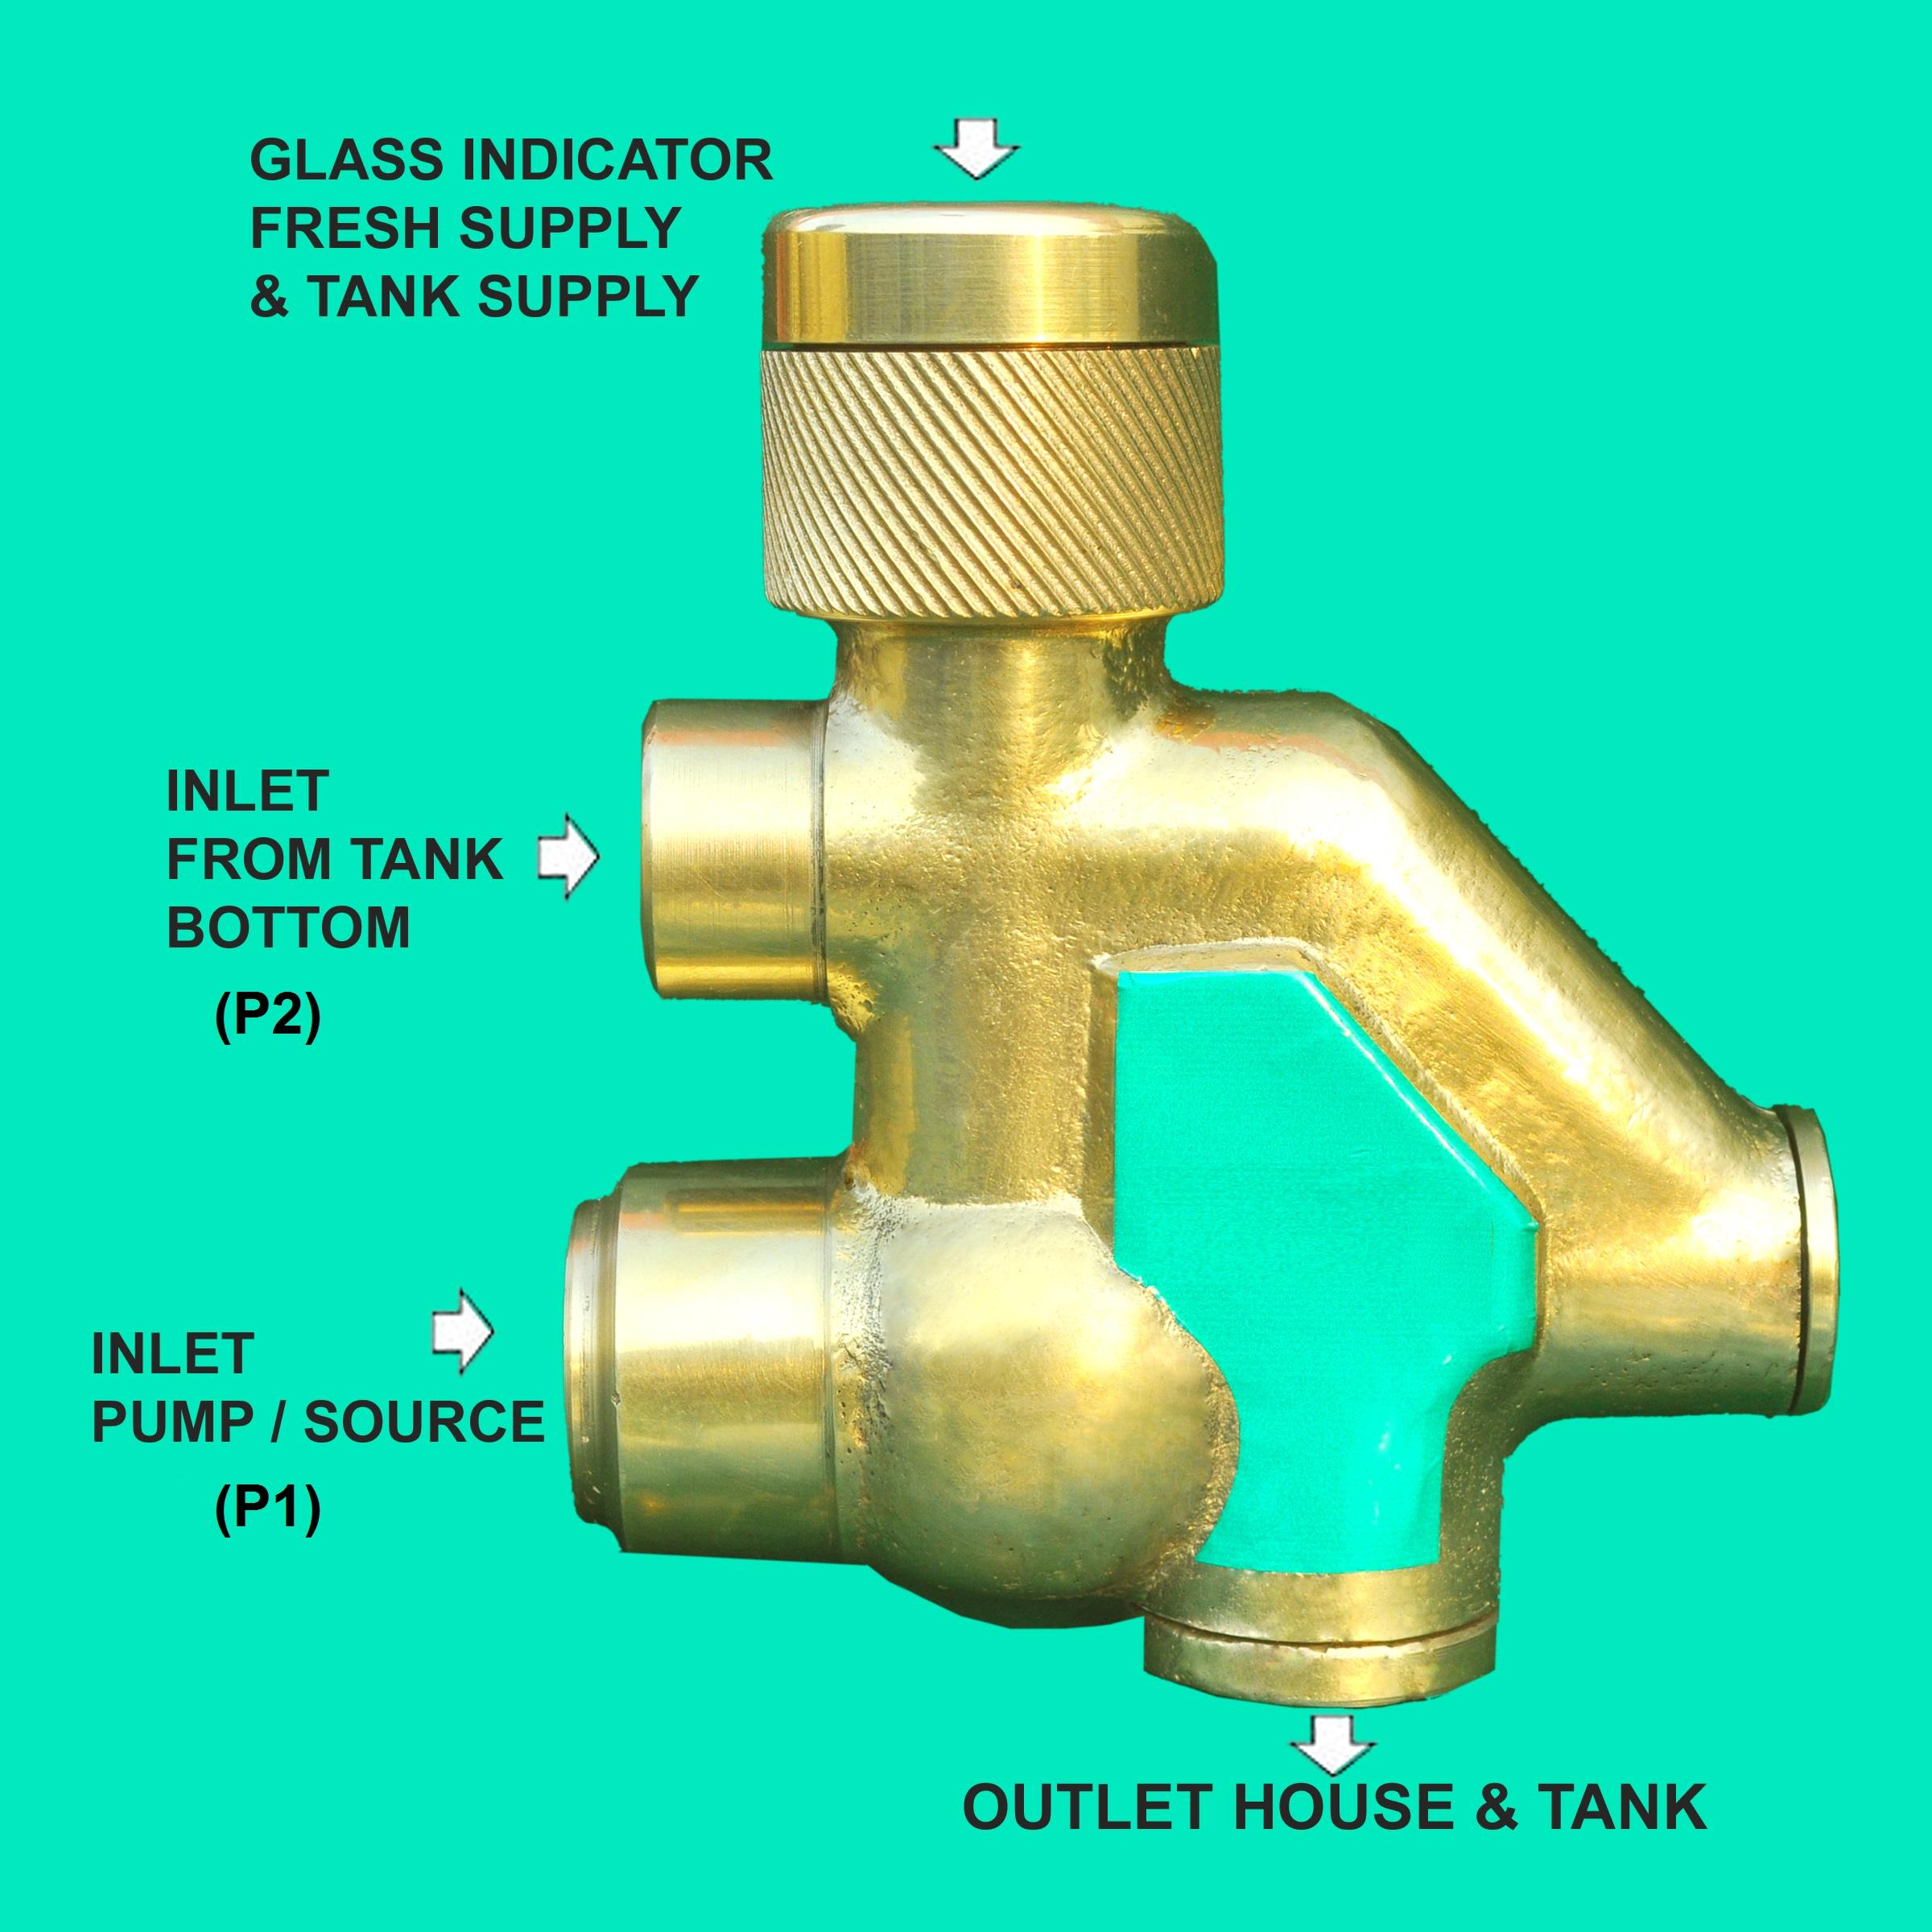
Proposed Technology (Cont.)
An O” ring is used to engage with a disc in lower part of piston, which fits in with inner curvature of lower hollow cylindrical part of piston and prevents flow of liquid from path P-2 to path P-1, which arrangement allows the liquid to pass through different paths depending upon source of supply.
When there is no water pressure in Path P-1 (fresh water), a hole on the body of bush gets exposed to Inlet-2, which allows flow of liquid from Inlet-2. Swing type valve gets pushed back to give way to liquid from path P-2 (overhead tank) and liquid comes out from outlet.

Slide 6
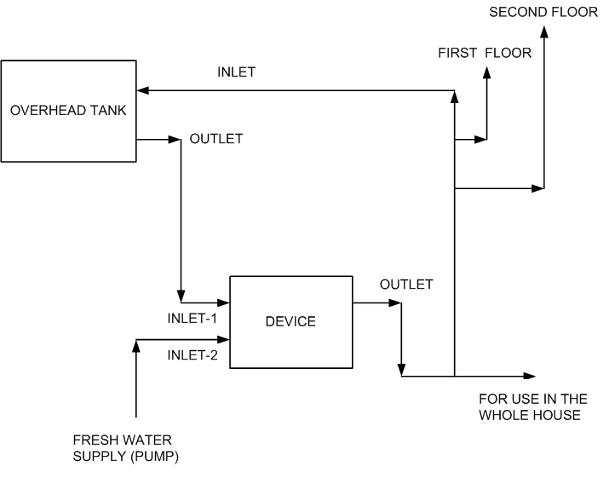
Proposed technology
Basic Flow Diagram

Slide 7
Exemplary Projected Estimates
Domestic market
Huge unexplored market with millions of households.
A government policy to promote low cost housing
A galloping demand for plumbing products and solutions.
The current invention can tremendously reduce the cost of plumbing operations of a similar kind to more than 50%.
As the demand of high-rise building increases, the demand on piping system increases too.
Export market
The product offers a tremendous Export potential to various countries especially Africa and Asia, where there is a growing need of housing and a thrust towards infrastructure development.

Slide 8
Patent/IP Status
Indian Application Number: 2678/DEL/2014
Application Status: Patent Pending
Publication date(U/s 11A): 25/03/2016
Priority Date: 18/09/2014

Slide 9

DELHI. MUMBAI. BANGLORE. HYDERABAD. PUNE. INDORE. CALIFORNIA
Contact Details
Noida (NCR) Office
E-13, UPSIDC Site-IV, Behind Grand
Venice, Greater
Noida, 201308
Contact Person: Tarun Khurana
Contact No.: +91-120-4296878/2399010-11
E-Mail: iiprd@iiprd.com, info@khuranaandkhurana.com
Website: www.iiprd.com | www.khuranaandkhurana.com

