Slide 1

Patent Licensing Proposal
A COMPRESSION TYPE WASHING MACHINE
AND ASSOCIATED METHODS (PCT/IB2019/055901)
Inventor: Mr. Rajagopalan

Slide 2
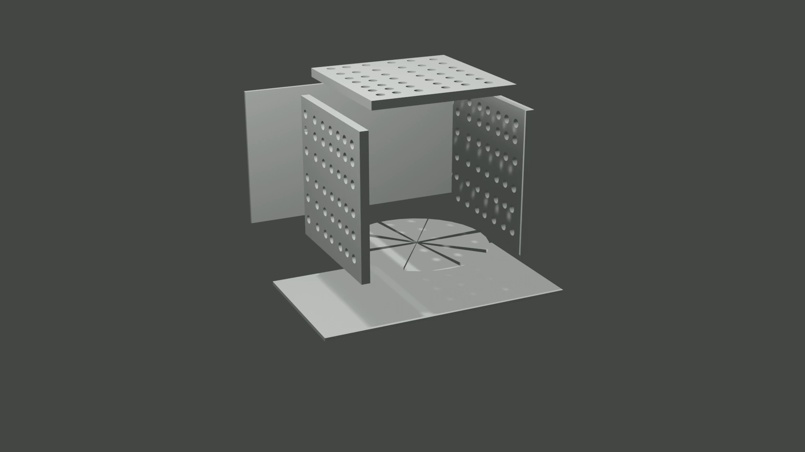
Technical Field of Invention:
Technical Field of the current invention pertains to Washing Machine for clothes, wherein processes for which Patent Applications are filed tend to improve existing process of washing clothes.
Introduction:
The current invention has the unique feature that allows Horizontal and Vertical Compression during the operation of washing of clothes. This features imparts additional pressure between the fibers of the clothes to remove the dirt effectively. It combines the advantages of both Hand Washing and Conventional Washing Machines. An idea of working can be construed by the provided animation.

Slide 3
4 Fs FOR THIS STAND APART TECHNOLOGY:
FIFTY PERCENT LESSER WATER CONSUMPTION
1
FIFTY PERCENT LESSER ELECTRICITY USAGE
2
FIFTY PERCENT LESSER WASHING TIME
3
FIFTY PERCENT LESSER NOISE
4

Slide 4
EXEMPLARY FACTS ABOUT THE INVENTION:
WATER | Conventional top loading/front loading machines use at least 15 gallons(~56 liters) per load. Our new washer only uses less than 7 gallons(~ 26 litres) per load. This is due to our method of washing in which clothes constantly absorb, lose and reabsorb water with detergent powder and hence only a small quantity of water that is sufficient to wet the clothes is necessary.
ELECTRICITY | Conventional front/top loading machines use from 250 to more than 1000 watts. Our washer will not need more than 120 watts. This is due to the significant reduction in washing time, water needed and the overall technique our washer uses to clean clothes.
TIME | Conventional top/front loading machine take from about 50 minutes to more than 100 minutes. Our washer needs less than 25 minutes for a wash since the clothes are compressed in horizontal and vertical axes cyclically for about 20 times which is usually enough to get the clothes clean.
NOISE | Conventional top/front loading washing machine produce noise from about 50 db to 80 db. Our washer produces less than 44 db noise since there is no need for rotation of clothes along with water or an agitator or collision of clothes and water along the walls/boundaries of the tub at high speeds and the only source of sound comes from a smooth running electric motor.
VIBRATIONS | Both top/loading machines vibrate significantly due to the rotational movement of clothes and water at high speeds. Our washer does not vibrate due to the absence of rotation of water and clothes at high speeds.
LESSER DETERGENT POWDER/HEAT | Due to lower water usage in our washer less detergent powder is needed to achieve necessary concentration for optimal wash. Also for those preferring to wash clothes in hot/warm water, electricity needed to heat the water is significantly reduced due to the less amount of water used. Note that heating water is a very expensive process in terms of electricity usage and for those requiring hot/warm water washing our washer reduces electric charges drastically.

Slide 5
Expectations:
Inventor seeks alliance with Potential Licensees to assign Licensing Rights.
Inventor is also interested in Sale of the Patents.
Contact Details:
IIPRD Consulting Email: ankit@iiprd.com Phone: +91-7838404168 Address: E-13, UPSIDC, Site-IV, Behind-Grand Venice, Kasna Road, Greater Noida - 201310, UP, National Capital Region, India.

