Slide 1

DELHI. MUMBAI. BANGLORE. PUNE. INDORE. HYDERABAD. CALIFORNIA
VORICONAZOLE TRANSDERMAL SPRAY
Identifying Licensee/Buyout Prospects
Indian Patent Application 3386/MUM/2014

Slide 2
INTRODUCTION
Fungal infection is one of the most common disease reported world wide and it affects approximately 25% of the population especially in tropical and subtropical countries.
Infections caused by Candida species and Dermatophytes are among the most widespread superficial cutaneous fungal infections.
Candida can potentially invade deeper tissues as well as blood leading to life threating systemic candidiasis.

Slide 3
INTRODUCTION
Voriconazole is a triazole antifungal medication is generally used to treat serious, invasive fungal infections like candidiasis aspergillosis etc.
Already immuno compromised patients are targets of these fungal species .
Delivering medicine to the general circulation through the skin is seen as a desirable alternative to taking it orally.
Topical products for the treatment of dermatological diseases include a wide choice of vehicles ranging from creams, gels, emugels, ointments, pastes to aerosols and transdermal spray.

Slide 4
TRANSDERMAL SPRAY
Transdermal is a route of administration wherein active ingredients are delivered across the skin for systemic distribution.
A transdermal spray-on system (TSS) consists of a solution containing the drug, a volatile solvent and a chemical penetration enhancer. TSS promotes drug delivery via the complex interplay between solvent evaporation and drug–solvent drag into skin. The volatile solvent carries the drug into the upper layers of the stratum corneum and as it evaporates, an increase in the thermodynamic activity of the drug occurs resulting in increased drug loading in skin.
TSS is easily applied, delivering precise drug dosage with lower incidence of skin irritation.

Slide 5
FORMULATION OF VORICONAZOLE TRANSDERMAL SPRAY
Drug
Excipients
Voriconazole
Antifungal
Polymer
EUDRAGIT RLPO,
Ethyl Cellulose
Penetration
Enhancer
Camphor: Menthol
Plasticizer
PEG-400
Solvent
Alcohol: Acetone
Voriconazole
Transdermal
Spray

Slide 6
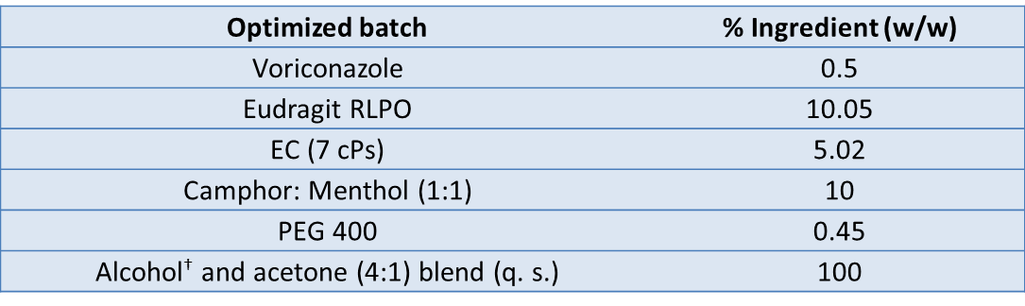
COMPOSITION: TRANSDERMAL SPRAY

Slide 7
VORICONAZOLE TRANSDERMAL SPRAY : STUDIES

Slide 8
VORICONAZOLE EXCIPIENTS COMPATIBILITY STUDY
The absence of chemical interaction between voriconazole and polymer (FTIR study)

Slide 9
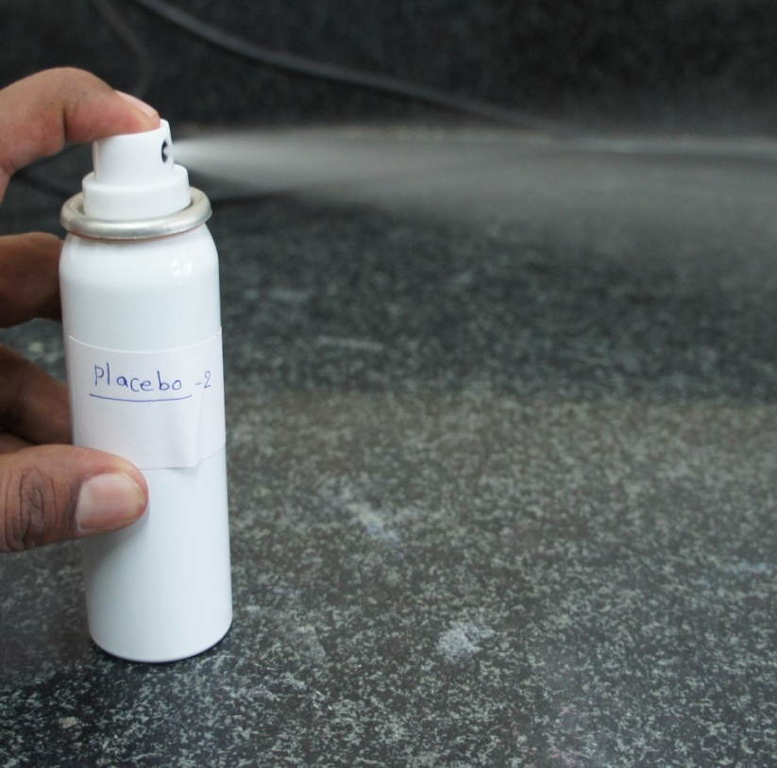
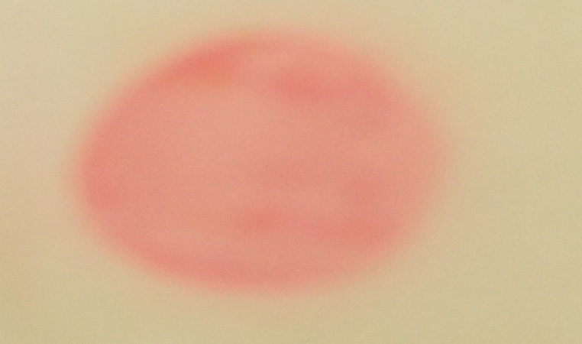
CHARACTERIZATION OF OPTIMIZED BATCH
Tests parameter | Average results
Viscosity (cP) | 31.9 ± 0.2
Amount delivered upon each actuation | 0.29 ± 0.043 ml
Spray angle | 78.69⁰ ± 1.59⁰
Leak test | No leak after feeling
Appearance of the film | Transparent
Mucoadhesive and flexibility of film | ++
Water wash ability | +++
Ex vivo film formation time (sec) | 247 ± 4.04
pH | 6.2 ± 0.2
Ex-vivo Flux, J_{ss} (µg/cm²/h) | 65.8 ± 0.98
Kinetics of model fitting | Korshmeyer peppas
Six months short term Stability Study | Identical & superimposable
Spray pattern of formulation
Observed film pattern present of color solution of safranin dye

Slide 10
EX-VIVO ANTIFUNGAL ACTIVITY (MICROBIAL ASSAY)
%W/W ingredient | Optimized batch | voriconazole with solvent | eutectic blend with solvent | Solvent (Alcohol& acetone bland)
Voriconazole | 0.5 | 0.5 | -- | --
Eudragit RLPO | 10.05 | -- | -- | --
EC | 5.025 | -- | -- | --
PEG-400 | 0.45 | -- | -- | --
Camphor: Menthol (1:1) | 10 | -- | 10 | --
Alcohol and acetone (4:1) blend (q. s.) | 100 | 100 | 100 | 100
Zone of inhibition (mm) | 37 ± 2.7 | 19 ± 3 | 13 ± 1.5 | 8 ± 2
Values are expressed in Mean ± S.D. n=3; Candida albicans (MTCC Code 1637)
Skin irritation study (Draize-patch test): After a 24 h exposure, the film formed was removed. The test sites were wiped with tap water to remove any remaining test article residue. The itching was observed at 4 h in both formulations due to the eutectic mixture that induces the soothing and cooling effect of formulation on the skin and after 24 h no observations of any visualized sign of edema, erythema.

Slide 11
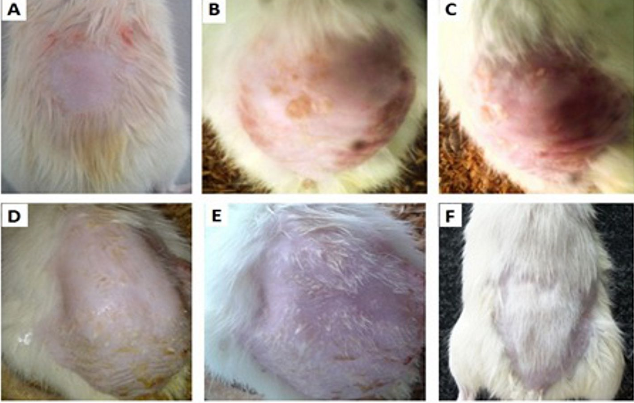
IN-VIVO DERMATODYNAMICS STUDY
Cutaneous infection of Candida albicans (MTCC Code 1637) are (A) 1st day, (B) 5th day, and (C) 7th day without treatment
Cutaneous infection of candida albicans are (D) 5th day, (E) 10th Day, (F)14th day after treatment . complete healing of candidiasis.

Slide 12
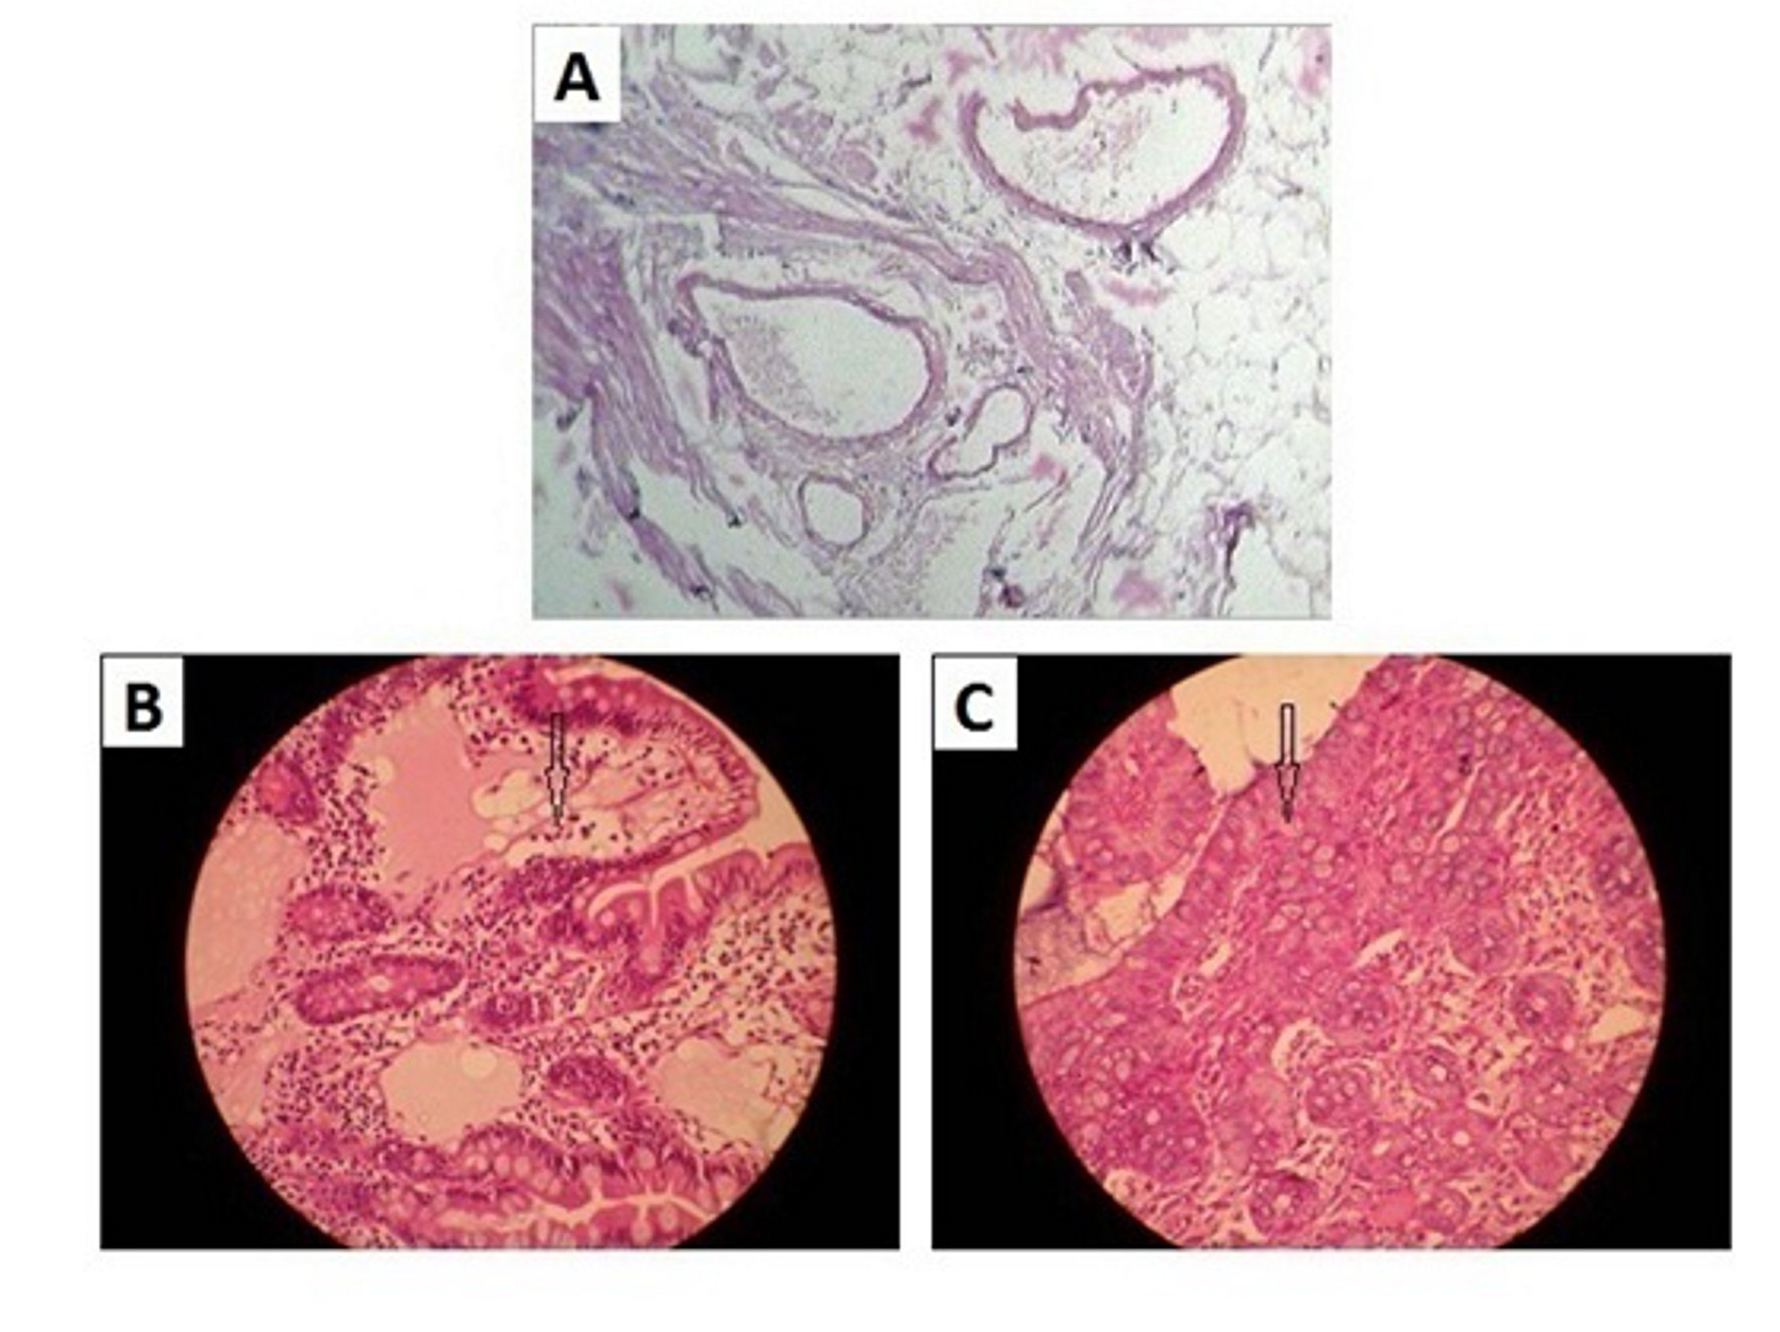
HISTOPATHOLOGY
Histopathology of rat skin infected with candida albicans, (A) Normal skin histogram, (B) control group (contain placebo) arrow show the presence of spore hyphae swelling of the cell, (C) after treatment with test formulation showing the complete absence of fungal elements.

Slide 13
ADVANTAGES OF PROPOSED TECHNOLOGY
Transdermal Spray has an advantage of active ingredients being delivered across the skin for systemic distribution.
The drug in the form of a spray is easily applied, delivering precise drug dosage with lower incidence of skin irritation.
Transdermal spray retains the same efficacy but with a significant reduction in dose, eliminates side effects of the drug.
The drug forms a layer on the skin thereby offers an increased local contact time further enhancing the efficacy

Slide 14
PATENT/IP STATUS
Indian Application Number: 3386/MUM/2014
Application Status: Patent Pending
Publication date: 06/05/2016
Priority Date: 24/10/2014

Slide 15

DELHI. MUMBAI. BANGLORE. PUNE. INDORE. HYDERABAD. CALIFORNIA
Contact Details
Noida (NCR) Office
E-13, UPSIDC Site-IV, Behind Grand
Venice, Greater
Noida, 201308
Contact Person: Tarun Khurana
Contact No.: Ph (IN):+91 120 4296878, 4909201, 2399113
E-Mail: iiprd@iiprd.com, info@khuranaandkhurana.com
Website: www.iiprd.com | www.khuranaandkhurana.com

