Slide 1

DELHI. MUMBAI. BANGLORE. PUNE. INDORE. HYDERABAD. CALIFORNIA
TOPICAL ANTIFUNGAL MICROEMULGEL
Identifying Licensee/Buyout Prospects
Indian Patent Application 3169/MUM/2014

Slide 2
INTRODUCTION
Fungal infection is one of the most common disease reported world wide affecting approximately 25% of the population especially in tropical and subtropical countries.
Infections caused by Candida species and Dermatophytes are among the most widespread superficial cutaneous fungal infections.
Candida can potentially invade deeper tissues as well as blood leading to life threating systemic candidiasis.

Slide 3
INTRODUCTION
Voriconazole is a triazole antifungal medication used to treat serious, invasive fungal infections like candidiasis , aspergillosis etc.
Immuno compromised patients are easy targets for these fungal species .
Delivering medicine to the general circulation through skin is seen as a desirable alternative to taking it orally.
Topical products for the treatment of dermatological diseases include a wide choice of vehicles ranging from creams, gels, ointments, pastes to aerosols, emulgels and microemulgels being the latest additions.

Slide 4
MICROEMULGELS
When both micro-emulsion and gel are used in combination dosage forms the prepared formulations are called as microemulgel, having the advantages of both emulgel as well as micro-emulsion.
Emulgels ( combined form of emulsion and gel) have several desirable properties like, being thixotropic, greaseless, easily spreadable as well as removable, emollient, non-staining, water soluble, longer shelf-life, bio-friendly, transparent, with pleasant appearance.
Micro-emulsions are isotropic mixtures of oil, surfactant, co-surfactant and the active drug . Micro-emulsion keeps drug in solubilized form while the small sized formed droplets provide large interfacial area for drug absorption.
Presence of lipid in the formulation helps to improve bioavailability by enhancing permeability of the drug.

Slide 5
ADVANTAGES OF MICROEMUGEL
Micro-emulsion keeps the drug in solubilized form and small sized formed droplets provide large interfacial area for drug absorption.
When the drug is delivered through lipid formulation, it remains in the dissolved state throughout its transit. The absorption of drug presented in solubilized form within a colloidal dispersion is enhanced.
Micro-emulgel provide a large surface area for drug absorption.
Oil portion increases the bioavailability by improving permeability of drugs.
Reduction in side effects of the drug with advantages of emulgel.

Slide 6
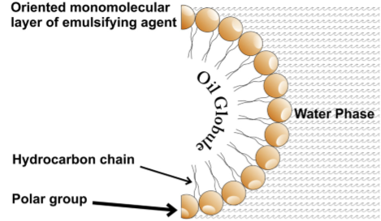
VORICONAZOLE MICROEMULGEL
PREPARATION OF VORICONAZOLE MICROEMULGEL
STRUCTURAL MODEL OF VORICONAZOLE LOADED MICROEMULGEL
Voriconazole Microemulsion
Incorporated in Carbomer 934P gel base
Voriconazole microemulgel
.
Voriconazole

Slide 7
Voriconazole
Active Pharmaceutical Ingredient
Microemulgel
-Neem oil
-Emulsifier
-Co-emulsifier
Voriconazole Microemulgel -Micelle size < 500nm -Better absorption -Better penetration -Better Efficiency -No Side Effects

Slide 8
VORICONAZOLE MICROEMULGEL : A NOVEL DRUG DELIVERY SYSTEM

Slide 9
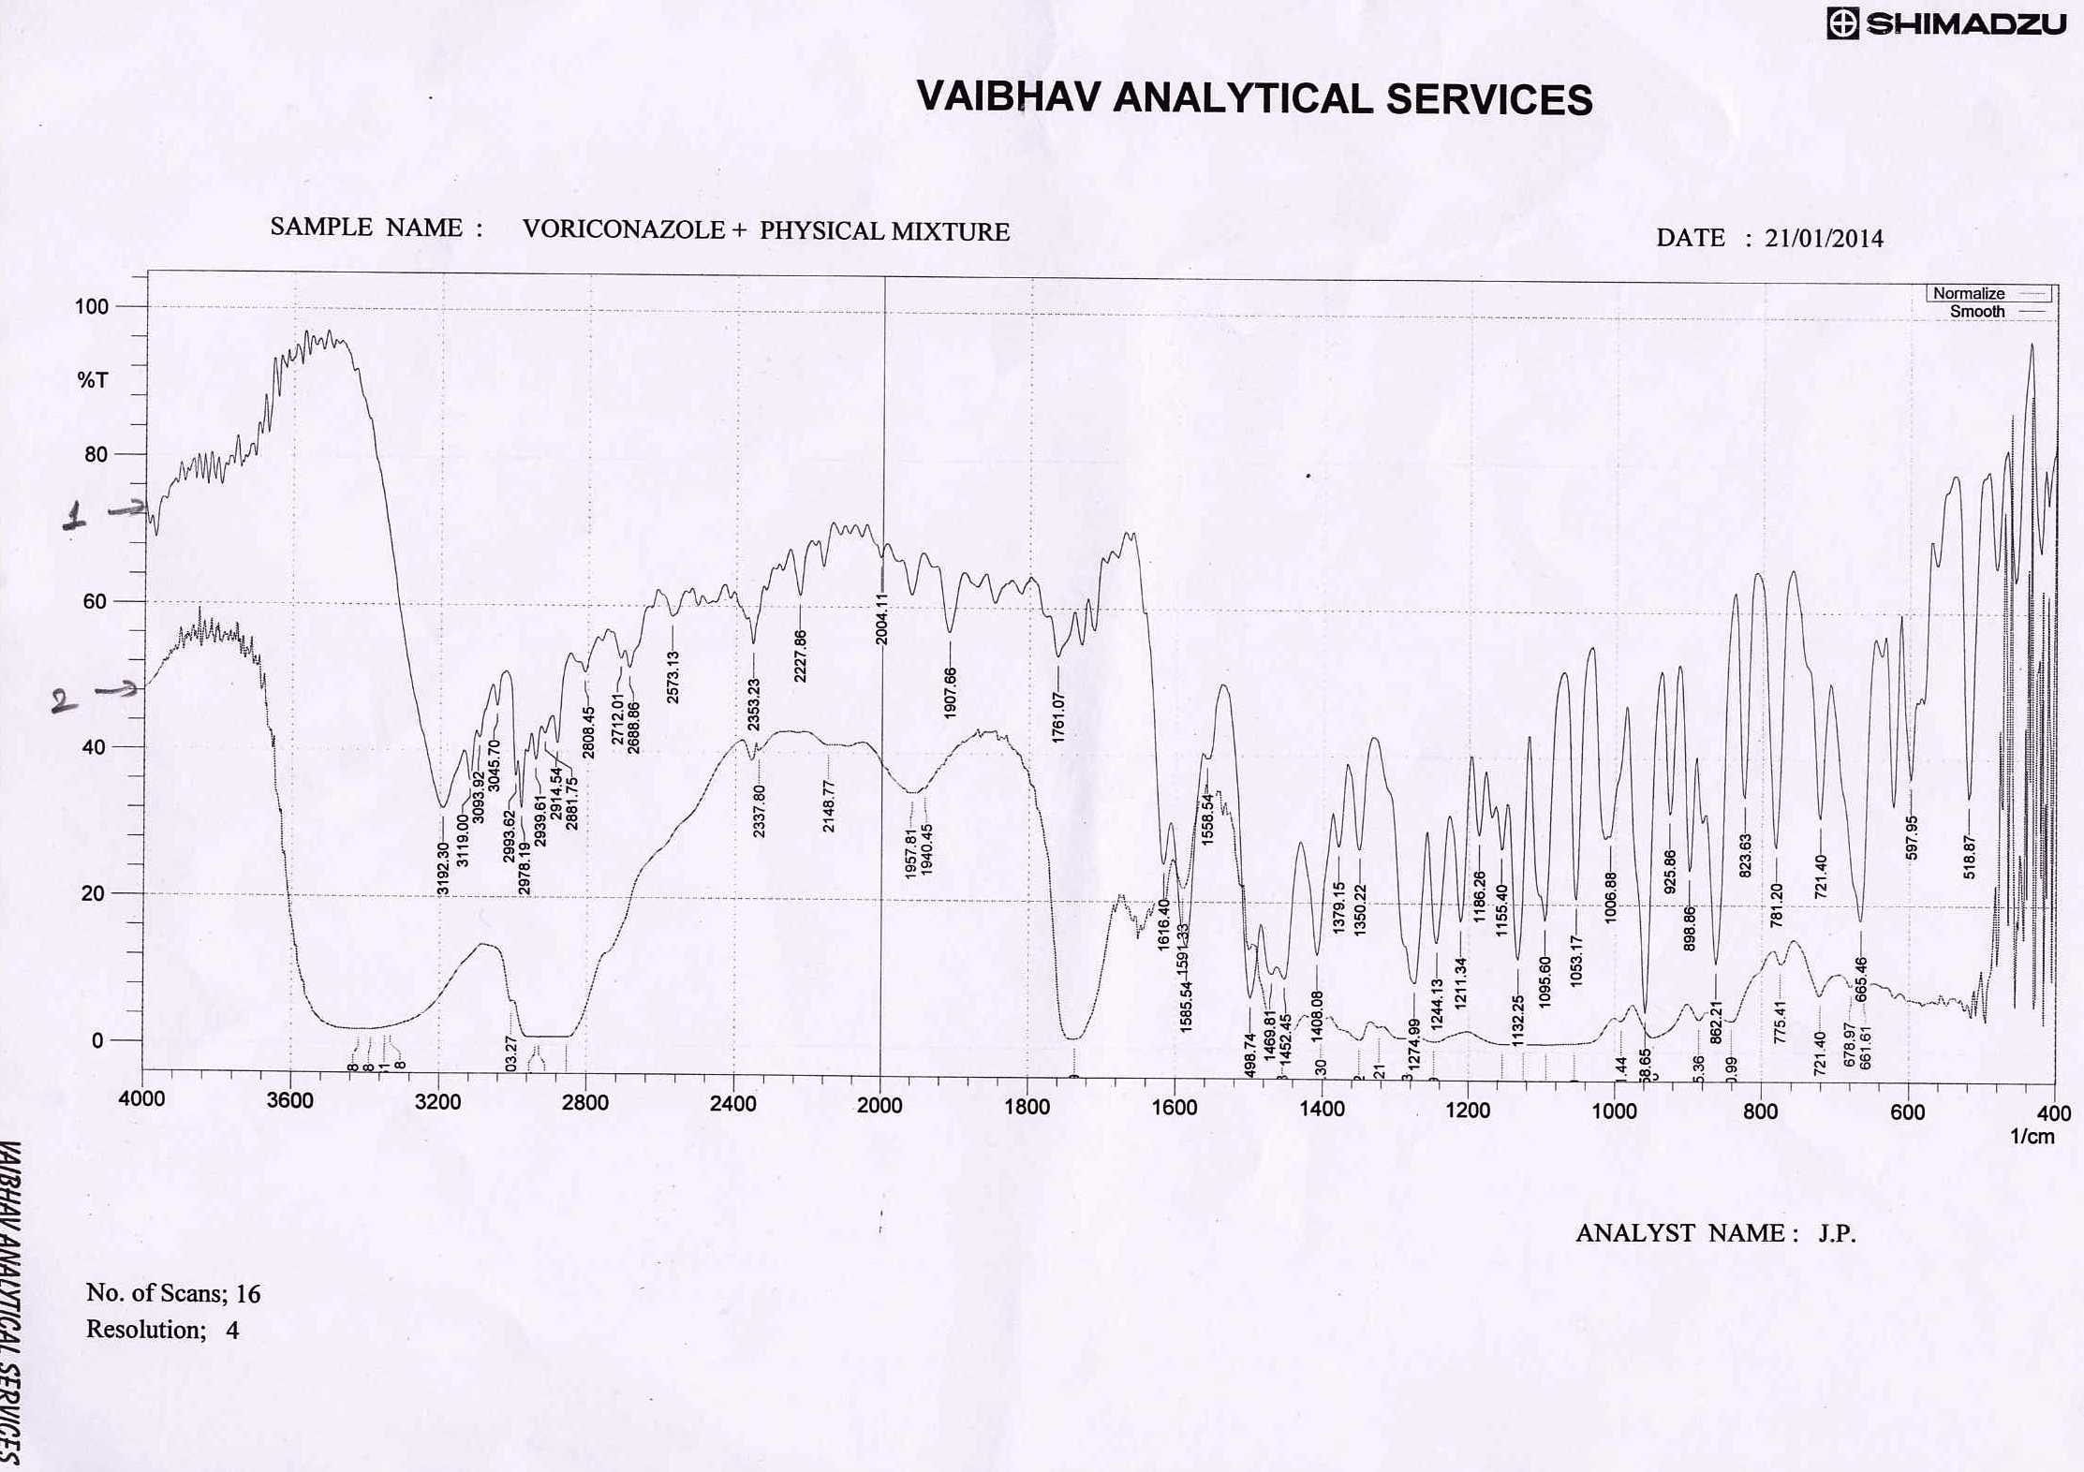
VORICONAZOLE-EXCIPIENTS COMPATIBILITY STUDY†
PHYSICAL MIXTURE (Voriconazole + Carbomer 934P + Acrysol K-150 + Neem oil + PEG-400+Propylene glycol+ TEA )
VORICONAZOLE
Presence of functional group | Observed frequency peak(cm⁻¹)
 | Voriconazole Physical Mixture | Voriconazole Physical Mixture
Triazole ring | 2914.54 | 2903.27
C-N stretch of triazole | 1616.40 | 1616.40
-CH Stretch | 1469.81 | 1469.81
C-N stretching of pyrimidine | 1350.22 | 1350.22
N(2), N(4), Co-ordination mode of 1H,1,2,4-triazole | 665.41 | 661.61

Slide 10
FORMULATION AND EVALUATION OF OPTIMIZED BATCHES OF MICRO-EMULSION
Formulation /Evaluation |  | Optimized batch
Acrysol™ K-150 / PEG-400 Mix (4:1) |  | 77%
Parker Neem® Oil |  | 8%
Rose water |  | 15%
pH |  | 5.83 ± 0.29*
Desirability |  | 0.65
Dilution Potential |  | 130 Times
Physical Stability by Centrifugation |  | No Creaming or Phase Separation
Conductivity (µS/cm) |  | 59
% Transmittance |  | 97.1
Micelle Size Analysis | Micelle Size (nm) | 59.8
 | Zeta potential (mv) | 0.53
 | Poly Dispersity Index | 1.596
Time required for 90% drug release (t₉₀; min) |  | 75
Density (mg/ml) |  | 1.12
*n=3; Mean ± SD; Optimized batch used for microemulgel preparation. Optimization did by constrained simplex lattice design and Design Expert® Software

Slide 11
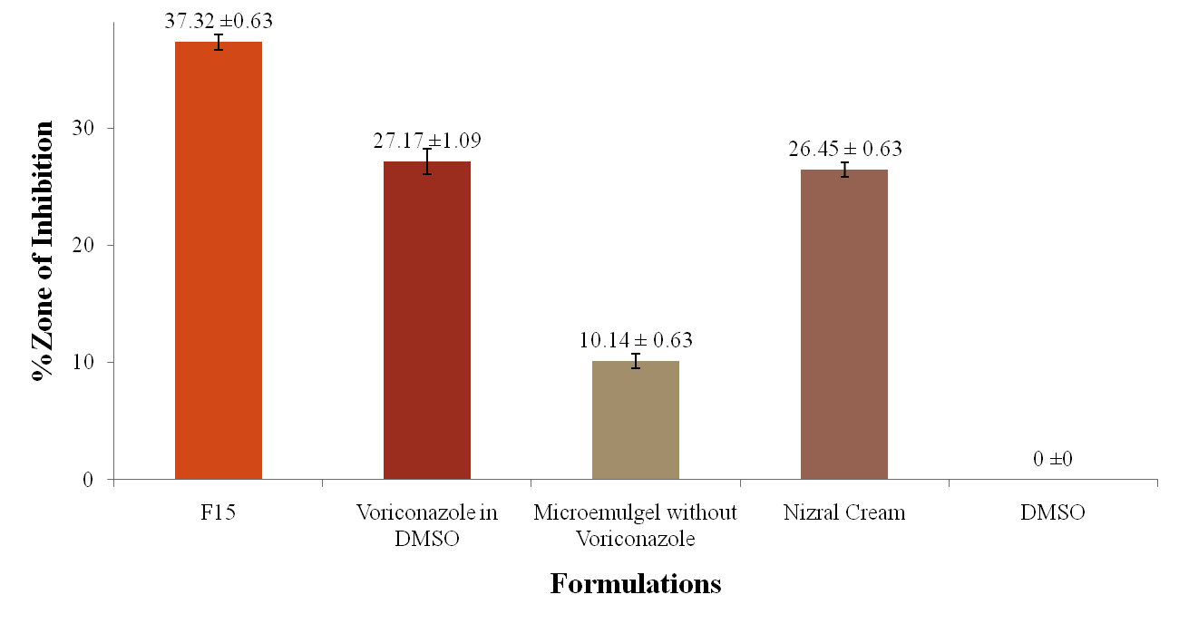
MICROBIAL ASSAY OF OPTIMIZED BATCH OF MICROEMULGEL
.
n=3; Mean ± SD

Slide 12
Ex-vivo skin penetration of voriconazole was carried out up to 6 h with wister female rat skin. Permeability coefficient, drug flux, % voriconazole penetrate, % voriconazole permeable, local accumulation of voriconazole were found. % Voriconazole retained within skin after 6 h were found more than 90%, so provide better local action (Protocol No.: RKCP/COL/RP/16/74)
Optimized batch of microemulgel followed Korsmeyer Peppas model of kinetics, anomalous transport and rate as function of time were tn-1 (n=release exponent)
Skin irritation study:† After a 72 h exposure, the emulgel was removed. The test sites were wiped with tap water to remove any remaining test article residue. The itching was observed at 1h, 3 h, 1 day, and 3 days. No observations of any visualized sign of edema, erythema.

Slide 13
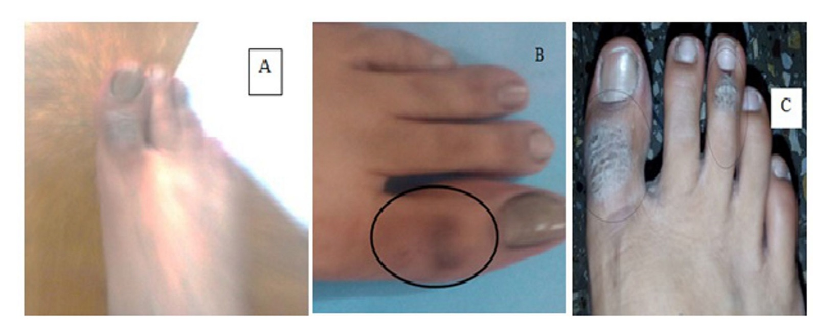

IN-VIVO HUMAN STUDY
B: in-vivo studies with optimized batch of microemulgel
C: in-vivo studies with a leading commercial brand
The absorption of drug presented in microgel form is enhanced, thereby presumably enhancing its therapeutic activity with no skin irritation and side effects reported.

Slide 14
PROPOSED TECHNOLOGY
Microemulgel has an advantage of emulgel and micro-emulsion; combining several desirable properties like good consistency, thyrotrophic, greaseless, easily spreadable as well as removable, emollient, non-staining, water soluble, longer shelf-life, bio-friendly, transparent with a pleasant appearance.
Microemulgel has been prepared by screening of oils, emulsifier, and co-emulsifier on bases of solubility of a desirable API in it.
An API has high solubility in Neem oil which also assist its therapeutic action. Presence of oil portion, facilitates better penetration of API in the skin. Oil Micelle Size being less than 500 nm provides more area for absorption of API in the skin enhancing its efficacy.

Slide 15
PATENT/IP STATUS
Indian Application Number: 3169/MUM/2014 A
Application Status: Patent Pending
Publication date: 08/04/2016
Priority Date: 07/10/2014

Slide 16

DELHI. MUMBAI. BANGLORE. PUNE. INDORE. HYDERABAD. CALIFORNIA
Contact Details
Noida (NCR) Office
E-13, UPSIDC Site-IV, Behind Grand
Venice, Greater
Noida, 201308
Contact Person: Tarun Khurana
Contact No.: Ph (IN):+91 120 4296878, 4909201, 2399113
E-Mail: iiprd@iiprd.com, info@khuranaandkhurana.com
Website: www.iiprd.com | www.khuranaandkhurana.com

