Slide 1

PATENT LICENSING PROPOSAL
A METHOD AND SYSTEM FOR SUPERSONIC
HYDROGEN FUEL POWERED HIGHER EFFICIENCY
ENGINES
Inventor: Sounthirarajan Kumarasamy

Slide 2
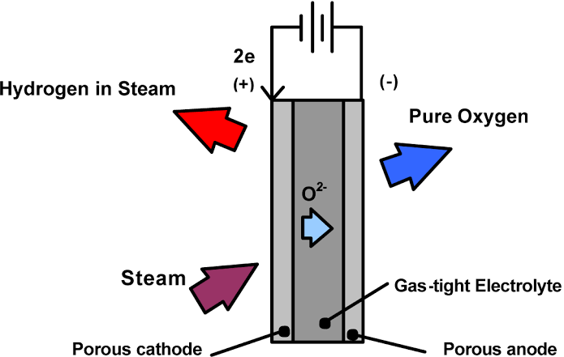
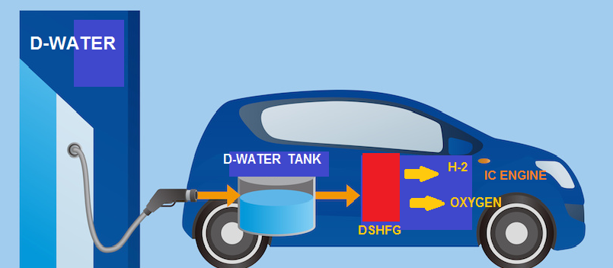
TECHNICAL FIELD OF INVENTION:
WORKING:
The present invention relates to the method and the system for onboard generation of hydrogen and oxygen by utilizing heat exerted from a hydrogen internal combustion engine
PATENT APPLICATION STATUS:
Patent pending in India: 201841037958
International Appl Filed: PCT/IN2019/050205
INTRODUCTION:
Supersonic hydrogen internal combustion engine offers many promising solutions. The present invention’s unique onboard hydrogen and oxygen generating technology uses IC Engine waste heat to produce hydrogen and oxygen by using high temperature electrolysis process in distilled water. This will boost the ratio of renewable energy sources, to help achieve a sustainable society.

Slide 3
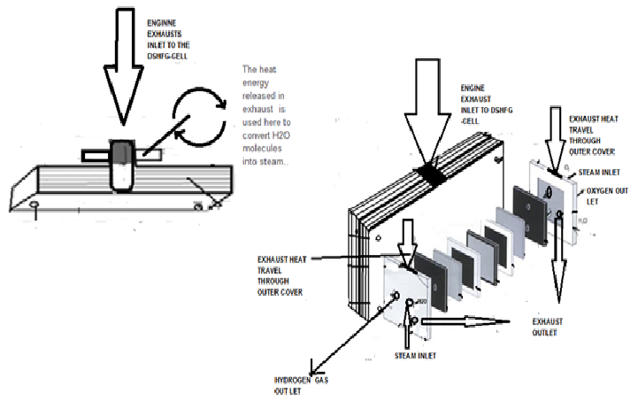
BACKGROUND OF THE INVENTION:
The technology essentially comprises of
Heat transferring units that transfer heat from an exhaust of a Hydrogen internal combustion engine,
Conduction layers positioned between a high temperature electrolytic device and the heat transferring units, which permit the heat transfer from the heat transferring units to the high temperature electrolytic device,
The above receives water from a water source and utilizing the heat transferred, converts water molecules into hydrogen and oxygen
This can be adapted into an internal combustion engine to generate power from the hydrogen and oxygen generated from the high temperature electrolytic device.

Slide 4
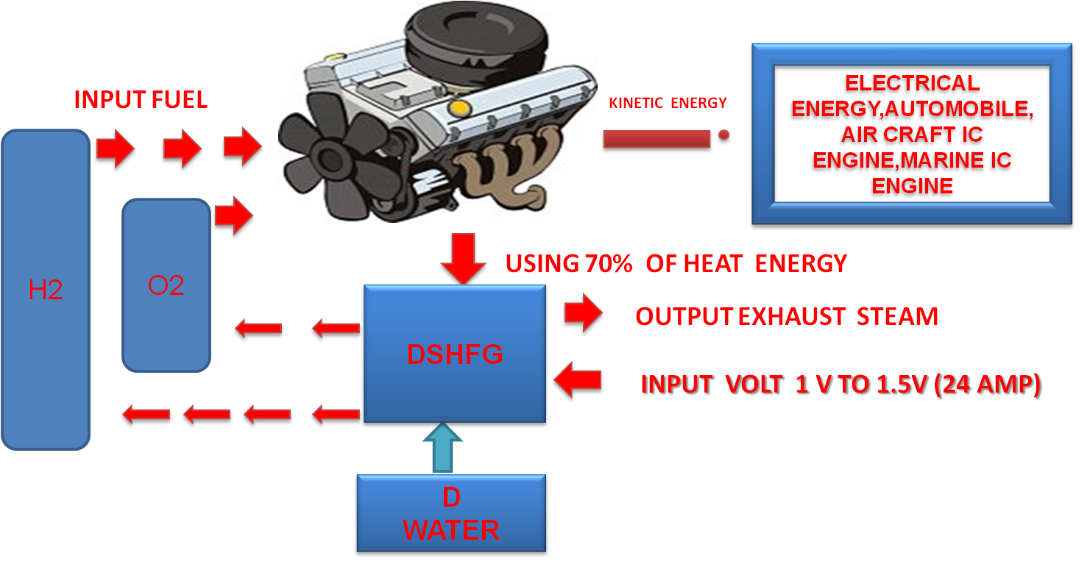
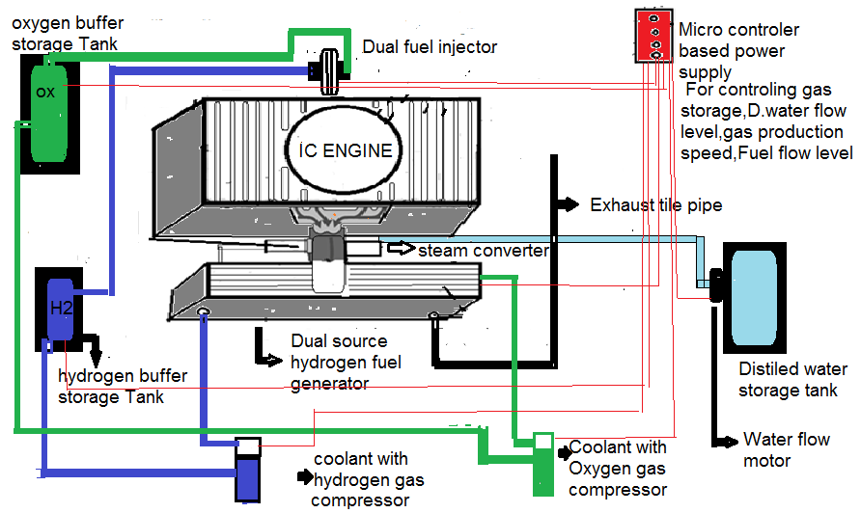
EXEMPLARY ILLUSTRATION SHOWING FEATURE OF THE INVENTION

Slide 5
SUPERIORITY OF THE INVENTION OVER EXISTING TECHNOLOGY:
This technology uses IC Engine waste heat to produce hydrogen by using high temperature electrolysis process. offers significant advantages in terms of cost and power as compared with other systems.
Supersonic Hydrogen Fuel Powered Higher Efficiency Engines inbuilt with Dual Source High-Tech Hydrogen Fuel Generator System and it has own capacity to maintain its hydrogen storage level and hydrogen production speed.
Using hydrogen IC engine’s 70% waste heat energy to convert distilled water into steam. Then the steam is supplied into the hydrogen DSHFG device which separates H (hydrogen) and O (oxygen) from H₂O by the process of high temperature electrolysis method.
With this technology the system operates between 100°C and 350°C.
It takes over 240 – 360 watts of electricity to generate 1kg of Hydrogen.
In comparison, with current technology, the calorific energy content of hydrogen is about 39kwh/kg. Taking in to account the process inefficiencies, it takes over 50kwh of electricity to generate 1 kg of hydrogen.
Overall, this technology provides solutions to the big questions in hydrogen economy, which are:
What is the cost of hydrogen gas? Hydrogen production cost?
Where does hydrogen come from?
How is it transported? How is it distributed? How is it stored?
How much cost to install hydrogen fueling stations?

Slide 6
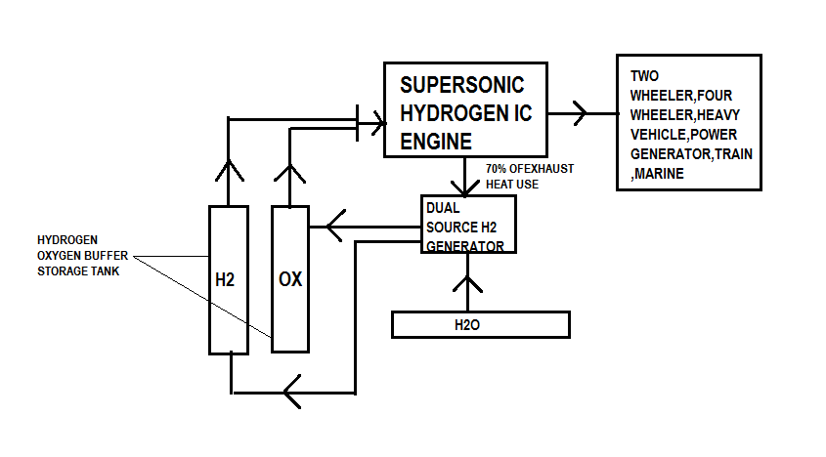
APPLICATIONS
Electricity production (Industrial and Domestic generators)
Agriculture pump set
Automobile industry (Two wheelers, Four wheelers, Heavy vehicles)
Aircraft IC Engines
Marine IC Engines.

Slide 7
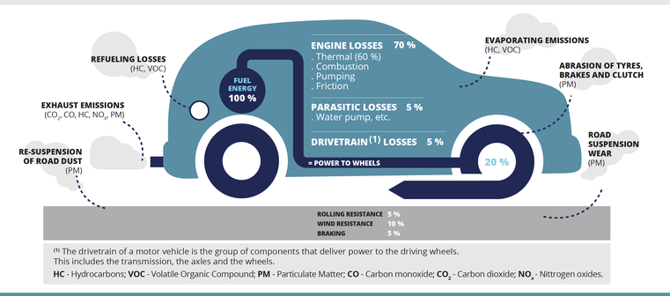
USEFULNESS OF PRESENT INVENTION
Supersonic hydrogen fuel powered higher efficiency IC engine can run in all IC engine vehicles
There is no need of Hydrogen filling station
No Hydrogen storage Risk
Environment friendly technology (99% pollution free)
Lower cost of Hydrogen production. Currently 1 kilogram of Hydrogen costs 1,100 Yen (US$9.85 or INR 700). Supersonic Hydrogen IC engine technology can bring the Hydrogen cost down to 30 Yen (US$ 0.28 or INR 20)
Supersonic Hydrogen Higher Efficiency IC engine could burn about five times more fuel and therefore produce five times more horsepower when used with both hydrogen and oxygen mixed fuel.
HYDROGEN PRODUCTION COSTS
Current
JP: ¥1,100
US: $9.85
IN: ₹ 700
Expected
JP: ¥30
US: $0.28
IN: ₹ 20

Slide 8
ABOUT INVENTOR/ PATENT HOLDER:
Inventor, Mr. Sounthirarajan Kumarasmy, is the Founder of two companies
NG Automobile Engineering Private Limited, India, and
Naripa Motor Corporation, Japan
He has over 18 years of experience in Various Industries like Textile, Automobile, Laser., His areas of expertise include Innovative Concept and Engineering Design in various fields.
His Earlier research concept evolved on convergent photo voltaic system which was started in 2003. This is a high tech Laser electric power generator where it will produce huge electric power than coal, fossil fuels or other sustainable energies. For this invention he got the Patent certificate on November 5, 2003.
Subsequently, another research was started in 2008 to find a solution using the existing hydrogen IC Engine. As a result, dual source High-Tech hydrogen fuel generator has been invented which is a clean energy and a boon to the mankind. For this invention he got the Patent certificate on November 27, 2018.

Slide 9
EXPECTATIONS:
Inventor seeks alliance with potential licensees to assign Licensing Rights, including on patents.
CONTACT DETAILS:
IIPRD CONSULTING Email : Arindam@iiprd.com Phone : +91-120- 4296878; +91-9811542307 Address : E-13, UPSIDC, Site-IV, Behind-Grand Venice, Kasna Road,
Greater Noida - 201310, UP, National Capital Region, India.

