Slide 1

Title of the Invention
Servo Transmission
Inventor
Mr. T.S.Chowdary

Slide 2
Technical Field of Invention:
This invention helps in achieving an automatic transmission for automobile system. Existing systems use high precision sensors and microprocessors due to which they are very costly. This invention helps in achieving the automatic transmission in a very economical cost. This invention also overcomes the shortcomings of current Automatic Transmission (AT) and Continuous Variable Transmission (CVT) systems.
IPR Status:
Application Number : TEMP/E-1/1205/2017/MUM
Priority Date : 01 April 2017
Patent Pending
Key Advantages Of Investing in Early Stage:
Investing in the initial stage of such an exceptional technology is an opportunity to get licensing rights at an extremely cost efficient price.
It provides flexibility for the modification as per requirements.
Involvement of investor's Research and Development expertise, would further enhance the quality of product.

Slide 3
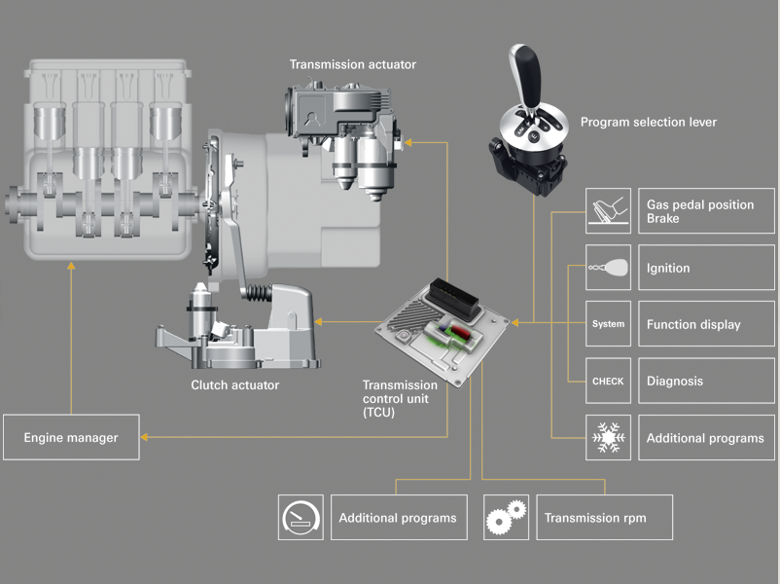
The Problem:
Present Automatic Transmissions like AT(Automatic Transmission) and CVT (Continuous variable Transmission) used in cars are expensive. As expensive precision sensors and microprocessor with software are used.
There is therefore a need to provide a new low cost Transmission.
This invention take care of all the advantages and over come disadvantages of AT and CVT.

Slide 4
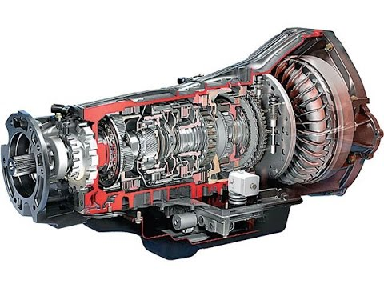
Introducing Servo Transmission:
In accordance with the invention there is provided Servo Transmission in particular for Automobile vehicles comprising PIV drive unit or cone pulleys with belt. The PIV drive or cone pulleys with belt infinitely varies input RPM to output RPM ratio between minimum and maximum limits at all speeds and torque demands at wheels by Servo mechanism comprising of Differential Unit, Taper wedge, Rack, Pinion Gears, Hydraulic Cylinder with Accumulator and pressure Relief Valve.
Manufacturing cost is low as only few mechanical parts are used and Manufactured in mass production in many Industries.

Slide 5
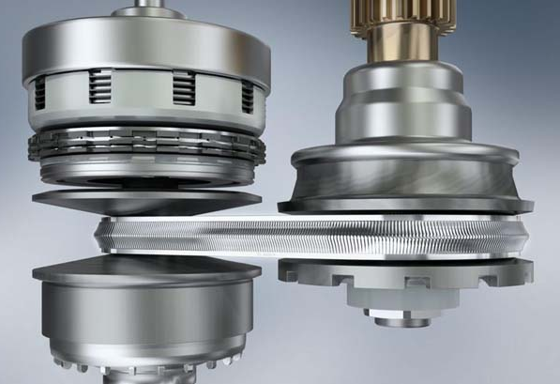
Working:
In accordance with the invention there is provided Servo Transmission in particular for Automobile vehicles comprising PIV drive unit. The PIV drive or cone pulleys with belt infinitely varies input RPM to output RPM ratio between minimum and maximum limits at all speeds and torque demands at wheels by Servo mechanism comprising of Differential Unit, Taper wedge, Rack, Pinion Gears, Hydraulic Cylinder with Accumulator and pressure Relief Valve.
Servo mechanism continuously senses torque demands at wheels by Differential unit and corrects the gear ratio of cone pulley unit infinitely between minimum and maximum limits at all speeds and torque requirement at wheels.

Slide 6
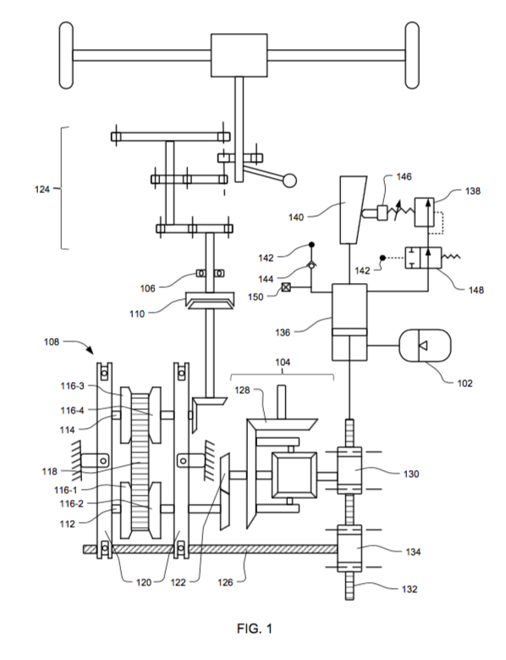
WORKING OF SERVO TRANSMISSION IN DETAIL:
Gear at neutral position at forward, reverse, and neutral mechanism Gearbox124.Differential Unit 104 bevel pinion gear 122 rotates freely at low torque as drive is not connected to wheels and Pinion 130 is held in position by Hydraulic Cylinder 136 at minimum gear ratio of input to output RPM of PIV Unit 1. Holding torque by Hydraulic Cylinder 136 on pinion 130 equals to ratio of pinion gear 128 RPM to bevel gear pinion 122RPM multiplied by Engine peak torque minus back pressure controlled by Relief Valve 138.When the clutch pedal is pressed clutch 110 disengages, forward gear is engaged and high pressure oil flows into Hydraulic Cylinder 136 through pipe 142 activating Cylinder 136 and actuating Valve 148 to block flow of oil to Relief Valve 138.Hydraulic Cylinder 136 displaces rack 132. So that PIV unit 108 input to output RPM gear ratio will be at maximum limit. When the clutch is pedal released slowly the clutch engages and wheels start rotating. The servo mechanism continuously senses torque at pinion 122. If torque on pinion gear 122 is greater than torque applied by Hydraulic Cylinder 136 on Pinion gear 130 through Rack 132due to load on wheels or due to Engine acceleration, Pinion gear 130 starts rotating against Hydraulic Cylinder 136 force displacing rack 132. Displacement of rack 132 causes rotation of pinion 13. Pinion 134 rotates screw 126 of PIV drive unit 108, increasing gear ratio of input rpm to output rpm until torque on Pinion 122 is slightly less than torque on Pinion130, which holds Hydraulic Cylinder 136 in position.

Slide 7
WORKING OF SERVO TRANSMISSION IN DETAIL:
If torque on Pinion gear 130 is less than Hydraulic Cylinder 136 pulling torque. The hydraulic cylinder 136 pulls rack 132 reducing input RPM to output RPM gear ratio of PIV drive unit 108 until torque on pinion 122 slightly less than torque on pinion 130, Which holds cylinder 136 in position. Servo mechanism continuously senses torque at pinion 130 &amp; 122 and corrects gear ratio of PIV drive unit 108infinitely between minimum and maximum limits at all speeds and torque requirement at wheels. Taper wedge 140 and relief valve 138 varies holding torque infinitely proportional to gear ratio. ****(In place of taper wedge (140) and Accumulator (102) . 3 or 4 relief valves (138) can be connected in parallel which varies pressure in Hydraulic Cylinder 136,which varies holding torque(Example:- 40, 60, 80,90 N-m). This relief valves are actuated by speedometer at different gear ratios for high acceleration.)

Slide 8
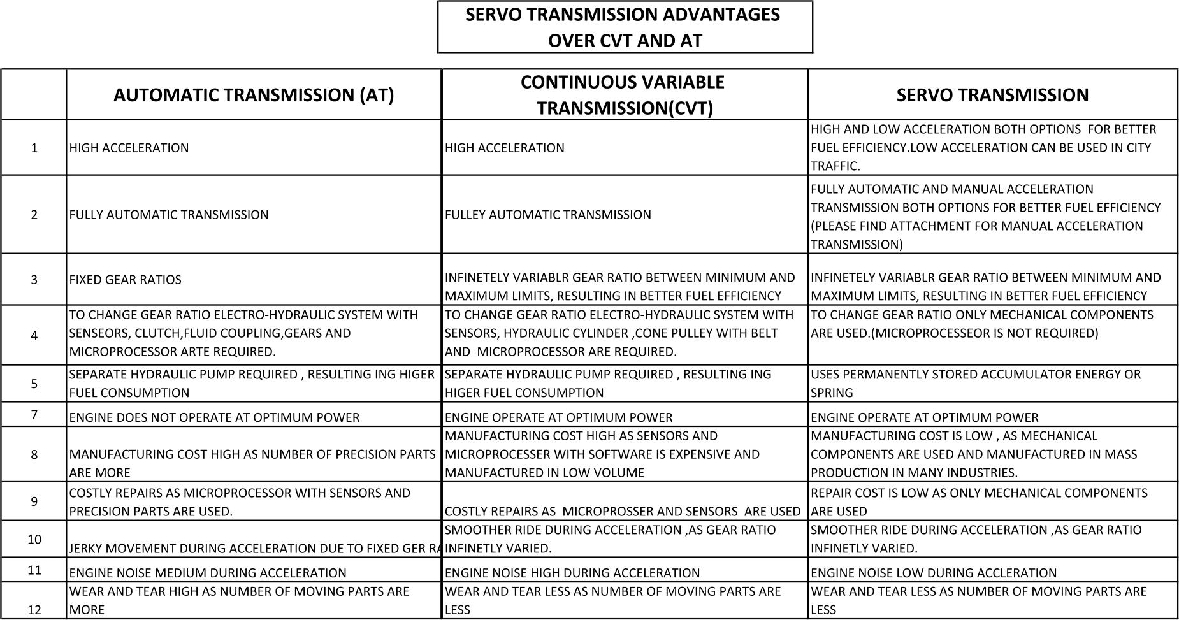
Comparison:

Slide 9
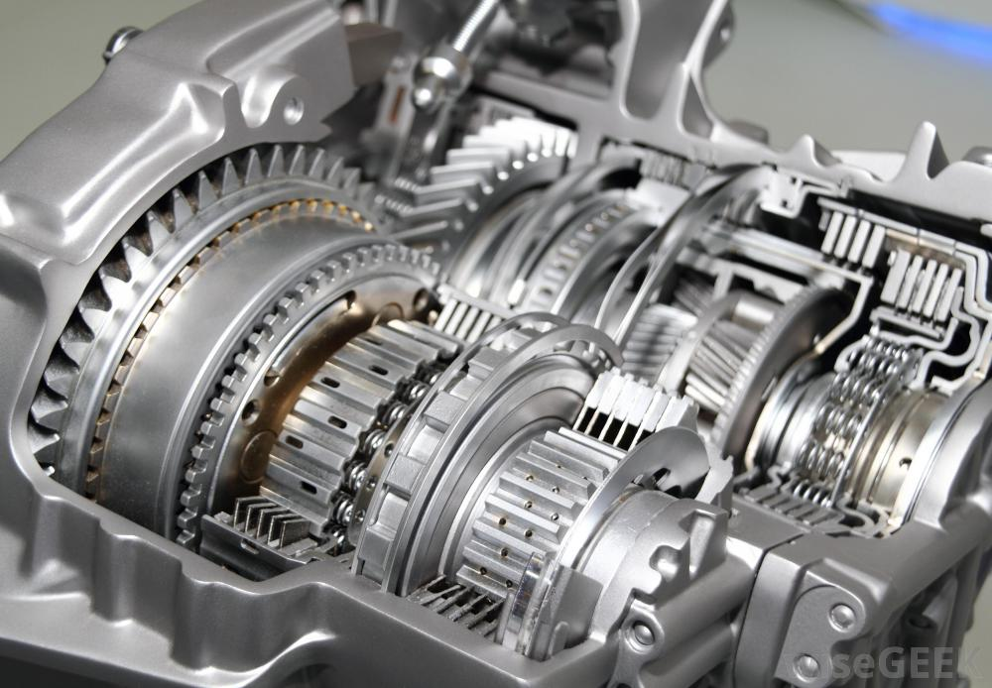
FAQs:
1. Why an Engine stalls?
A. Engine stalls if load acting on Engine is greater than rated torque. Due to torque demands at wheels, Due to wrong selection of gear by driver.
2. What are present mechanisms in use to avoid Engine stalling and how it over come Engine stalling?
A. (1) Automatic Transmission (AT)
(2) Continuous Variable Transmission
(3) Manual Transmission (MT)
(4) Automatic Manual Transmission (AMT).
All these Transmission Systems corrects the gear ratio to overcome Engine stalling, thus reducing load on Engine.

Slide 10
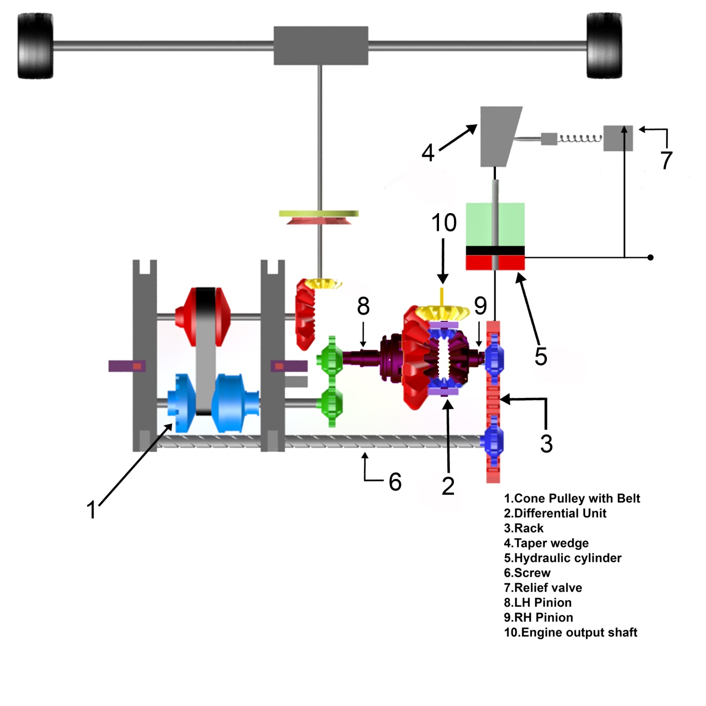
FAQs:
3. How Servo Transmission corrects the gear ratio to overcome Engine stalling ?
(A) Differential unit (2) RH pinion (9) is held by Hydraulic Cylinder (5)by hydraulic pressure with the torque slightly less than peak torque (Example:-90 N-m) of Engine (Example:-100 N-m) and LH pinion (8) is connected to wheels through cone pulley unit(1). By Differential working principle when the torque exceeds 90 N-m, RH pinion (9) starts rotating displacing Hydraulic cylinder rack (3) and corrects gear ratio of cone pulley unit (1)through screw (6) until the load on engine is reduced 90 N-m. When the load on engine is less than 90 N-m, hydraulic cylinder pulls back correcting the gear ratio to 90 N-m. This Servo Mechanism continuously senses torque and corrects gear ratio.

Slide 11
FAQs:
4. When Engine generates less torque at low RPM how does Servo Transmission over come?
A. Usually when Engine is at low RPM, gear ratio is high, the taper wedge (4) and relief valve (7) Reduces pressure in Hydraulic cylinder (7) reducing differential unit RH pinion (9) holding torque (Example:- 40 N-m) proportional to Engine torque. ****(In place of taper wedge (4) . 3 or 4 relief valves (7) can be connected in parallel which varies pressure in Hydraulic Cylinder which varies holding torque. This relief valves are actuated by speedometer at different gear ratios for high acceleration.) ***
Note:- When ever clutch is disengaged or half clutch is used Hydraulic Cylinder moves to high gear ratio.(i.e. 1st Gear)

Slide 12
Expectations:
Technology transfer fees and royalties
Licensing
Target Industry:
Automobile Industry

Slide 13
THANK YOU

