Slide 1


Title of the Invention:
Rain Water Management
using Elevated Channels over Roads with Stack Effect to vent Vehicle Exhaust
Inventor:
Manisha Deshpande
Applicant:
Dr. D.Y. Patil Vidyapeeth

Slide 2
Technical Field of Inventions
The present Invention relates to the field of Civil Engineering.
The present Invention helps in effective management of Rain Water.
The present invention has cutting edge technology for controlling the situation of droughts and floods.
Patent Status
Indian patent application No: 201721024084
Priority Date - 07th July 2017
Patent Published and Pending

Slide 3
Present Situation
Texas 2017
Latur 2016
Mumbai 2017

Slide 4
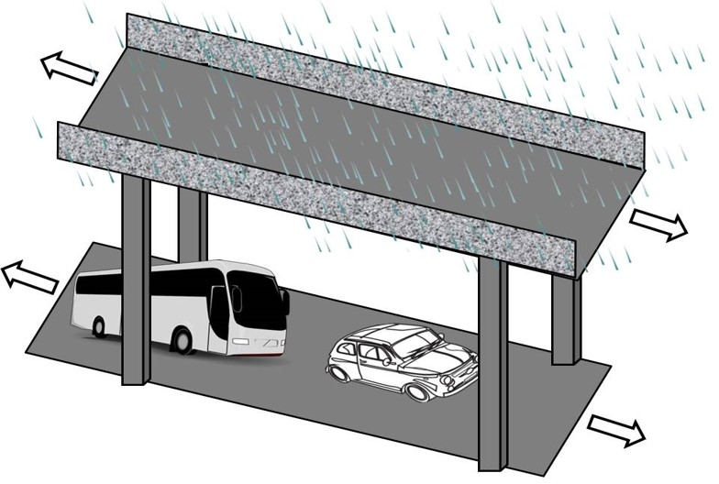
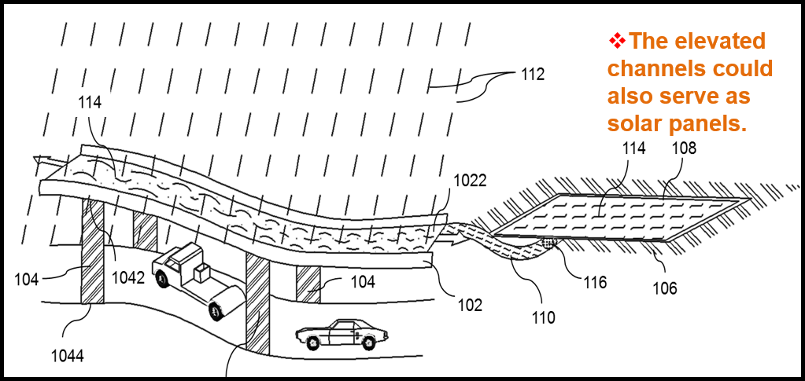
Our Approach

Slide 5
Working
The present Invention provides for a device that diverts rainwater before it reaches an area beneath, thus reducing flooding on the area beneath.
The present Invention provides for a device that diverts rainwater before it reaches an area beneath, where it could mix with drain water, thus retaining the purity of the rainwater.
The channels that diverts rainwater wherein the device is foldable for ease of operation, maintenance and durability while providing sunlight as well on area beneath when needed, and can be operated manually or automatically.
The present disclosure provides for a device that diverts rainwater using existing structures such as pillars etc. where possible. Thus the installation can be done in available space, with no need to create extra space for the device.

Slide 6
Advantages
Provides a solution for flood minimization in congested, already developed areas of cities, where other options involve major redevelopment & uprooting of existing structures, for eg. if constructing water reservoirs below ground level.
The present disclosure provides for a device that diverts rainwater that has provision for venting vehicular exhaust when installed over roads, without polluting the rainwater being diverted, and preventing health hazards to people between the road and device above.
The present disclosure provides for a device that can be built over existing roads in villages, without the need to use extra rural or farmland space, which is precious for farmers.

Slide 7
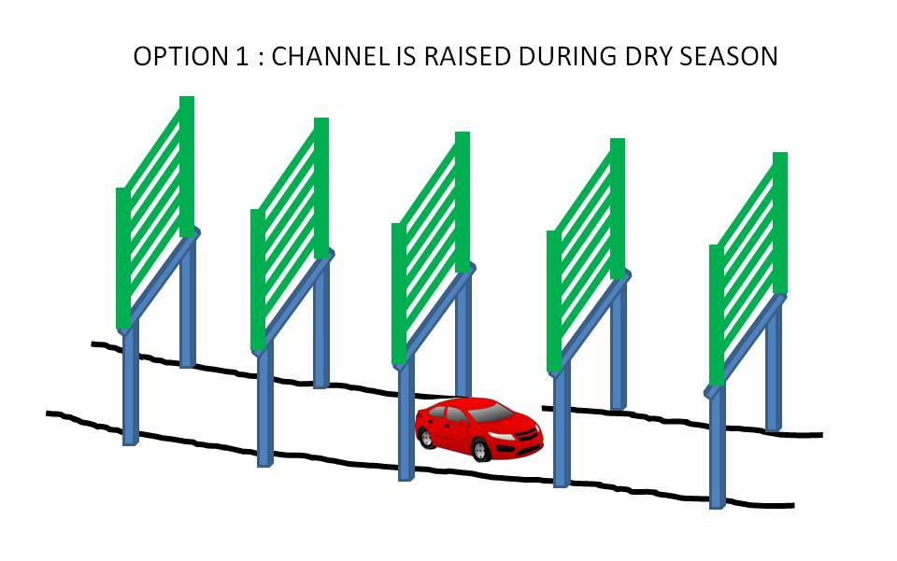
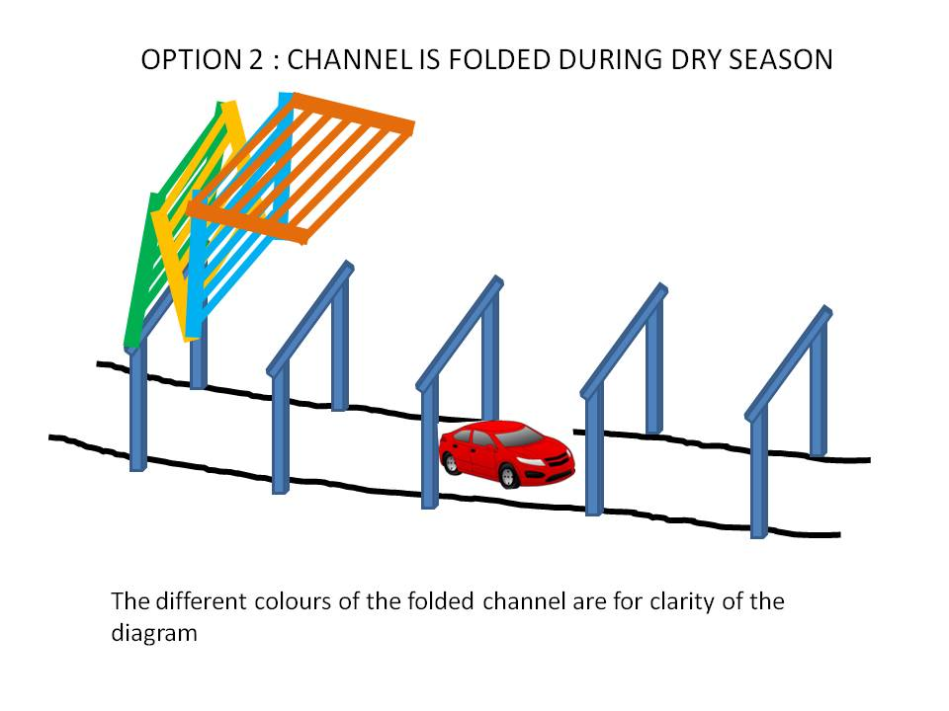
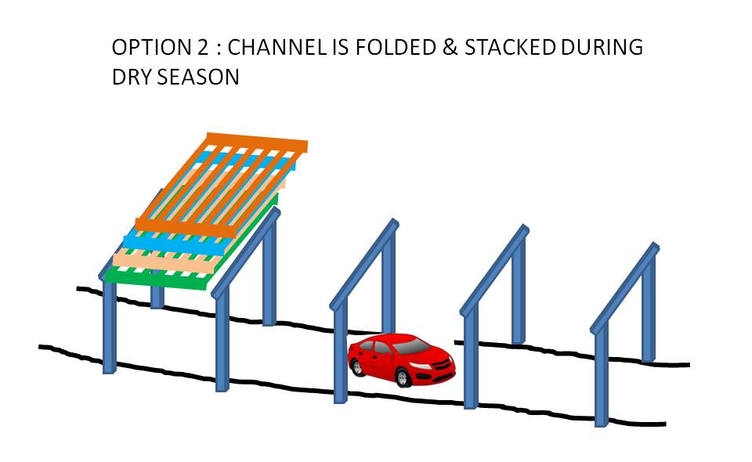
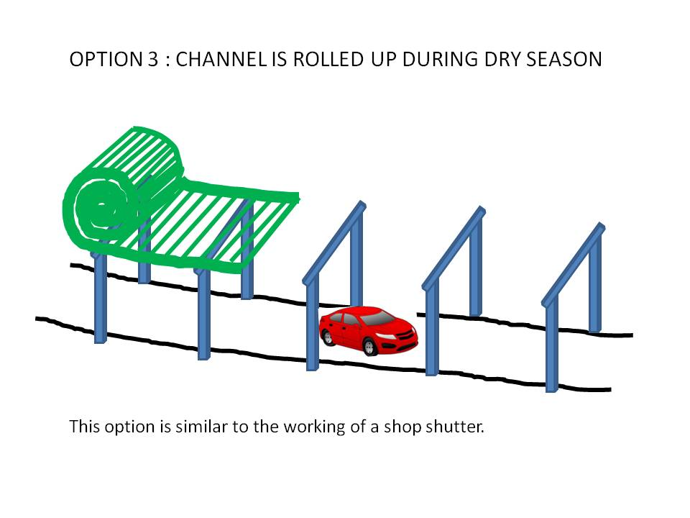
Illustration

Slide 8
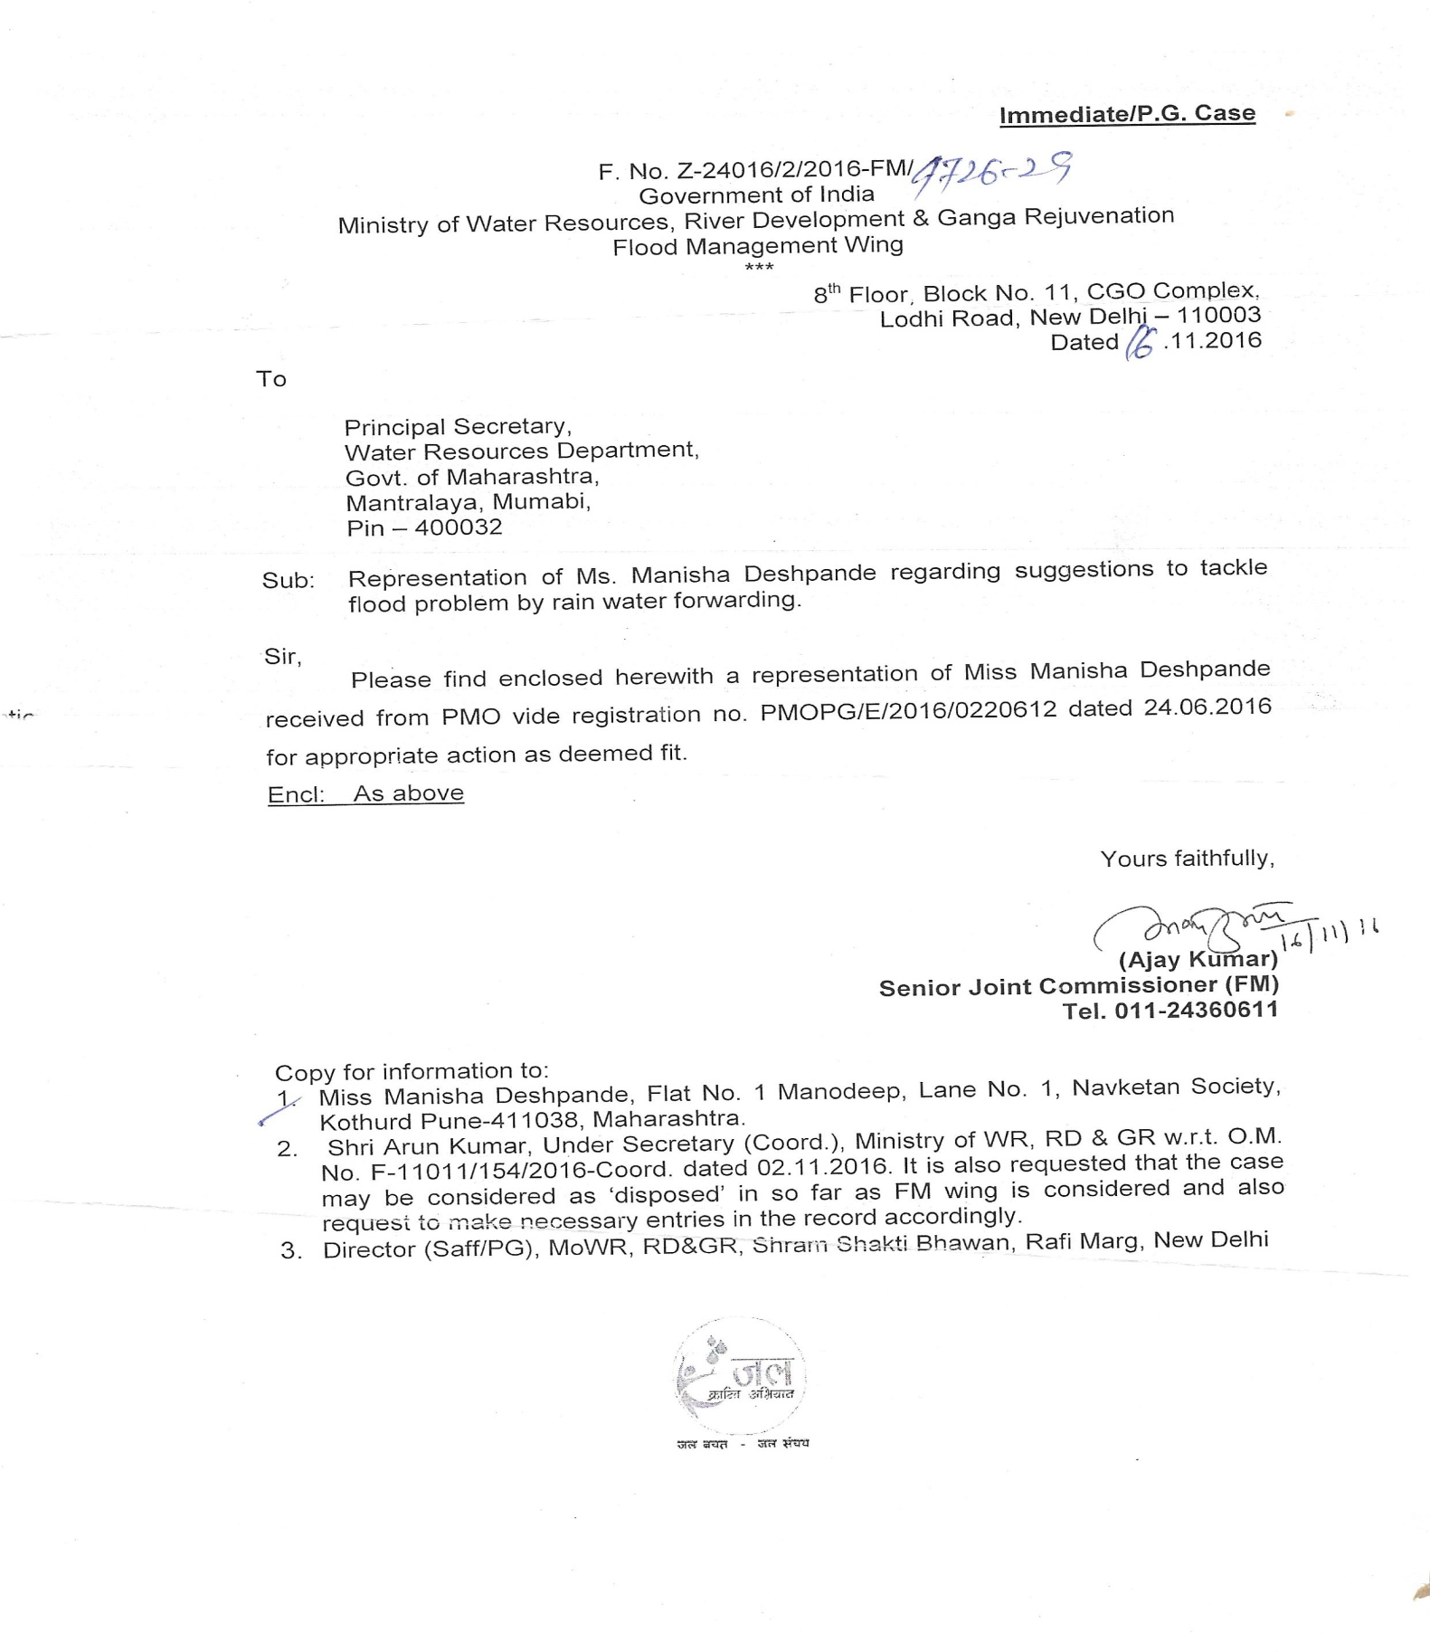
Letter from GOI Ministry of Water Resources (Flood Management Wing)
To
GOM Water Resources Department)

Slide 9
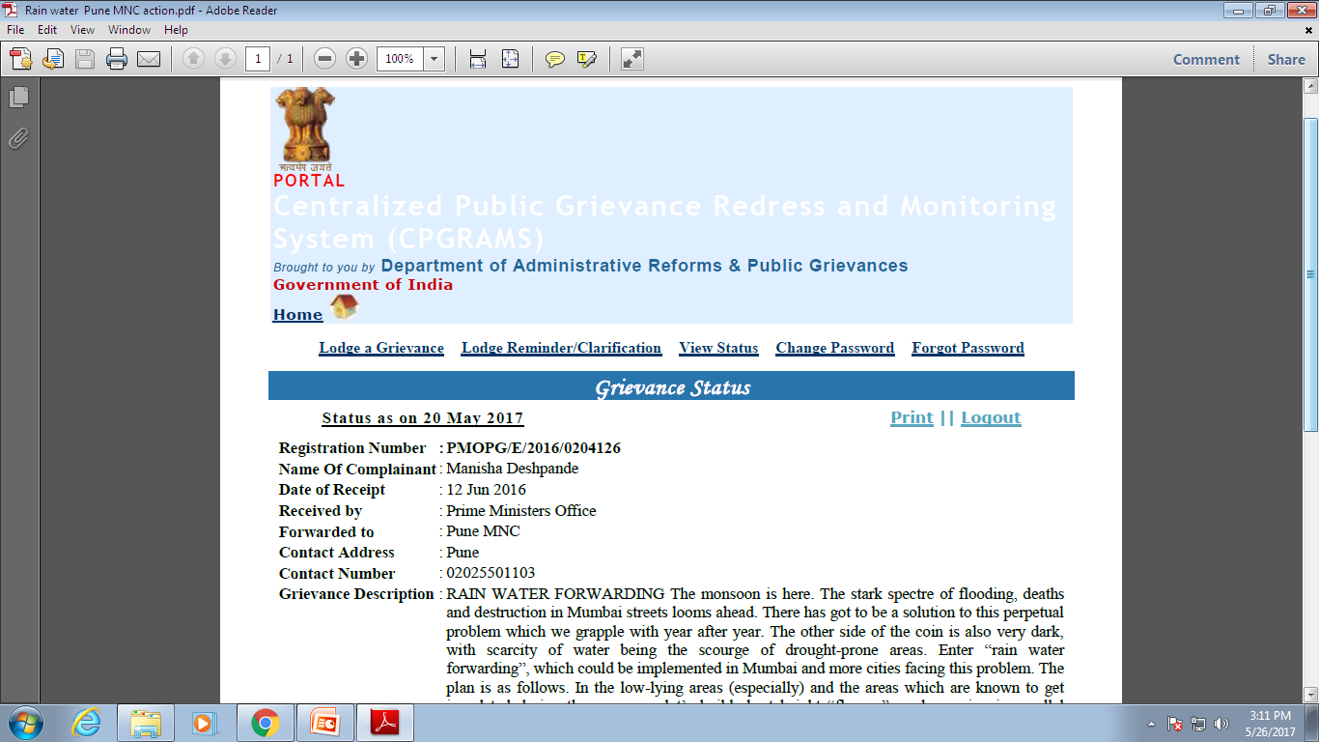
Status of Original Submission to PMO

Slide 10
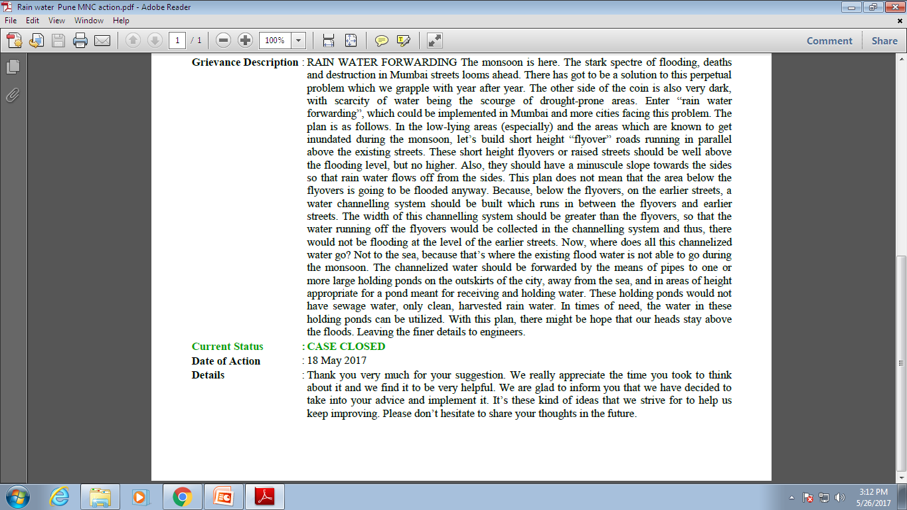

Slide 11
Expectations
Looking for Companies to participate in advancement of the product
Looking for the Licensing of the Patent
Looking for the Technology Transfer

Slide 12
THANK YOU
Contact Person:
Mr. Ankit Kumar
New Delhi Office - IIPRD
9, Birbal Road, Jangpura Extension, Delhi - 110014
Tel: +91-(011) 40079530
E-Mail id: ankit@iiprd.com

