Slide 1


Title of the Invention:
MINIATURE REMOTE
Inventor:
Mr. Lakshya Lalit

Slide 2
Technical Field of Inventions
The present invention relates to the field of wireless remote control.
More particularly it is compact and robust in size.
The present invention extends to enhance the capability to automate the tasks using sound frequencies.
Patent Status
Indian patent application No: 201811017300
Priority Date - 08th May 2018

Slide 3
Prior Art
1) Currently available small remotes are at least larger than 20mm x 20mm.
2) For more number of commands we require a bigger remote.
Size
1) Radio Frequency Based technology (BLE, IOT).
2) More number of components (memory chip, resonator).
Technology Used
1) Less or equal number of controls per remote
2) Expensive
Features
1) High current usage.
2) Higher capacity of battery required (not suitable for coin cell) .
3) Faster consumption of battery hence low battery life.
Battery Consumption

Slide 4
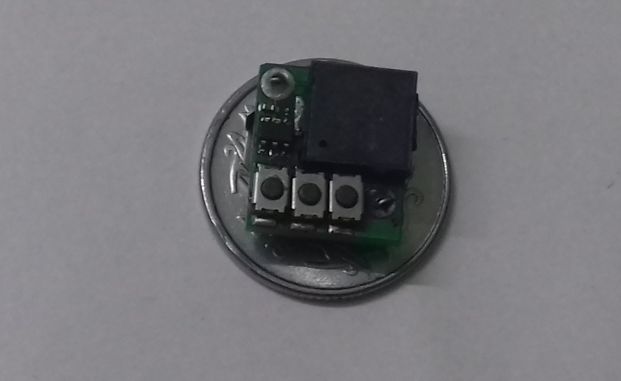
Miniature Remote
For Video Demo, Visit: https://www.youtube.com/watch?time_continue=1&v=CChj8HVn-9E
New Miniature Design
1) Number of controls- 1 to 5
2) Range- ~15 meters
3) Small size
Features
1) Patent filed in INDIA, Application number-201811017300, dated-08-05-18.
2) Working prototype already fabricated.
3) Successful testing performed.
1) Less number of components.
2) Low power consumption.
3) Simplified design, less components therefore easy to manufacture.
Design Advantage
Current Status
15mm*15mm

Slide 5
Comparison
 | Existing Remote | Miniature Remote
SIZE | 27mm x 27mm (Flic) | 15mm*15mm
BATTERY LIFE | Short | Long
COST | High | Low
RANGE | Long | Relatively less

Slide 6
Applications
SMART SPEAKERS
1) Perform various task using remote with speaker
2) Switch appliance
HOME AUTOMATION
1) Control Lights
2) Play music
3) Thermostat, Coffee Machine
4) Snooze alarm
5) Take photo
6) Gagarge door, shower
AUTOMOBILE
1) Open window
2) Stereo, AC control
3) Phone pick
4) Start stop navigation while driving
OTHERS
1) Hospitality Industry
2) Toys

Slide 7
Threats
COMPETITORS
1) Smart Buttons
2) Namely - Dash Button, FLIC etc
EMERGING TECHNOLOGY
1) Gesture based control
2) Voice based command
3) Mobile based remote
4) Internet based remote
COMPATIBILITY
1) Device these days use various communication protocols, so they need to be adapted accordingly
DRAWBACK
1) Miniature remote may require a receiver per room
2) But mobile phone can also act as intermediate receiver to avoid installing multiple ones.

Slide 8
Commercial Prospects
Expectations
TOTAL MARKET SIZE
100 million of Installed smart speakers which provides ready infrastructure to be used with our product.
MARKETING STRATEGY
1) OEM
2) Branded buttons
3) App based marketing
MANUFACTURING FACILITY
1) Chips can be fabricated using existing manufacturing facility
2) Estimated cost per piece chip – less than a 10 cents
3) Housing, other components may be outsourced
4) Per piece cost of remote will depend amount of bulk order, is estimated to be lower than counterparts
TIMELINE
Because design has already been patented and prototype has been manufactured, the commercial production can be started right away.
Looking for Companies to participate in advancement of the product.
Looking for the Licensing of the Patent
Looking for the Technology Transfer

Slide 9
THANK YOU
Contact Person:
Mr. Ankit Kumar
New Delhi Office - IIPRD
K-16, Jangpura Extension, New Delhi - 110014, India.
Tel: +91-(011) 40079530
E-Mail id: ankit@iiprd.com

