Slide 1


SAFETY ISOLATION BAG®
(The Pneumoperitoneum Device for In-Bag Morcellation)
Invention Name:
“Safety Isolation Bags For Intra-Abdominal, Endoscopic Procedures, Power Morcellation and Vaginal Morcellation”
The Best Morcellation Bag
Inventor: Dr. Lalu Joseph
PCT/ IN2015/000420
US2018/0008250A1

Slide 2
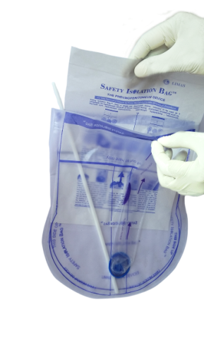
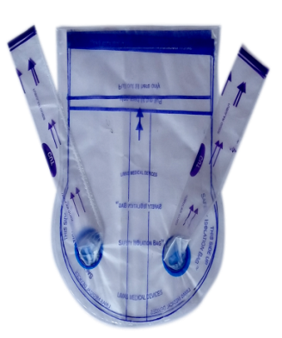
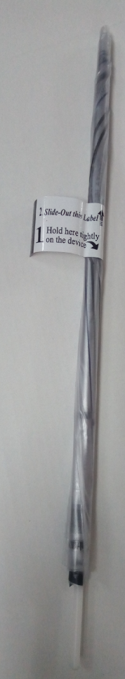
Registered Trademarks of the Device:
SAFETY ISOLATION BAG®
PNEUMOSAC®
Available in different sizes (mostly used sizes are 2500 ml and 5000 ml)
With single tubular guide or double tubular guides (Tubular Guides are for passing the telescope and hand instruments & morcellator is passed through the mouth of the device)
The most appreciated in-bag morcellation device
Pre-rolled & ready to insert device (saves time in rolling and assembling it during surgery with wet gloves)
Very easy to open the device (just by pulling apart both flaps)
The body of the device will not get twisted (this is the most challenging problem surgeons face with other devices)

Slide 3
Ergonomic Design:
Clear markings on how much the mouth of the device and the tubular guides to be pulled out
Helps in easy insertion of telescope and other instruments
Simple to use & User friendly
Learning curve of single procedure
No latex

Slide 4
Wide User Base:
Many leading hospitals use Safety Isolation Bag for in-bag morcellation. Currently, there are more than 400 users of this cutting edge technology out of which some exemplary users are:
APOLLO HOSPITAL
MANIPAL HOSPITAL
JASLOK HOSPITAL
BREACH CANDY HOSPITAL
ALTIUS HOSPITAL
LAKESHORE HOSPITAL
PVS HOSPITAL
ASTER HOSPITAL
ELITE HOSPITAL
DAYA HOSPITAL
WEST FORT HOSPITAL
ASWANI HOSPITAL
CRAFT HOSPITAL
MIMS HOSPITAL
IQRA HOSPITAL
SUNRISE HOSPITAL
GEM HOSPITAL
GATEWAY HOSPITAL
CLOUD NINE HOSPITAL
MEDTRINA HOSPITAL
JUBILEE MISSION MEDICAL COLLEGE
AMRUTA MEDICAL COLLEGE
WADIA HOSPITAL
NAANAVATI HOSPITAL
RELIENCE HOSPITAL
MES HOSPITAL
STARCARE HOSPITAL
SBM HOSPITAL
LIFELINE HOSPITAL
PAULS HOSPITAL
LITTLE FLOWER HOSPITAL
ISHA HOSPITAL
MATHA HOSPITAL

Slide 5
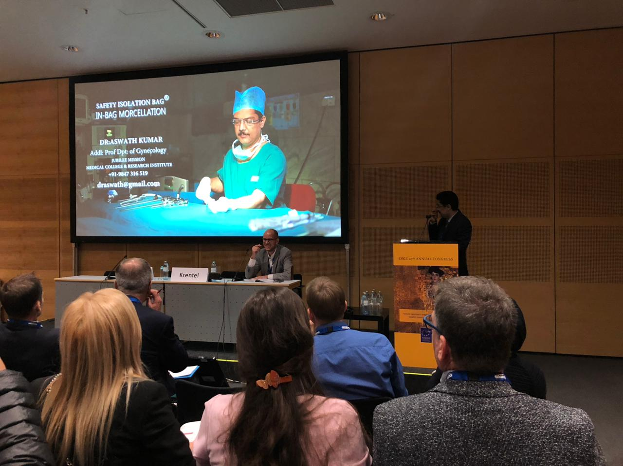
Demonstration:
Few Testimonial Videos of Users of the Device & Tutorial
https://www.youtube.com/watch?v=M-OP94cAQrg&t=34s - DR DIVYESH SHUKLA
https://www.youtube.com/watch?v=EoGJ4FVGPPU&t=99s - DR. HAFEEZ RAHMAN
https://www.youtube.com/watch?v=zGE0L9T9OrE&t=51s - DR. BIJU PARAMESWARAN
https://www.youtube.com/watch?v=zw39vwkWzoA&t=8s - ANIMATION VIDEO
https://www.youtube.com/watch?v=VtKDqwwLKdI&t=69s - DR. P. G. PAUL
https://www.youtube.com/watch?v=zGE0L9T9OrE&t=56s - DR. ASWATH KUMAR
https://www.youtube.com/watch?v=JU78vrhDNDg - DR. CYRIAC PAPPACHAN
Prof. Aswath Kumar Presenting SAFETY ISOLATION BAG during European Society of Gynaecological Endoscopy at Vienna Austria on 9.10.2018

Slide 6
Patent Family:
EP3220835A4
US2018008250
Expectation:
Company seeks alliance with Potential Licensees to assign Licensing Rights to market these technologies.
Company is also interested in sale of the Granted / Issued Patents.

Slide 7
THANK YOU
CONTACT US:
Greater Noida (NCR) Office
E-13, UPSIDC, Site-IV, Behind-Grand Venice, Kasna Road, Greater Noida - 201310, UP, National Capital Region, India.
Tel: +91-(120) 4296878, 4909201, 4516201
Fax: +91-(120) 4516201
E-Mail id: ankit@iiprd.com

