Slide 1
Land slide – H or Y block retention wall Patent application no.2677/MUM/2014 and PCT/IN2016/000045
Presentation by
Rajendra Ladkat
Email: contact@rajendraladkat.com
Mobile-9226759450

Slide 2
UNO report
.The significance of landslides is set to increase in the coming years as a result of population growth, expansion of infrastructure, and increased forestry and agricultural activity in the region.
In temperate and tropical Asia, projected climate change related impacts are likely to result in compound effects of landslide incidences.
Landslides cause environmental damage to forests and agricultural resources by removing topsoil, blocking rivers and increasing downstream sedimentation.
Scientific studies confirm the crucial role of trees and forests in preventing landslides not only by reinforcing and drying soils, but also in directly obstructing smaller slides and rock falls”.
Steep terrain, vulnerable soils, heavy rainfall and earthquake activity make large parts of Asia highly susceptible to landslides

Slide 3
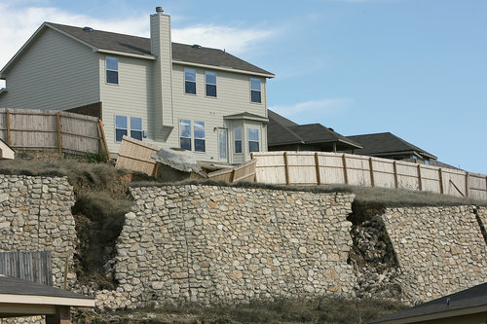
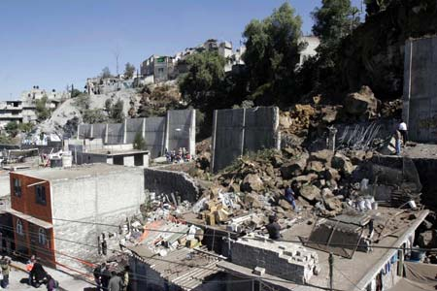
Fall of retention wall
1
2 Landslide in Iztapalapa, Mexico City- a 50 cubic metre landslide in the Itzapalapa, a poor suburb of Mexico City slid onto a house at the toe of the slope, killing two people , a very large (5 m high) retaining wall that had been built between the slope and the houses. Clearly the wall has failed under the weight of the landslide.
Landslide threatens NW San Antonio homes, Damage to a retaining wall and property to a home in The Hills at Rivermist subdivision in San Antonio, Texas on Monday, January 25, 2010.
1
2

Slide 4
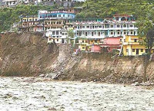
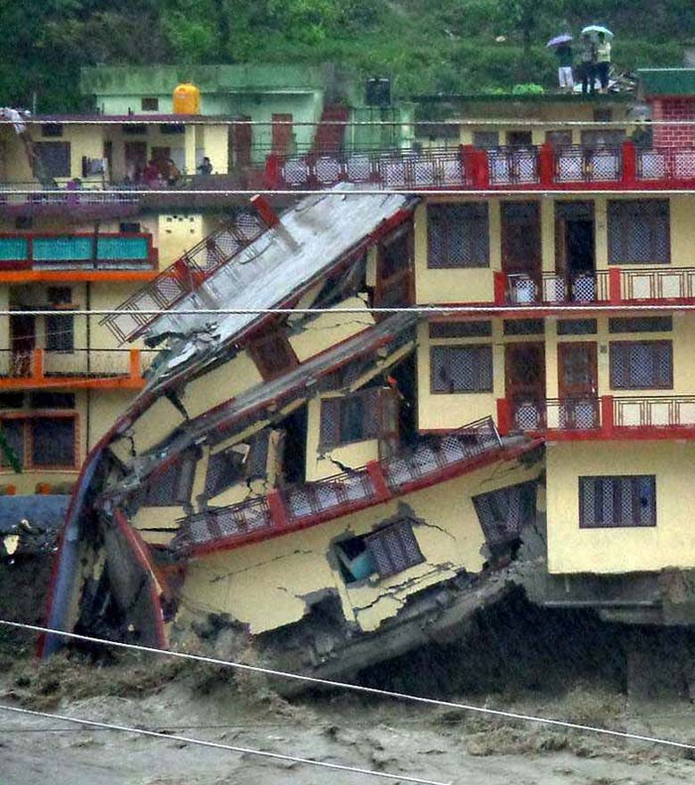
Flood in Uttarakhand
The Utrakhand flood teaches us that we must learn to build sustainable models for pilgrim-based tourism in the fragile regions of the country.
In Badrinath, 10 buildings were washed away while in Munsiyari the Kali Ganga river engulfed 400 houses

Slide 5
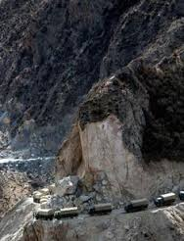
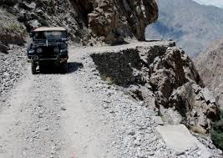
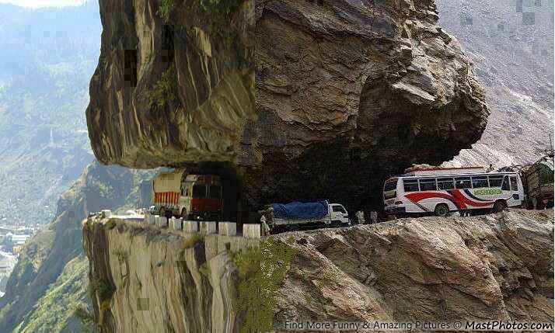
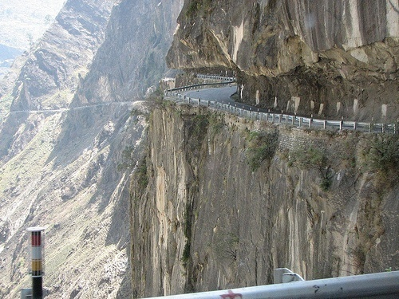
Roads in Himalayans belt

Slide 6
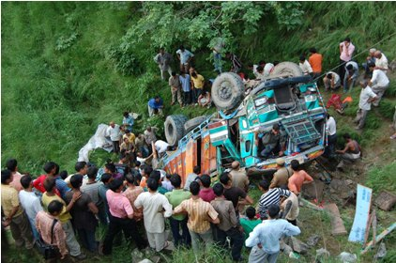
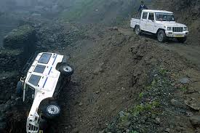
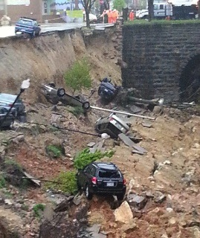
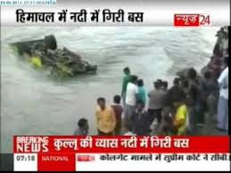
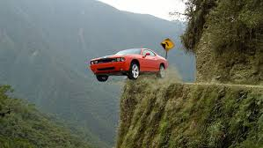
Vehicle falling in gorge
1 Shimla: At least 37 people are feared dead and 25 others injured when a truck carrying about 65 people lost control on a straight road stretch at Hatnala under Balh police station and fell into a nallah in Mandi district.
1

Slide 7
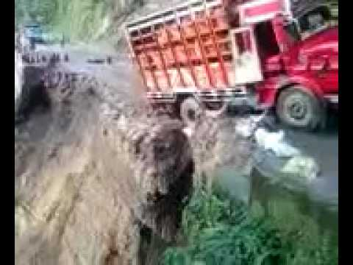
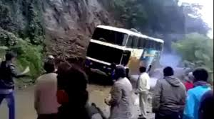
Video of truck and Bus fall in Gorge
https://www.youtube.com/watch?v=73BcTTMrAfA
https://www.youtube.com/watch?v=0F9vCpJFdBo
1
2

Slide 8
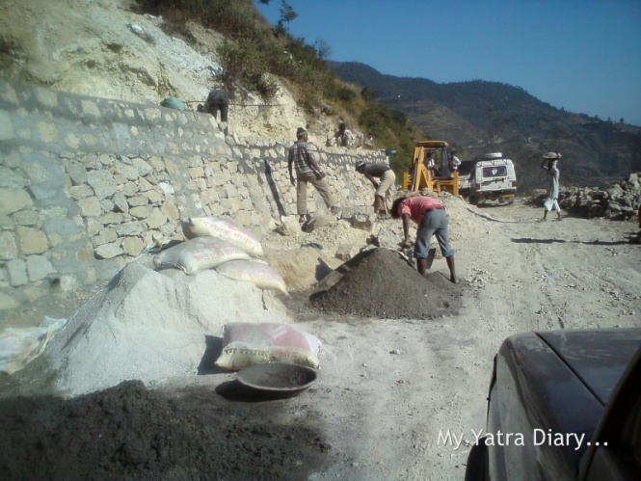
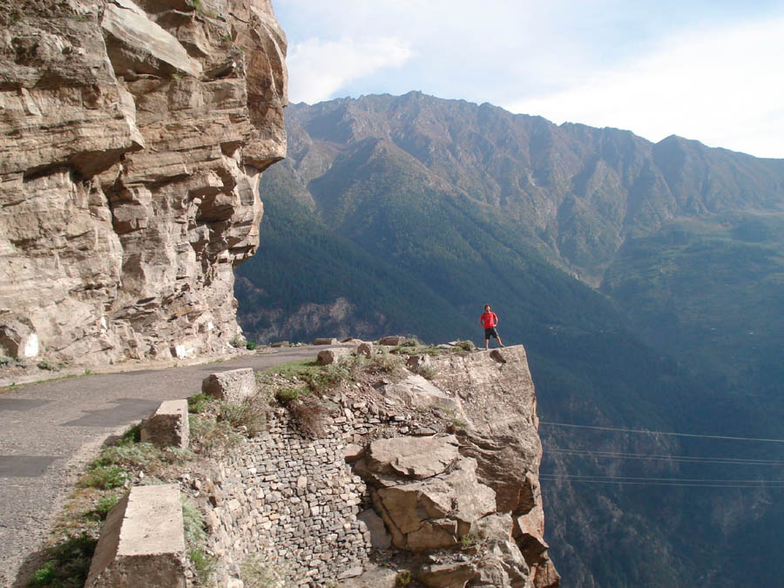
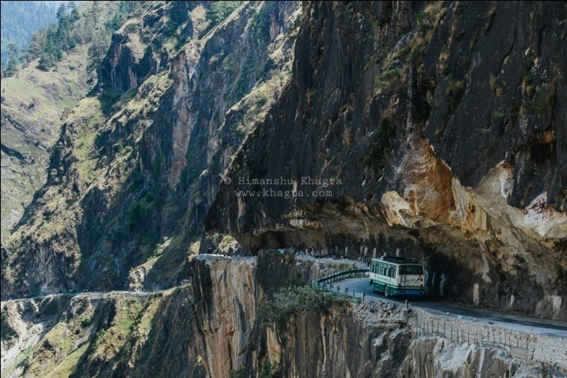
Existing solutions

Slide 9
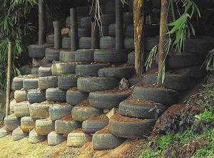
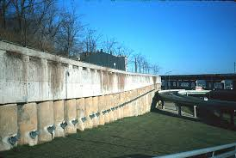
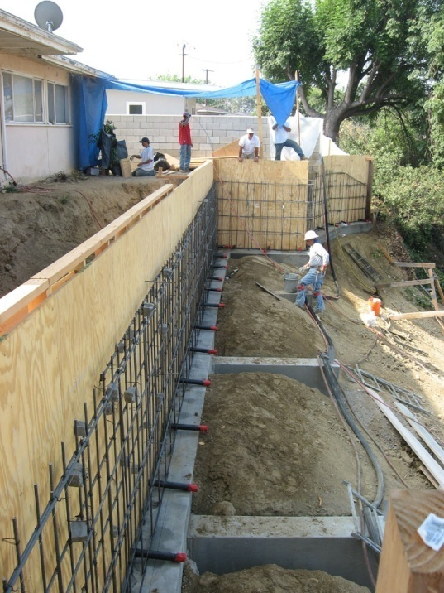
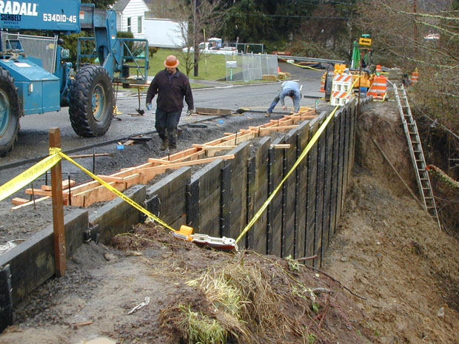
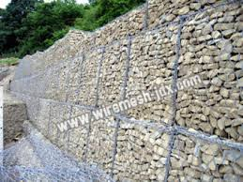
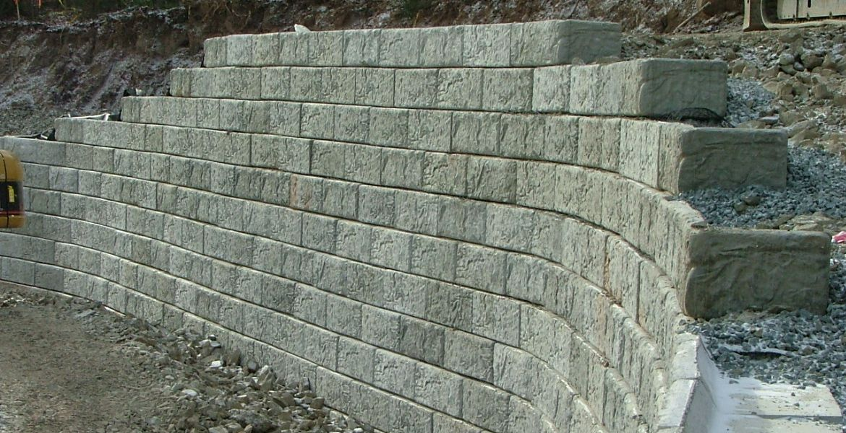
Existing solutions
1 Reinforced wall constructed entirely of used car tyres and soil in St. Georges Grenada
2 Mt Adams retaining wall-The $45 million dollar wall - piers along base of Mt Adams tied back into a tunnel drilled through solid rock underneath the hillside
1
2

Slide 10
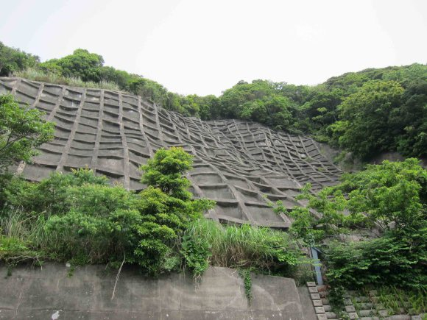
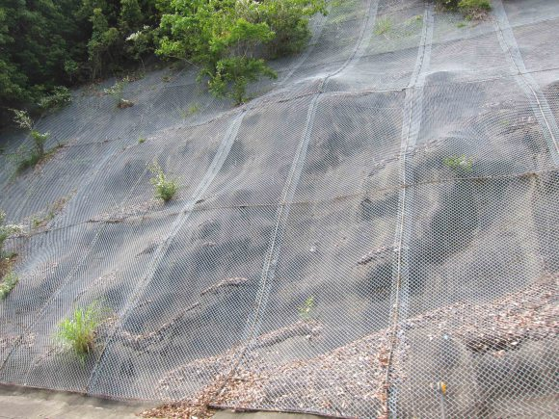
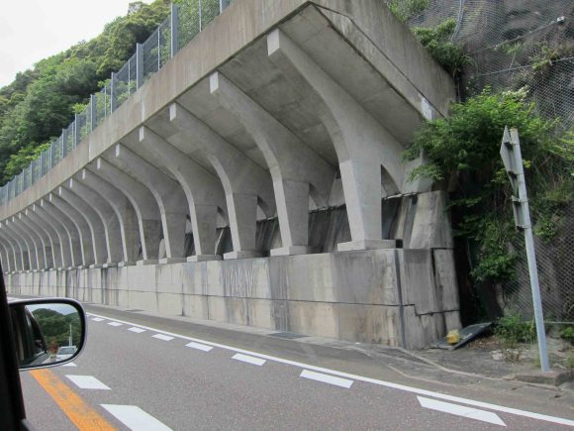
Some methods in Japan
1- Since all of the roads in this area is cut along the mountains, the Japanese take great precautions in preventing rock slides. Here is a huge concrete retaining wall to keep the land from moving.
2 Here’s another example of another retaining wall. Underneath the fence is some sort of hard surface on top of the soil and rock.
3 Here is an example of a massive concrete wall built to hold back landslides. I looks like it can stop a whole mountain from falling on us!
1
3
2

Slide 11
Goal
To reduce the incidences of landslides.
To reduce the frequent widening of roads and excavation of mountains caused due to natural and manmade disasters.
To reduce deforestation caused due to road widening.
To reduce the clogging and flooding of rivers caused due to landslide debris.
To reduce the construction time of retaining walls by using pre-casted blocks.
To prevent incidences of vehicles falling into valleys on roads with narrow turnings by building a well protected wall.
To act as a multipurpose protective wall on sides of road lying in mountains, flood prone areas, riversides, railway tracks, buildings and houses near steep slopes, etc.
To provide a wall with a long life.
To save on the labour costs.

Slide 12
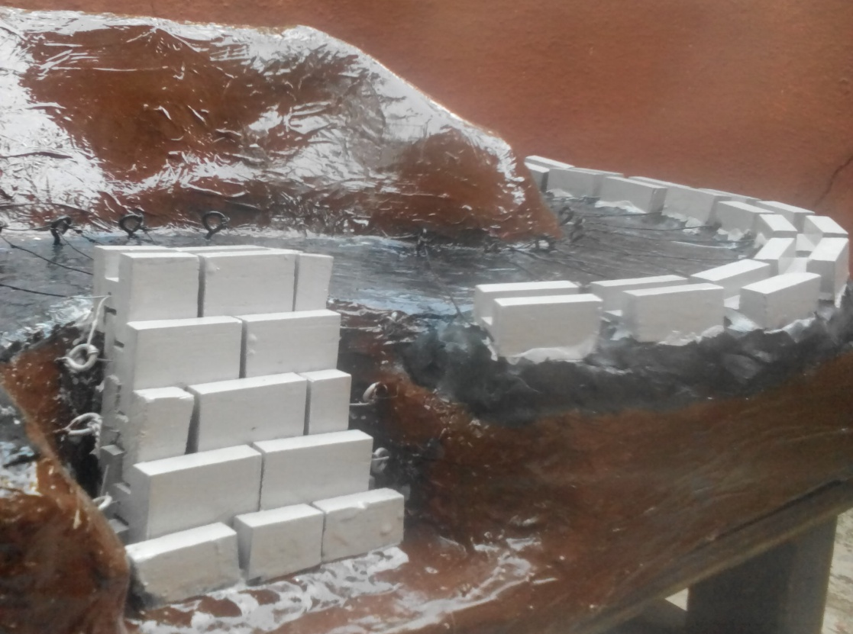
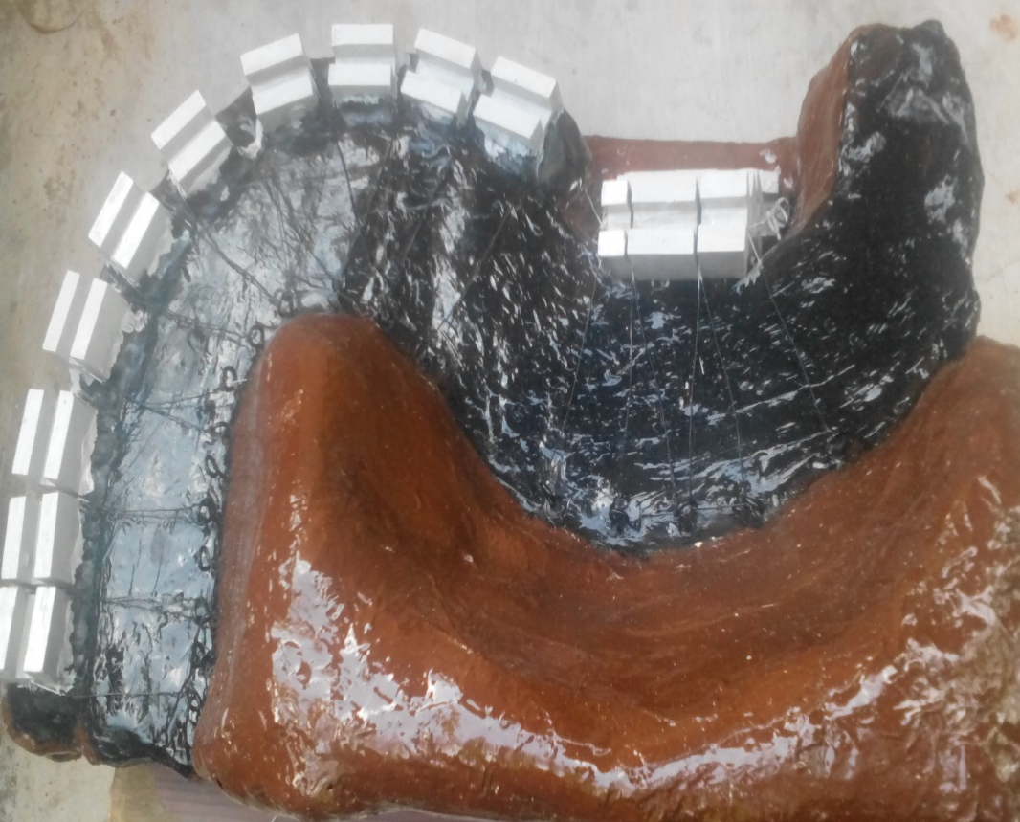
Concept & Model
We have proposed Pre casted H ( for slopping wall ) or Y ( for vertical wall) Reinforced concrete cement block where frequent landslides is occurred.
The H and Y block’s height and width depends upon the slope and height of the mountain
The H blocks are designed in such a way that they are interlocked with each other in the form of steps.
Such design of sloping blocks is being created to prevent pressure of landslide instead of straight vertical wall.
Each of the H block has a circular hollow pipe penetrating throughout the block at centre which consist of steel wire rope passing through every H block in the row

Slide 13
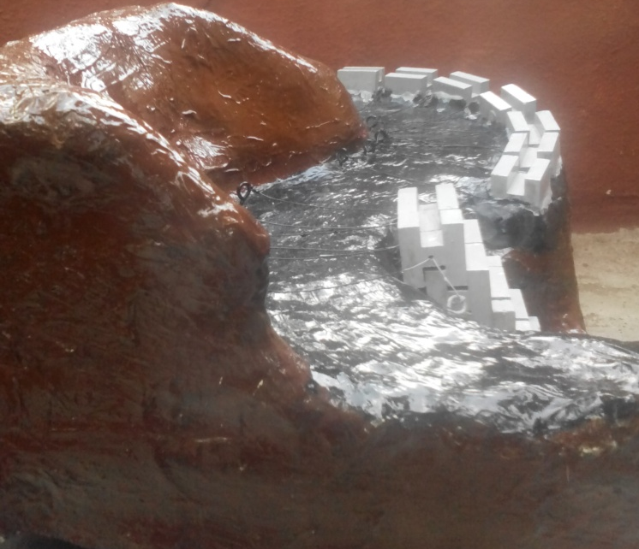
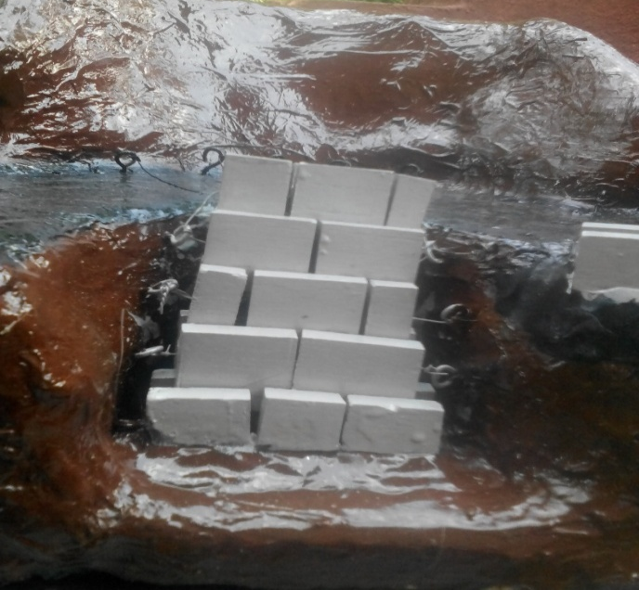
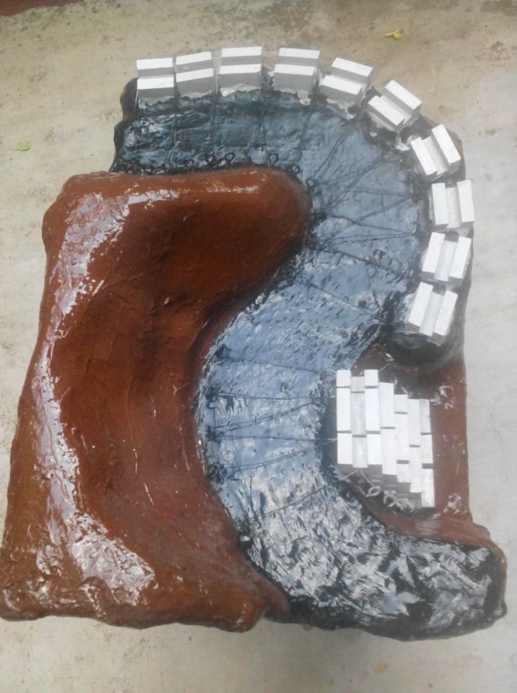
This steel wire rope is attached to the threaded pile which is being inserted deep inside the earth thus supporting H blocks.
The thickness of the wire rope depends upon pressure on each block and risk of the landslide considering height and slope of mountain.
The threaded pile is also inserted horizontally into the earth crust increasing the firmness the H block. Certain gap is being created due to thickness of wire rope which is being looped around the wire that is passing through two H block.
This gap also allows the excess ground water flow thus reducing the pressure on the block. It also acts like a screen which allows the flow of water and restricts the flow of pebbles.
The uppermost H block is attached to the wire rope which passes under the tar road from one end to another end of the road.
The other end of the rope is being tied to the threaded pile to acquire the desired support. Such design of uppermost H block prevents the vehicle from falling in the valley from any accident. Similarly pre cast Y block can be used to construct a straight wall

Slide 14
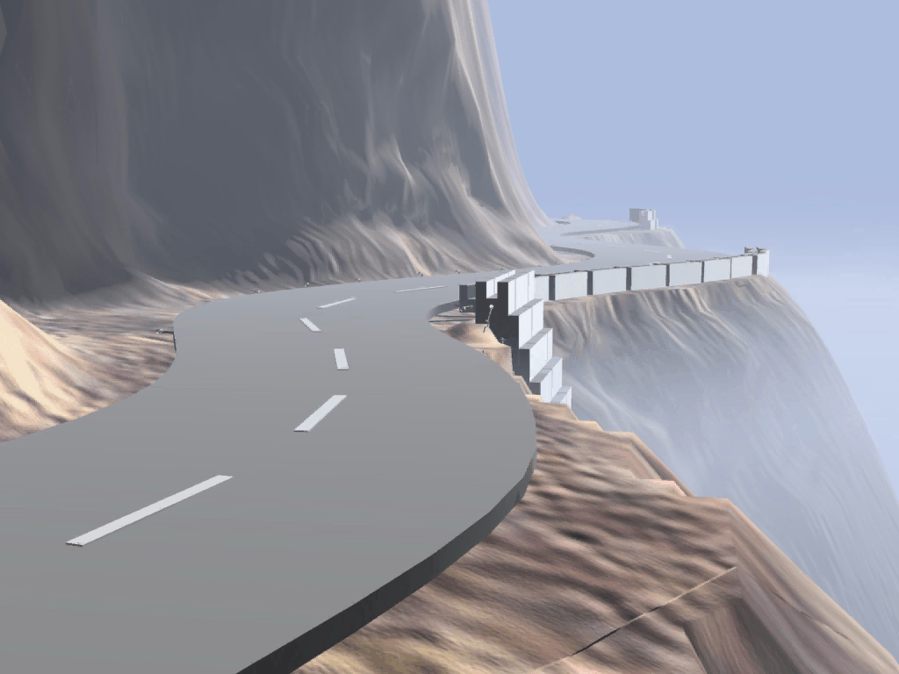

Slide 15
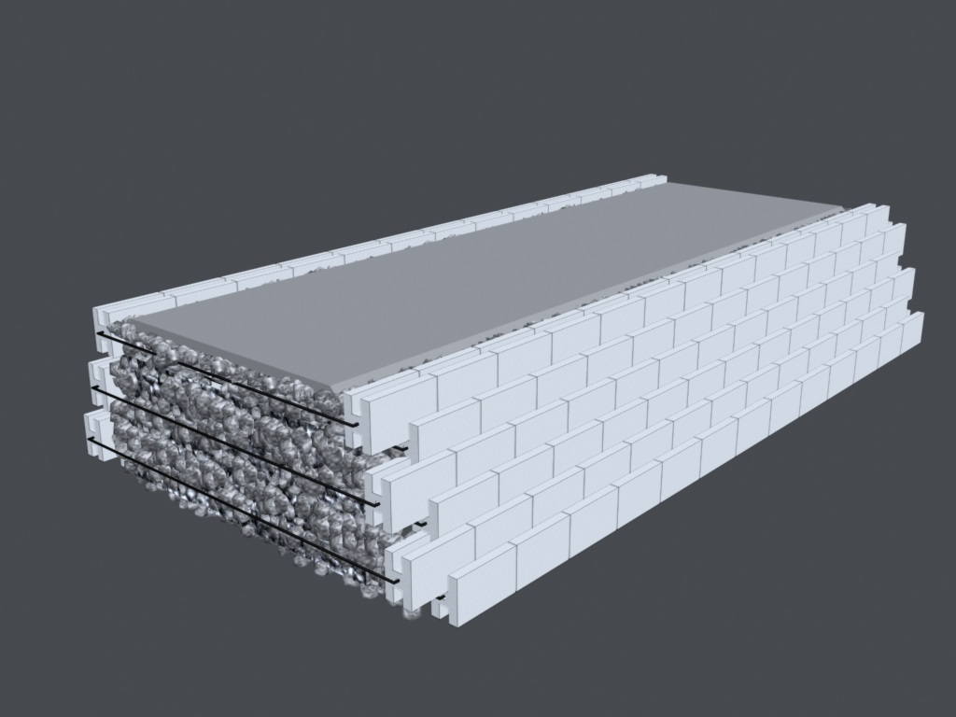
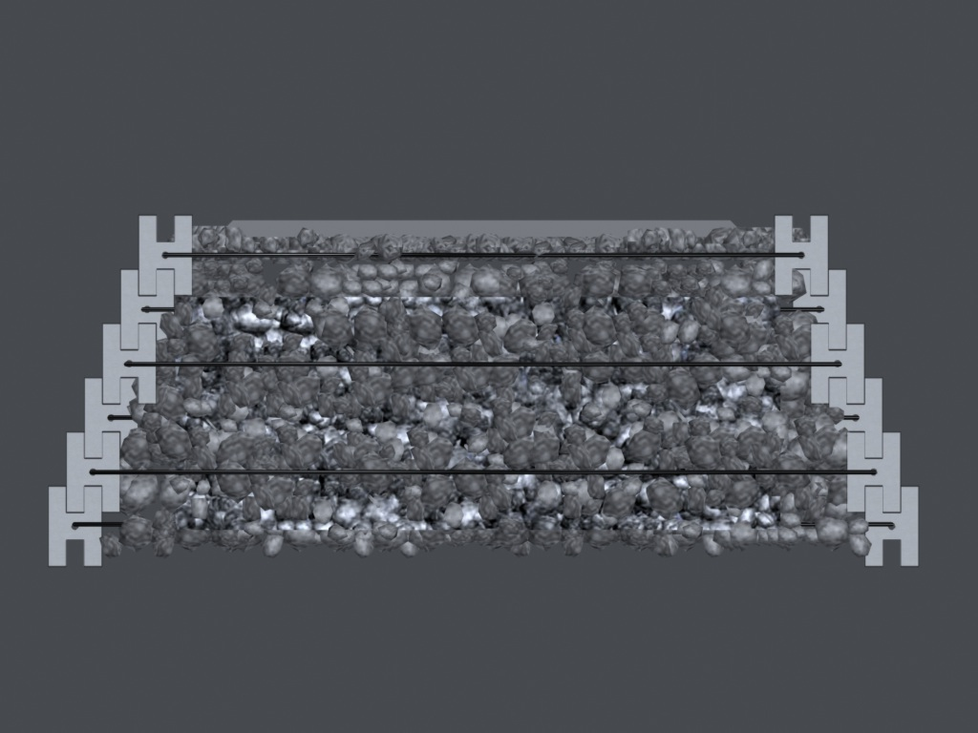
Highway roads

Slide 16
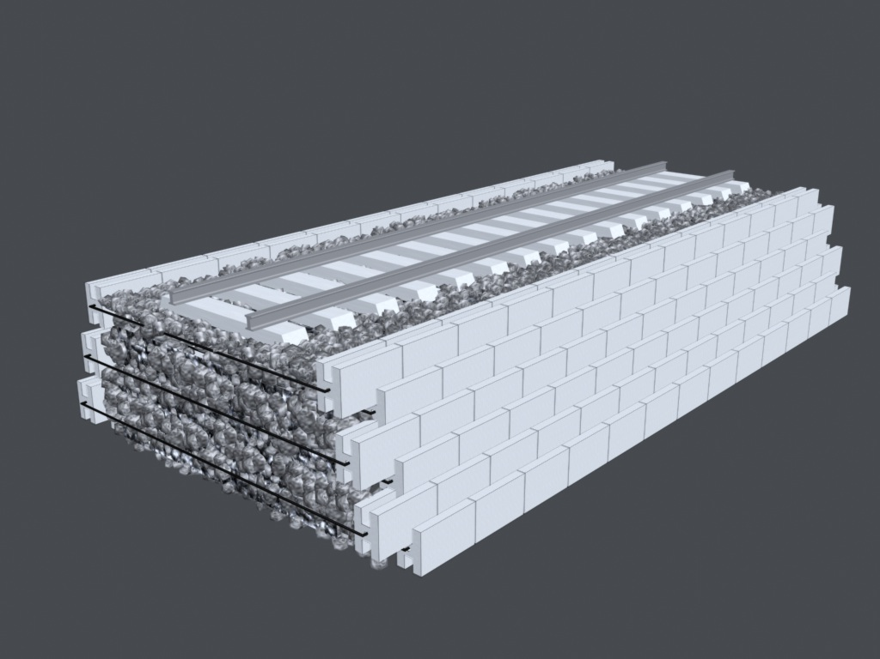
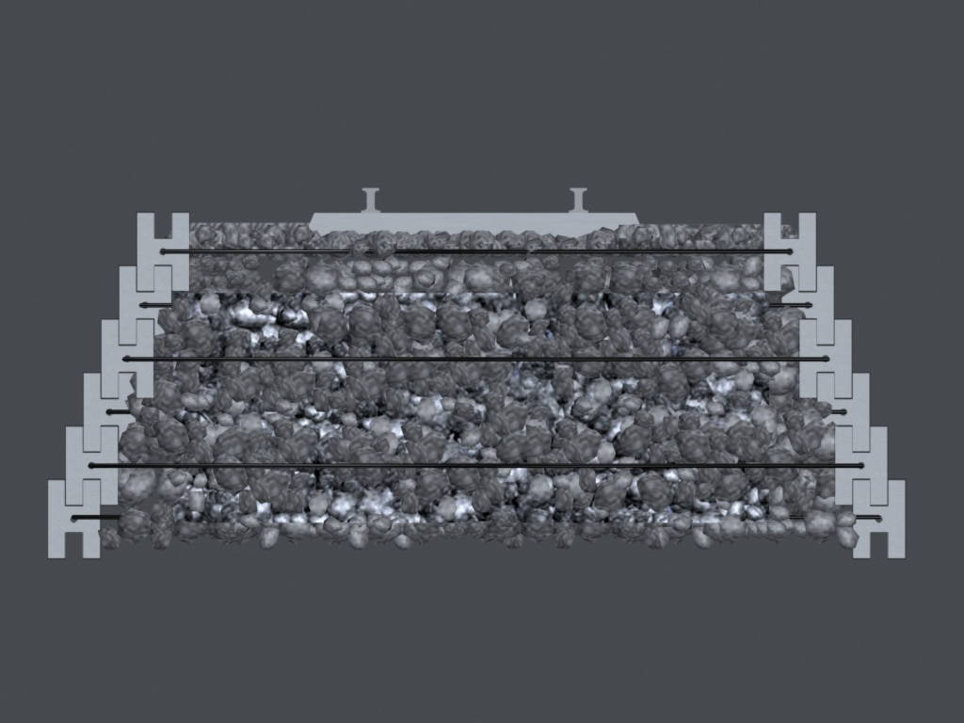
Railway track

