Slide 1


DELHI. MUMBAI. BANGLORE. PUNE. INDORE. CALIFORNIA
Energy Consumption Computing Technology through IoT sensors for Hotel/Hospitality Automation Industry
Identifying Licensee/Buyout Prospects
PCT Patent Application PCT/IB2016/054680

Slide 2

INTRODUCTION
According to a UNWTO report, Hotel facilities rank among the top five in terms of tertiary building sector. Most hotels, besides being benergy consumption in the ig power guzzlers are also huge on water consumption. According to reports, a single five star hotel consumes electricity enough to fulfill the requirements of 600 households and water sufficient for 1000 households.

Slide 3

INTRODUCTION
Market trends suggest that global demand for energy sources is forecast to grow by 57 per cent in the next 25 years leading to a dramatic increase in energy prices and water shortage. This poses a great threat considering the projections of growth of the hospitality industry.

Slide 4

INTRODUCTION
Surveys done by Carbon Trust consistently illustrate that customers are more inclined to choose a hotel that does not damage the environment and some are even prepared to pay a premium.
However, people, even if not particularly concerned about the depletion of resources of the planet, are always very cautious about saving their money.

Slide 5
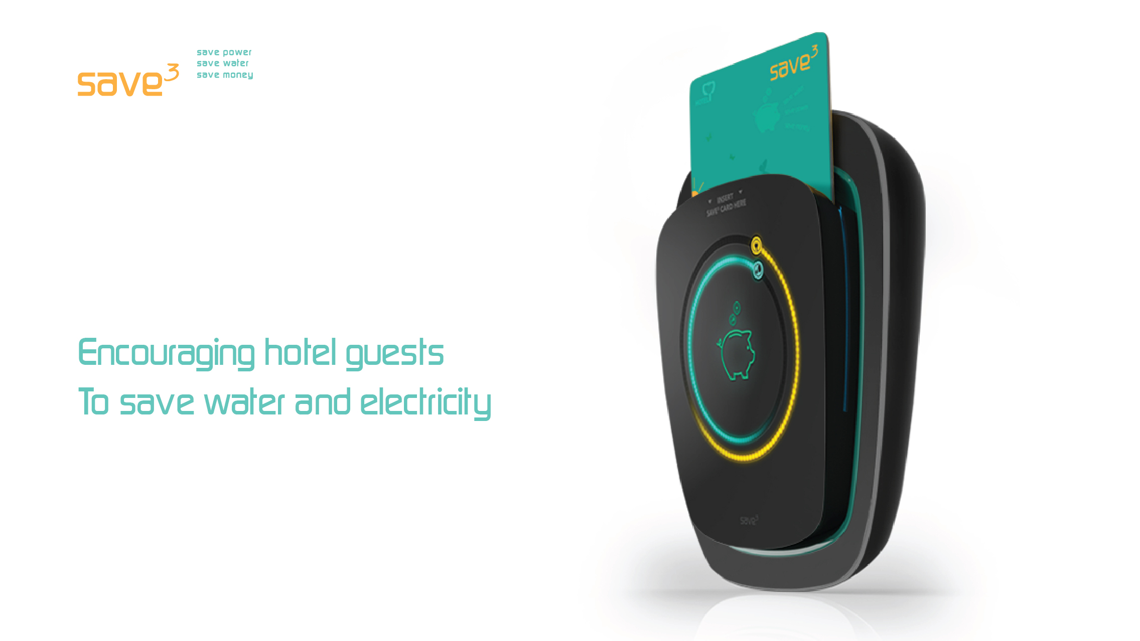
Proposed Technology

Slide 6

Proposed Technology (Cont.)
The Save3 system comprises of the Keycard, the Switch and wireless monitoring devices, all connected to each other.
These keycards and switches are Smart Objects, with extended capabilities. Besides accessing the room and regulating the electrical services when guests move in and out of the room, these are also routed in the electricity and water supply circuits and keep a record indicating the amount of water and electricity consumed.

Slide 7
Proposed Technology (Cont.)
When a guest enters the hotel room and inserts the Keycard in the Switch for the first time, the indicator bars are at a maximum, indicating the estimated maximum resource usage provision for the period that the room is booked.
The indicator gradually shortens as water and electricity are consumed, and this feedback is continuously updated on the front panel of the switch.
At the time of check-out, the Save3 Keycard carries this information entitling the guest for a part-refund on the cost of the room, depending on the length of the indicator bars remaining.

Slide 8

Proposed Technology (Cont.)
Guest checks-in at the Front Desk. Collects the Save3 Keycard.
Save3 Keycard is used to open the door of the hotel room.

Slide 9
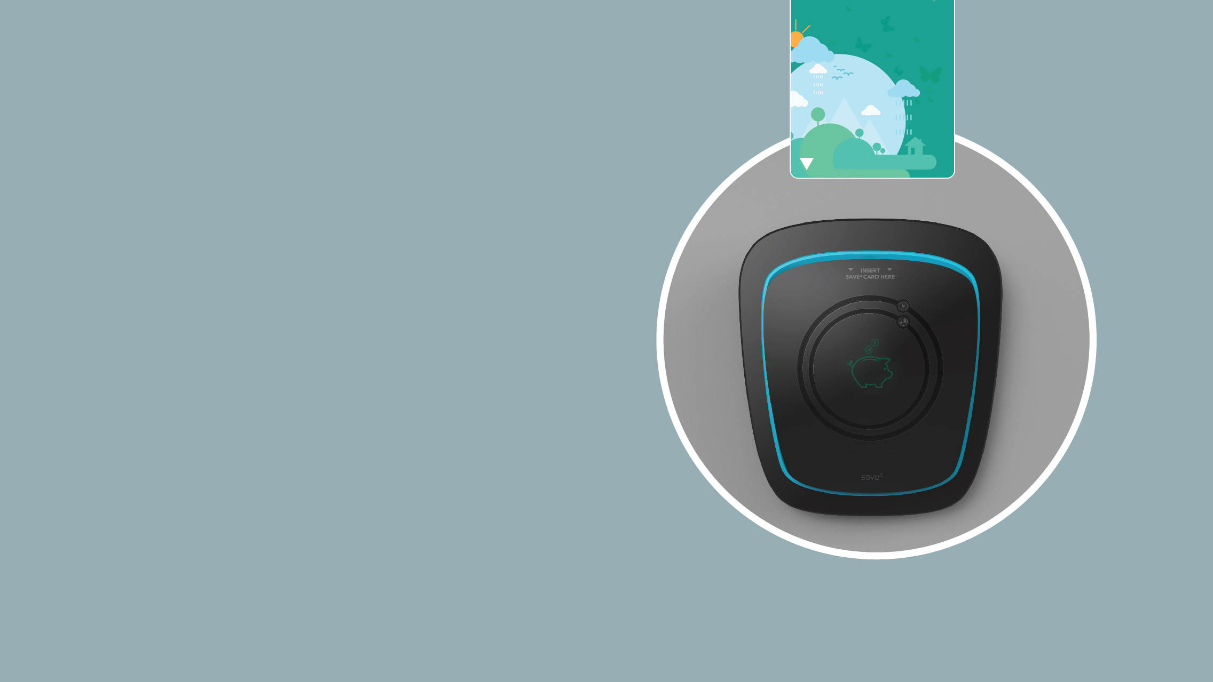
Proposed Technology (Cont.)
Save3 Keycard is inserted in the Save3 Switch inside the room.

Slide 10
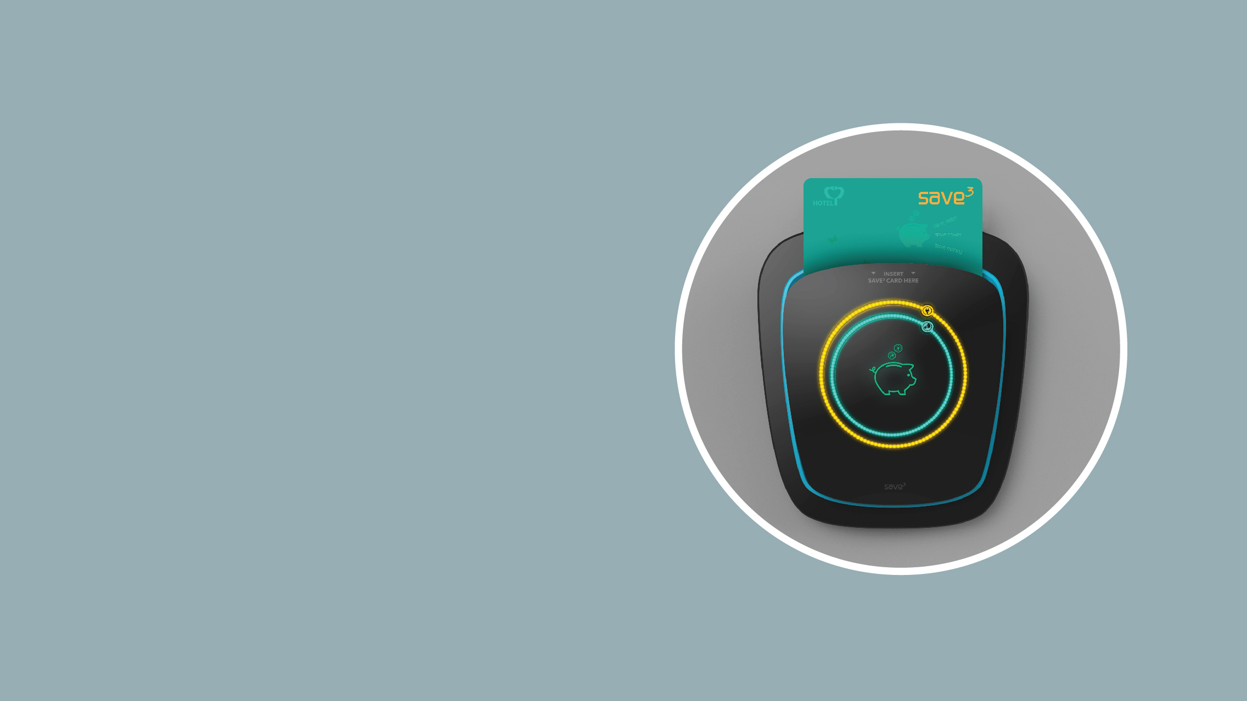
Proposed Technology (Cont.)
Save3 Keycard is detected: the Orange Electricity and Blue Water Bars light up to full.

Slide 11

Proposed Technology (Cont.)
The room is in use: the bars keep shortening in length, as Electricity and Water are consumed.

Slide 12

Proposed Technology (Cont.)
Length of the bar is directly proportional to Electricity and Water saved.

Slide 13
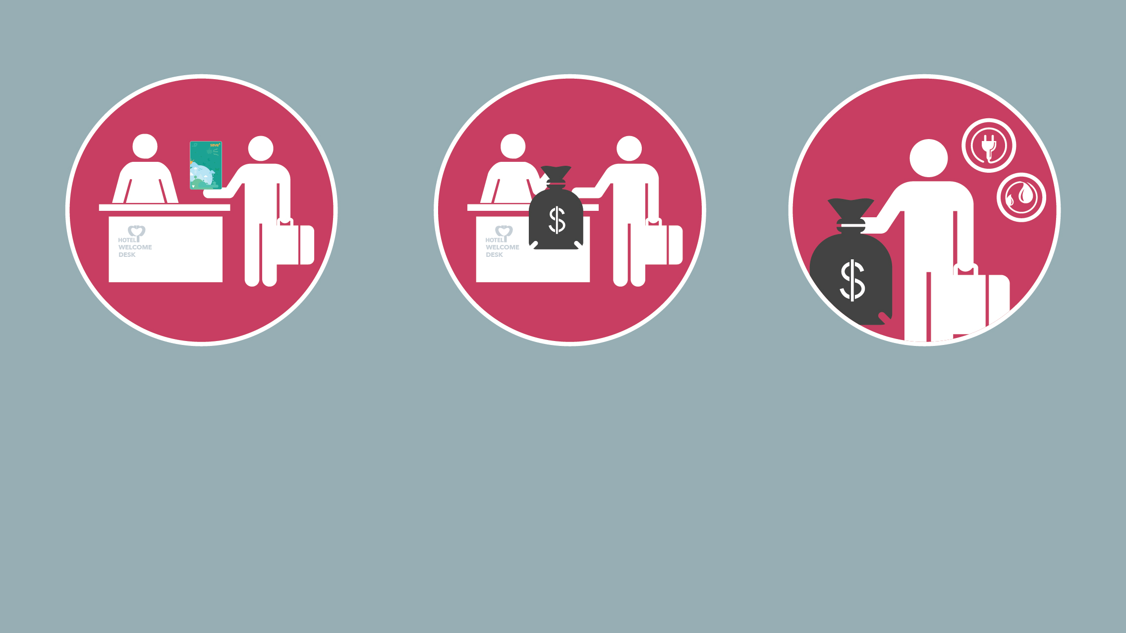
Proposed Technology (Cont.)
Guest checks-out at the Front Desk. Returns Save3 Keycard that carries information from the Save3 Switch.
Refund!! The bars were longer.... More money back!
The bars were shorter... Less money back!

Slide 14
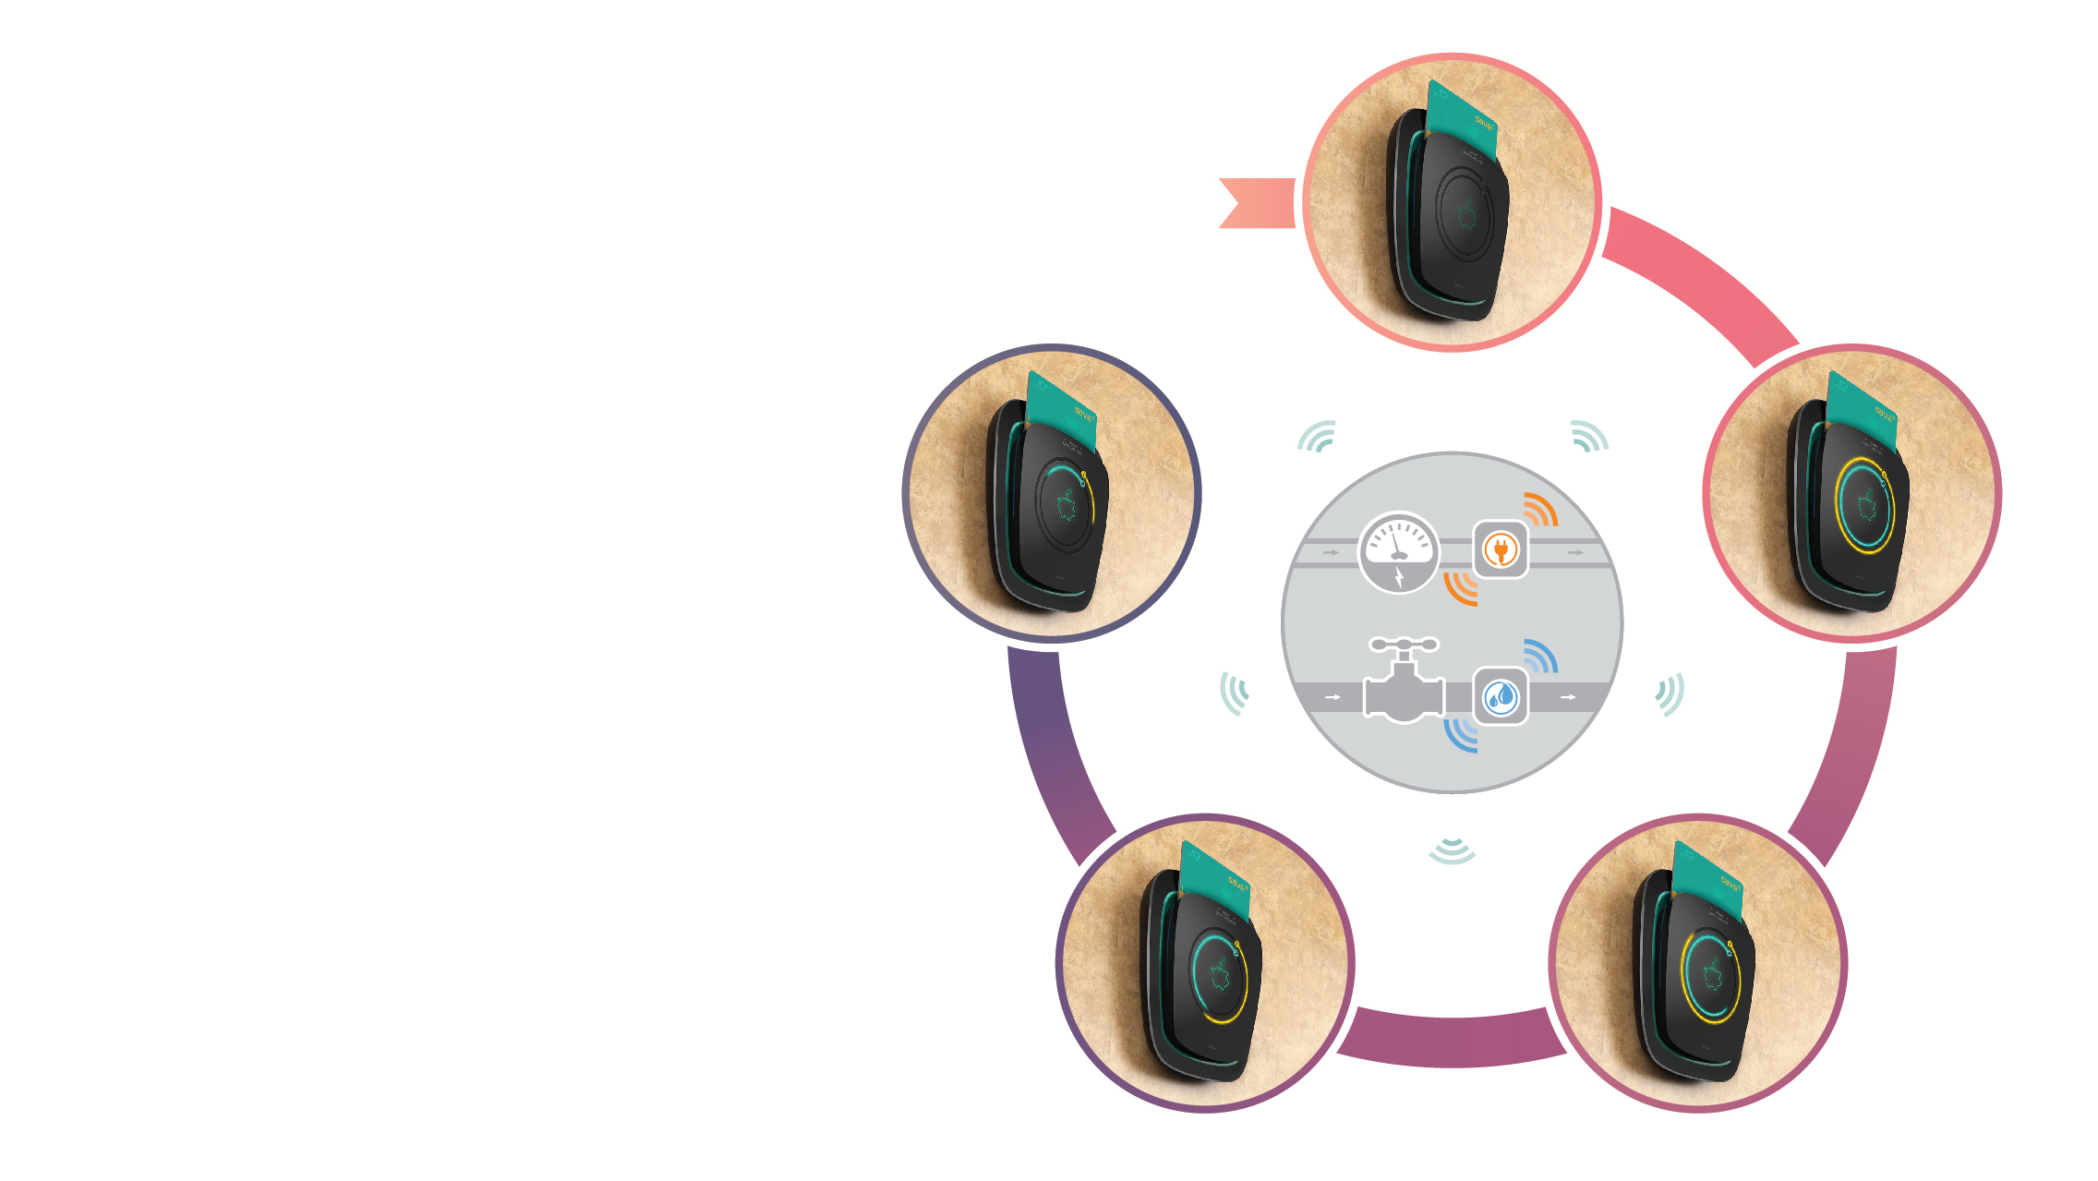
Proposed Technology (Cont.)
Wireless connectivity monitors usage and provides feedback
to Smart Objects
Information regarding water and electricity usage is transmitted wirelessly to the Save3 Switch.

Slide 15
Proposed Technology (Cont.)
The main water-inlet and electrical meter for each room are both wirelessly enabled and connect with the Save3 Switch. This connectivity amplifies the capabilities of these smart objects and the information is made visible when the Save3 Keycard is inserted in the switch.
Wireless connectivity monitors usage and provides feedback
to Smart Objects

Slide 16
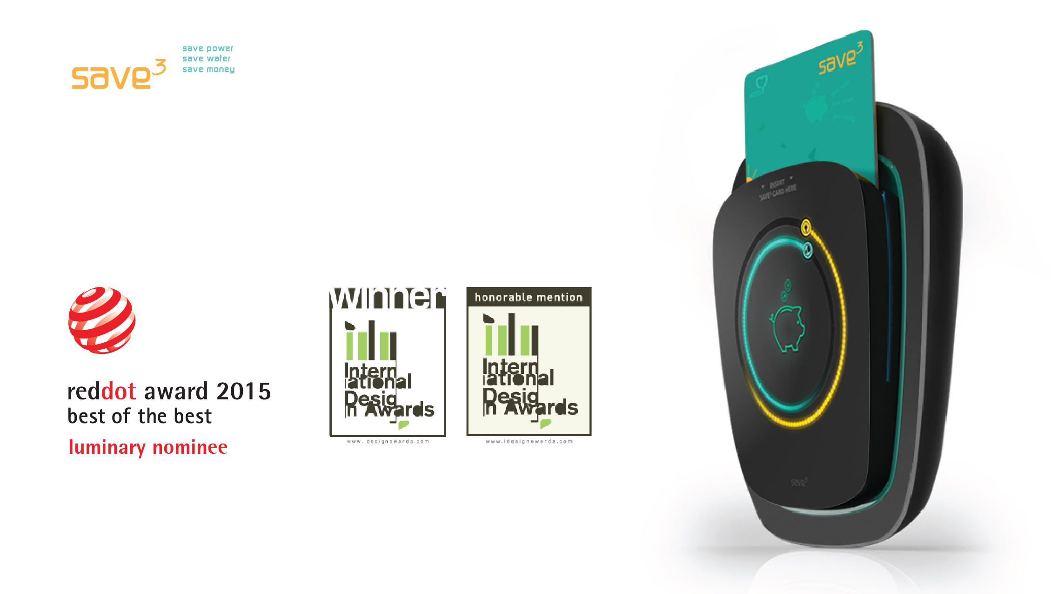
Proposed Technology (Cont.)
International Awards

Slide 17
Exemplary Projected Estimates
187,000 hotels, 17.5 million guest rooms
STR Global estimates that there are 187,000 hotels, offering 17.5 million guest rooms, around the globe.
400,000 hotels
Some estimates put the number of hotels around the world at around 400,000, with an additional 100,000 or so if you include B&Bs and hostels etc.

Slide 18
Patent/IP Status
Indian Application Number: 2393/DEL/2015
PCT Application: PCT/IB2016/054680
Application Status: Patent Pending
Priority Date: 04-08-15

Slide 19

DELHI. MUMBAI. BANGLORE. PUNE. INDORE. CALIFORNIA
Contact Details
Noida (NCR) Office
E-13, UPSIDC Site-IV, Behind Grand
Venice, Greater
Noida, 201308
Contact Person: Tarun Khurana
Contact No.: +91-120-4296878/2399010-11
E-Mail: iiprd@iiprd.com, info@khuranaandkhurana.com
Website: www.iiprd.com | www.khuranaandkhurana.com

