Slide 1

      Patent Licensing Proposal
      BURNER HEIGHT ADJUSTMENT MECHANISM
      FOR GAS STOVE
      Inventor: Mr. ASHISH KUMAR

Slide 2
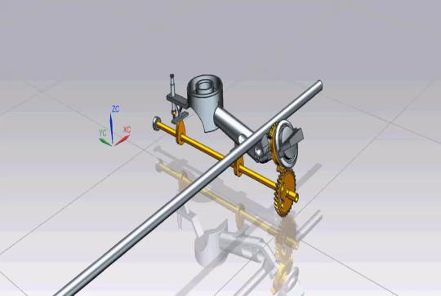
Technical Field of Invention:
Working:
Technical Field of the present invention pertains to Mechanical Engineering, wherein core inventive step of the present invention provides a significant value addition in domain of Cooking Appliances Industry.
Patent Application Status:
Patent Application Number: 2717/CHE/2013
Status: Granted
Introduction:
The present invention aims at maximizing efficiency of gas stove and ensuring that full heat energy generated by burning of fuel is utilized for cooking of food irrespective of type and size of the cooking vessel used.

Slide 3
Exemplary Trends:

Slide 4
Background of the Invention:
LPG being a fossil fuel will get depleted over the time.
Hence, saving and efficient utilization of LPG is of paramount importance for the country.
Over the years, LPG stove manufactures have improved the efficiency and are claiming more than 68% efficiency.
Exemplary factors governing the efficiency of LPG stove are: improving the design of burner, fuel rails, mixing tube and nozzle.
The rated efficiency of gas stove is for maximum burner flow condition but for all other flow conditions, gas stoves operate at lower efficiency. This is mainly due to heat transfer losses.
Scientifically it is known that reducing the distance to an optimum level between source and sink improves the heat transfer.
About the Invention:
In order to improve the efficiency of an LPG stove, the present invention provides a mechanism whereby gap between the top surface of the gas burner in a gas stove can be adjusted as per the requirement of the user or cook depending on the gas flow.

Slide 5
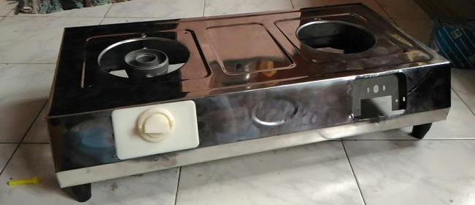
Prototype:
Front View
BOX-Bottom cover
BOX-Top Cover
Gas Knob
Ring Knob
(for burner height adjustment with safety mechanism)

Slide 6
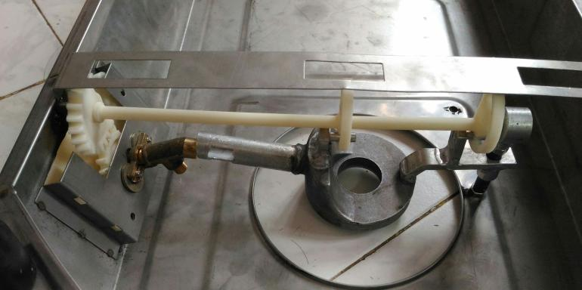
Prototype:
Bottom View
Gear guard
Driver Gear
Driven Gear
Cam Shaft

Slide 7
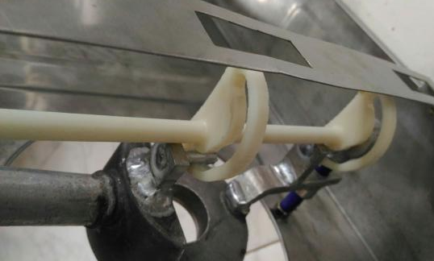
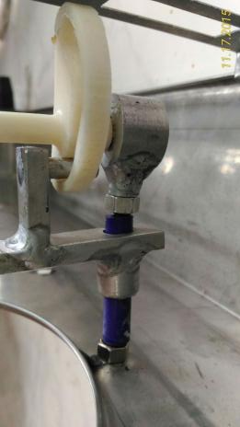
Prototype:
Bottom - Closeup View
Eye
Cam
Bush welded to Mixing Tube
Guiding Sleeve

Slide 8
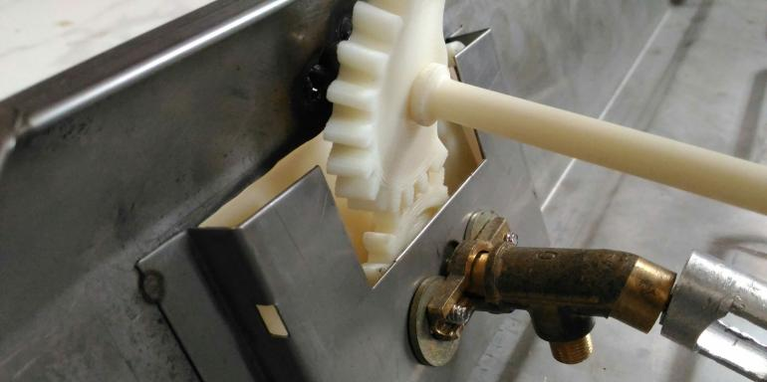
Prototype:
Bottom - Closeup View

Slide 9
Expectations:
Inventor seeks alliance with Potential Licensees to assign Licensing Rights.
Inventor is also interested in Sale of the Patents.
Contact Details:
IIPRD Consulting
Email: ankit@iiprd.com
Phone: +91-7838404168
Address: E-13, UPSIDC, Site-IV, Behind-Grand Venice, Kasna Road, Greater Noida - 201310, UP, National Capital Region, India.

