Slide 1

LOCATOR ALARM AND DISTANCE FINDER USING NETWORK TOWER
Patented Vide Indian Patent Number : 282621

Slide 2
INTRODUCTION

Slide 3
INTRODUCTION
The present invention deals with method to find current location of a particular person using network towers coordinates instead of GPS based technology and providing value added services to user using this .

Slide 4
MOBILE PHONE USERS IN INDIA
Source: http://tech.firstpost.com/news-analysis/number-of-smartphone-users-crosses-300-million-in-india-as-shipments-grew-18-percent-359075.html
http://trak.in/tags/business/2017/02/04/india-mobile-subscriber-stats-jio-record/

Slide 5
LOCATION BASED SERVICES MARKET IN INDIA
With over 900 million mobile subscribers, location based applications market in India is estimated to be in range of 20 million USD.
It is growing and expected to grow over 20 times in 4 to 5 years.
Location Based Services (LBS) market in India is expected to grow at a CAGR of 58.61 percent over the period from 2014 to 2019.
Source: http://www.marketsandmarkets.com/PressReleases/location-based-service.asp
https://mobilemarketingwatch.com/location-based-services-market-in-india-projected-to-grow-steadily-51961/

Slide 6
PROPOSED FRIEND LOCATION & DISTANCE FINDER

Slide 7
FRIEND LOCATION & DISTANCE FINDER
This technology enables a first user to send a request to add a second user as a friend using phone number of the second user.
Storing, at a server or a database operatively coupled thereto, friend relationship between the first user and the second user based on acceptance of the request by the second user.
Determining, at the server, distance between the first user and the second user based on first mobile tower coordinates or a landmark corresponding to the first mobile tower coordinates of the first user and second mobile tower coordinates or a landmark corresponding to the second mobile tower coordinates of the second user.

Slide 8
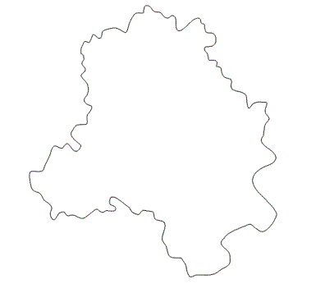
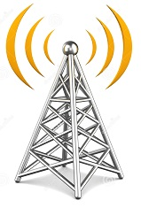
USE CASE
Two friends at two different places want to know each other location & distance
Person 2
👤
Person 1
👤

Slide 9
FRIEND REQUEST
👤
👤
999999999
User with mobile number “9999999999” sends friend request to user with number “8888888888”
Server forwards the friend request to user with mobile number “8888888888”
8888888888
FRIEND LOCATOR
“8888888888”
Accepted your friend request !
FRIEND LOCATOR
FREQUEST “8888888888”
FRIEND LOCATOR
You Have Received FREQUEST from “9999999999”
Would you like to accept:
If YES press “1” or “0” to DECLINE
FRIEND LOCATOR
Selected Option “1”
SERVER
Server informs the user with mobile number “9999999999” response of his friend
Server receives the response from user having mobile number “8888888888”

Slide 10
FRIEND LOCATION
👤
👤
999999999
8888888888
User with mobile number “9999999999” requests for location of user with mobile number “8888888888”
FRIEND LOCATOR
The number you have given is in your Friend list
Your Location: ABC
Friends Location: XYZ
Landmark : Airport
Distance: 14 Km (Approx.)
FRIEND LOCATOR
FLOC “8888888888”
USER
“8888888888”
SERVER
Server based on mobile tower coordinates of user with mobile number “8888888888” retrieves his location
Server informs the user location/distance of his friend with mobile number “8888888888”

Slide 11
PROPOSED DESTINATION BASED ALARM SYSTEM

Slide 12
DESTINATION BASED ALARM SYSTEM
User sends a request from a mobile device for destination based alarm for a selected destination.
Server receives the request and retrieve a list of one or more mobile towers pertaining to the destination.
Server sends the list of one or more mobile towers or landmarks corresponding thereto to the user’s mobile device.
The server receives from the user’s mobile device, selection of at least one mobile tower or a corresponding landmark from the list of the one or more mobile towers or corresponding landmarks.
When the user’s mobile device reaches the range of the selected at least one mobile tower. Server raise the alarm through the user’s mobile device.

Slide 13
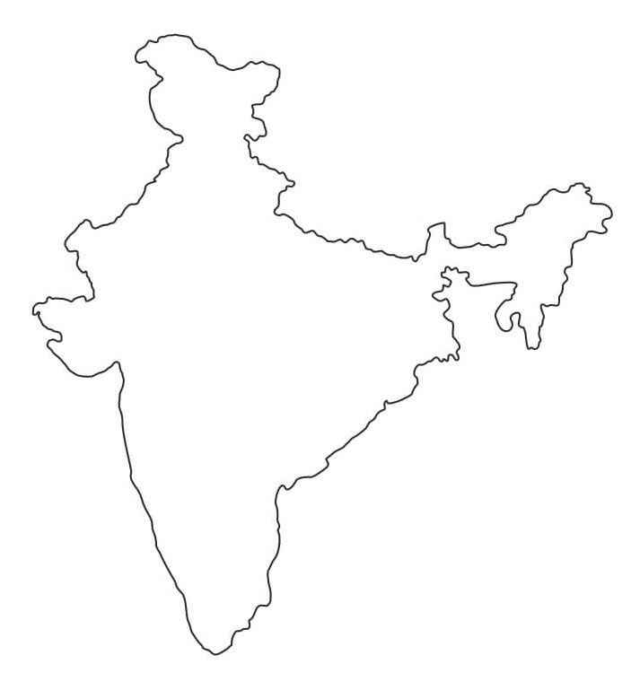
A user is travelling from Delhi to Mumbai
Delhi
👤
Mumbai
👤

Slide 14
TRAVEL ALARM REQUEST
STEP: 1
ENTER REGION NAME
Region Name:
NAVI MUMBAI
STEP: 2
SERVER
STEP: 3
SELECT YOUR OPTION
Panvel
Vashi
Belapur
Select All
Selected Option:
02 (VASHI)
STEP: 4
STEP: 5
ALARM DETAILS
Current Location: Delhi
Destination: Mumbai
Land Mark: Vashi Mall
Distance: 1024 KM
Press ‘1’ to Conform or Press ‘0’ to Exit
Selected Option:
01 (CONFORM)
THANK YOU FOR SELECTING LOCATION ALARM

Slide 15
PROPOSED DISTANCE FINDER

Slide 16
DISTANCE FINDER
When a user wants to know the distance between his current location and his selected destination. He sends a request to serve through mobile phone.
After getting the request from the user, server calculates the distance between based on position coordinates of tower corresponding to the current location of the user’s mobile device and position coordinates of the selected at least one mobile tower.
After calculating the distance server informs the user distance between two locations through users mobile.

Slide 17
A user wants to know distance between his current and selected location
Current Location
👤
Requested Location

Slide 18
DISTANCE FINDER REQUEST
STEP: 1
ENTER LOCATION
LOCATION:
RAMAPURAM
STEP: 2
SERVER
DISTANCE DETAILS
Current Location: Tambaram
Destination: Ramapuram
Land Mark: Childrens Park
Distance: 26 KM (Approx)
STEP: 3
STEP: 4
THANK YOU FOR SELECTING DISTANCE FINDER

Slide 19
USER CASE TAXI
Proposed technology can be used by user for booking and tracking a taxi
USER
👤
TAXI SERVICE
Booking Succesfull
Pickup Location: ABC
Drop Location : XYZ
Distance: 14 Km (Approx)
TAXI SERVICE
Pickup Location: ABC
(Based on mobile tower coordinates)
Enter Drop Location : XYZ
Distance is calculated based on mobile tower coordinates of pickup and drop location

Slide 20
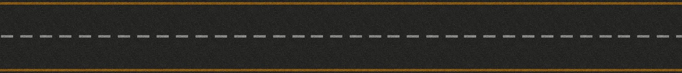
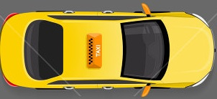
A user getting regular update of taxi location he is waiting for
USER
SERVER
👤
TAXI LOCATION
(Based on mobile tower cocordinates of taxi driver)
A
TAXI LOCATION
(Based on mobile tower cocordinates of taxi driver)
B
TAXI LOCATION
(Based on mobile tower cocordinates of taxi driver)
C
TAXI LOCATION
Taxi Reached
Location A
Location B
Location C
User Location

Slide 21
ADVANTAGES OF PROPOSED TECHNOLOGY

Slide 22
ADVANTAGES
This technology works with ordinary mobile phone, user need not to have a GPS enabled mobile with him.
This technology can be used to provide various location based value added services, Using this technology telecom and service provider companies can reach out to customers section which is not using these services till now.
This innovation can make life easier and happier for everyone as most of the mobile phone users in India are using ordinary mobile phones.

Slide 23
THANKS!
Any questions?
You can reach me at
+91-7838404168 & ankit@iiprd.com

