Slide 1

Offices: New Delhi. Bangalore. Mumbai. Pune. Indore. California (Fremont)
Phone: +91.120.4296878, 2399113, Fax: 2399011
Website: www.iiprd.com
Email: iiprd@iiprd.com
Patent Consulting | Research | IP and Litigation Support

Slide 2
OBJECTIVE
Objective of the instant sample study was to perform an exemplary Infringement Analysis. We have reviewed multiple official and third party websites, literature, videos, on-device testing, blogs, whitepapers, etc of WhatsAppTM to collect and map the evidences against Claim 7 of issued patent US 7,865,563, currently owned by Microsoft.

Slide 3
EXEMPLARY PATENT Vs PRODUCT
US7865563
Persisting a group in an instant messaging application
WhatsApp
Released Date 2010
Status Granted
Priority Date 28 Aug 2008
Filing Date 28 Aug 2008
Issued Date 04 Jan 2011
Assignee Microsoft
Owned by Facebook
Market Status Currently Operational
Feature Group Chat
Workaround Does not seem to be tweaked. Entire feature has to be disabled.

Slide 4
US Application No: 12/200,411
Exemplary Claim Mapping: Claim 7 Vs. WhatsApp Group Chat Feature
Claim Elements | Product: WhatsApp
A method comprising the following acts
(a) causing a processor to receive a request to include a plurality of entities in an instant messaging group in an instant messaging application; | Yes (Slide 5)
(b) causing the processor to create a persistent instant messaging group in response to the received request, wherein the persistent instant messaging group includes the plurality of entities, wherein the persistent instant messaging group is automatically persisted across multiple sessions of use of the instant messaging application; | Yes (Slides 6-7)
(c) causing the processor to receive an instant message from a first entity in the persistent instant messaging group by way of the instant messaging application, wherein the received instant message is directed to the persistent instant messaging group; | Yes (Slide 8)
(d) causing the processor to transmit the received instant message to at least each member of the persistent messaging group who is logged into the instant messaging application; and | Yes (Slide 9)
(e) causing the processor to transmit the received instant message as an offline message to each member of the persistent messaging group who is not logged into the instant messaging application. | Yes(Slide 10)

Slide 5
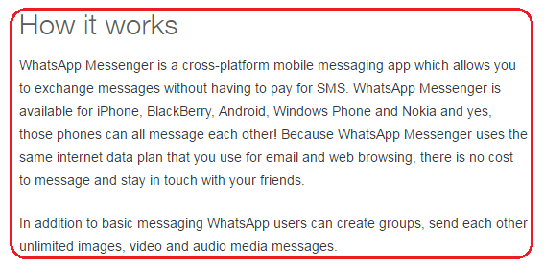
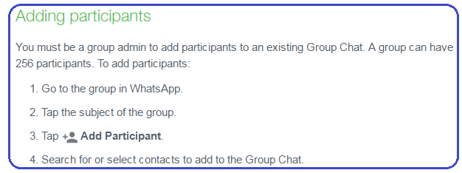
Claim Mapping: Claim 7 Vs. WhatsApp Group Chat Feature
Claim Elements -
(a) causing a processor to receive a request to include a plurality of entities in an instant messaging group in
an instant messaging application;
Comments:
It is evident that WhatsApp works on Smartphone, which includes a processor to execute various WhatsApp operations.
Plurality of entities are considered as chat participants
Instant messaging application is considered as WhatsApp messenger.

Slide 6
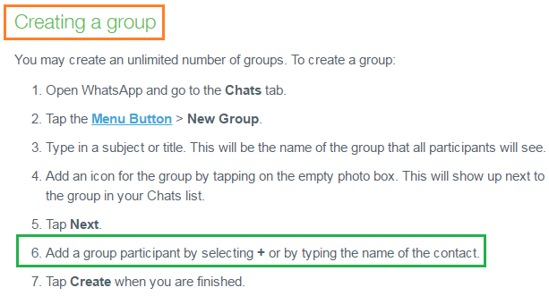
Claim Mapping: Claim 7 Vs. WhatsApp Group Chat Feature
Claim Elements -
(b) causing the processor to create a persistent instant messaging group in response to the received request, wherein the persistent instant messaging group includes the plurality of entities, wherein the persistent instant messaging group is automatically persisted across multiple sessions of use of the instant messaging application;
Comments:
The created group automatically persists forever unless it is explicitly deleted.

Slide 7
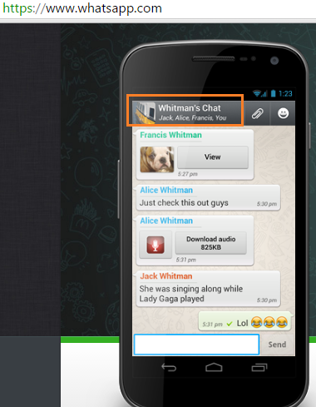
Claim Mapping: Claim 7 Vs. WhatsApp Group Chat Feature
Claim Elements -
(b) causing the processor to create a persistent instant messaging group in response to the received request, wherein the persistent instant messaging group includes the plurality of entities, wherein the persistent instant messaging group is automatically persisted across multiple sessions of use of the instant messaging application;
Comments:
A mobile device is depicting screen of a Smartphone, which displays a group created as “Whitman’s Chat”.
Group consists of participants as Jack, Alice, Francis. and a group creator as “You”.

Slide 8

Claim Mapping: Claim 7 Vs. WhatsApp Group Chat Feature
Claim Elements -
(c) causing the processor to receive an instant message from a first entity in the persistent instant messaging group by way of the instant messaging application, wherein the received instant message is directed to the persistent instant messaging group;
Comments:
As illustrated, encircled blue color portion depicts a textbox ,where a participant (Jack, Alice etc.) types (WhatsApp receives) an instant message and sends in the group by tapping on “Send”.

Slide 9
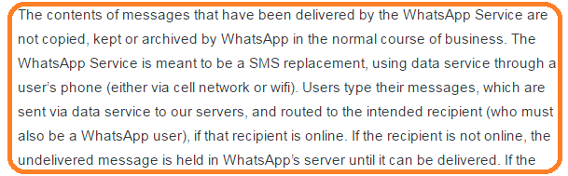
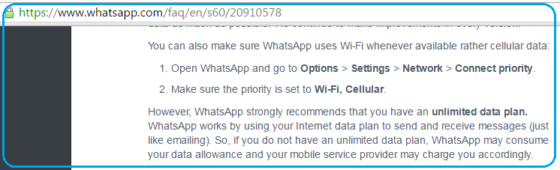
Claim Mapping: Claim 7 Vs. WhatsApp Group Chat Feature
Claim Elements -
(d) causing the processor to transmit the received instant message to at least each member of the persistent messaging group who is logged into the instant messaging application; and

Slide 10
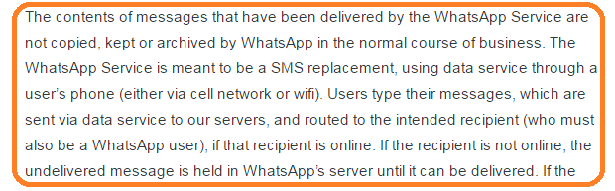
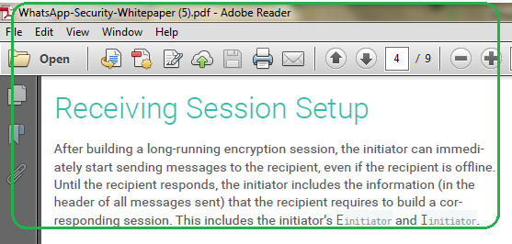
Claim Mapping: Claim 7 Vs. WhatsApp Group Chat Feature
Claim Elements -
(e) causing the processor to transmit the received instant message as an offline message to each member of the persistent messaging group who is not logged into the instant messaging application.

Slide 11
Disclaimer
IIPRD has prepared this exemplary/sample report based on information sources that are believed to be reliable by IIPRD. IIPRD disclaims all warranties as to the accuracy, completeness or adequacy of such information. Neither IIPRD nor its affiliates nor any of its proprietors, employees (together, "personnel") are intending to provide legal advice in this matter.

