Slide 1

Title of the Invention
Apparatus For Dry Run Protection Of Electrical Pumps
Inventor
Mr. Prashant Parashuram Sathe

Slide 2
Technical Field of Invention:
This invention protects motor pumps from getting damaged in dry run or overload condition by detecting the conditions on time and stopping the operation of the pump. The apparatus consists of heating elements and a thermal switch connected to the electrical circuit of the pump to control the operation.
IPR Status:
Application Number : 201721031988
Patent Pending
Key Advantages Of Investing in Early Stage:
Investing in the initial stage of such an exceptional technology is an opportunity to get licensing rights at an extremely cost efficient price.
It provides flexibility for the modification as per requirements.
Involvement of investor's Research and Development expertise, would further enhance the quality of product.

Slide 3
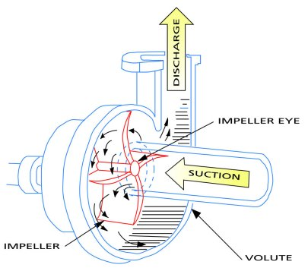
Background:
A motor pump is a device that moves fluids, or sometimes slurries, by mechanical action. Pumps operate by some mechanism like reciprocating or rotary, and consume energy to perform mechanical work by moving the fluid.
Pumps operate via many energy sources, including manual operation, electricity, engines, or wind power.
One of the main reasons of damage of components of a motor pump is dry running due to functioning of the pump without presence of a fluid.
Image taken from www.pumpfundamentals.com

Slide 4
The Problem:
Dry running due to functioning of pump without a fluid flowing increases the temperature and damages the components such as mechanical seals configured with bearing of impeller. Past efforts have simply provided for monitoring level of fluid present in a supply tank of the fluid.
There is therefore a need in the art to provide for an apparatus that can detect dry run condition of a pump and can stop operation of the pump when the condition is detected.
This invention detects the initiation of dry run and/or overloading conditions and can stop the operation of the pump during such conditions.

Slide 5
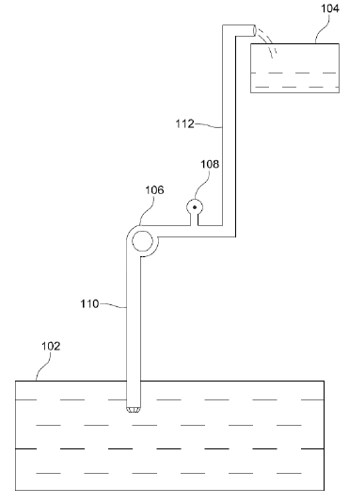
Working:
The apparatus (108) consists of at least one heating element (204) to be placed in vicinity of or in contact with fluid passing through the pump (106) from sump tank (102) to overhead tank (104) to enable heat transfer between at least one element and the fluid, and a thermal switch (206) configured in vicinity of or in contact with at least one heating element such that rise in temperature of at least one element engenders increase in temperature of the thermal switch, wherein when temperature of the thermal switch rises above a pre-set threshold value, the thermal switch stops operation of the pump.

Slide 6
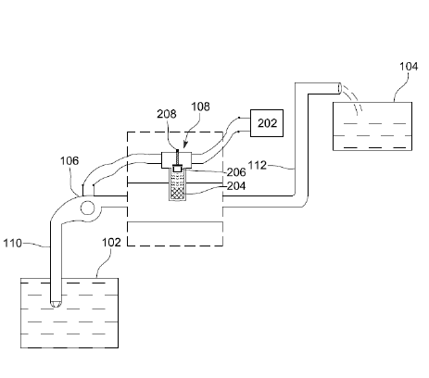
Working:
At least one heating element (204) and the thermal switch (206) can be arranged in electrical circuitry (300) of the pump (106), where electrical current from power source (202) of the pump (106) flows through the heating element and the thermal switch.
When the fluid is flowing through the discharge pipe (112), temperature of the heating element is maintained to a certain upper limit due to conductive or convective heat transfer of heat from the heating element to the fluid.
When fluid is not passing through the pump, temperature of at least one heating element rises thereby increasing temperature of the thermal switch.

Slide 7
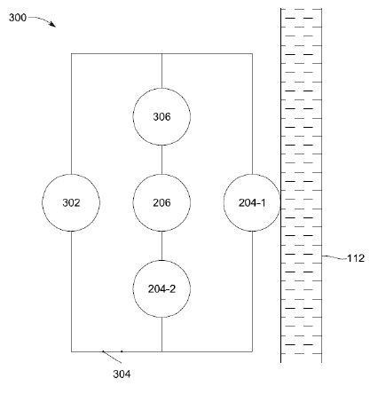
Working:
The thermal switch (206) is arranged in series configuration with electrical circuit (300) of the pump. The thermal switch comprises at least two contacts in closed configuration, and wherein when temperature of the thermal switch rises above the pre-set threshold value, at least two contacts become openly configured thereby breaking the electrical circuit of the pump.
Rise in temperature of the thermal switch (206) is gradual and it takes a specific time interval for temperature of the thermal switch to reach the pre-set threshold value. Higher pre-set threshold value is associated with more delay and lower pre-set threshold value is associated with less delay. This delay differentiates between random flow fluctuations of the fluid and actual dry run condition that persists for longer period.

Slide 8
Working:
The thermal switch (206) also acts as an overload protection switch that stops operation of the pump when current passing through the thermal switch crosses a pre-set current threshold value.
The thermal switch (206) can be an automatic thermal switch that automatically resets when its temperature falls below the pre-set threshold value. Or, it can be a manual thermal switch that is reset by pressing a reset button (208) configured with the thermal switch.

Slide 9
Expectations:
Technology transfer fees and royalties
Licensing
Target Industry:
Mechanical industry

Slide 10
THANK YOU

