Slide 1


PROPOSAL REGARDING LICENSING OF GRANTED PATENT EP 3134097

Slide 2
INTRODUCTION
The current invention pertaining to Granted Patent (EP 3134097) helps in Relieving Pain, Stress and Insomnia vide composition that doesn’t require to be consumed within the body and has no harmful effects. This EP Patent is also in advanced prosecution in the US/India, and is granted in Canada and South Africa. The product is already under commercialization in limited capacity by the Patentee.

Slide 3
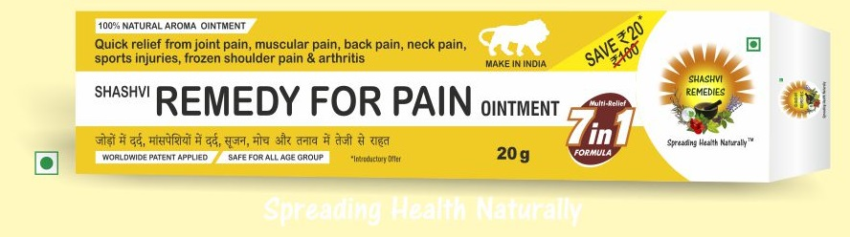

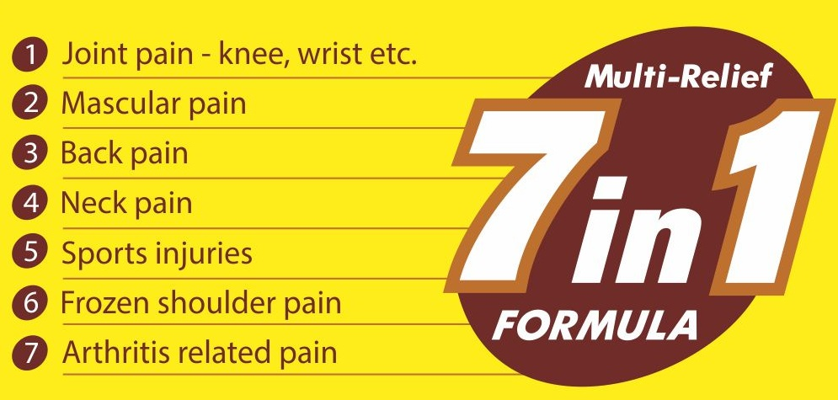
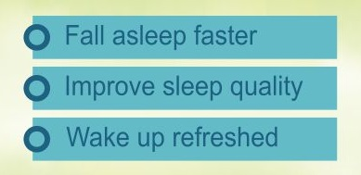
2 GLOBALLY PATENTED PRODUCT-LINES
SHASHVI REMEDY FOR PAIN [SRP]
SHASHVI NIGHT [SN]
A revolutionary herbal ointment
Instantaneous pain-relief with no side-effects for any type of pain
Clinically proven superior performance compared to its synthetic counterparts
A first of its kind herbal ointment to cure the problem of insomnia and stress
Non-addictive
No prescription required

Slide 4
MARKET ANALYSIS FOR SRP
Trend: Branded drugs market dominance by few top players (Pfizer & Purdue with ~50% market share) being threatened
Key drivers
Rising ageing population
Alarming rise in chronic diseases. E.g. cancer therapy
Favorable regulation for pain management drugs
Patent expiry of blockbuster drugs nearing
Consumer demand for sustainable pain-management solutions rising
Source: TMR reports
Opportunity
Consumers & investors are searching for vendors with breakthrough solutions for varied & chronic pain problems
Source: IBEF,IMS OTC review, Marketers Media

Slide 5
SRP AIMS TO FILL THE VOID
Source: CISION PR Newswire
Market Share (%)- India
.025
.074
.213
.609
.755
.901
Market Share (%)- World
.002
.006
.019
.091
.191
.321
ADVANTAGE SHASHVI REMEDY FOR PAIN (SRP)
Pain-relief represents a huge but fragmented market (~$60 bn in 2018)
Any newcomer with key differentiation resolving pain-points not addressed by existing solutions stands to gain a decided advantage & quick scalability
Shashvi Remedy for Pain (SRP) offers a breakthrough in herbal pain relief with patented formulation allowing a single solution for all types of pain applied topically & without need of a prescription!!

Slide 6
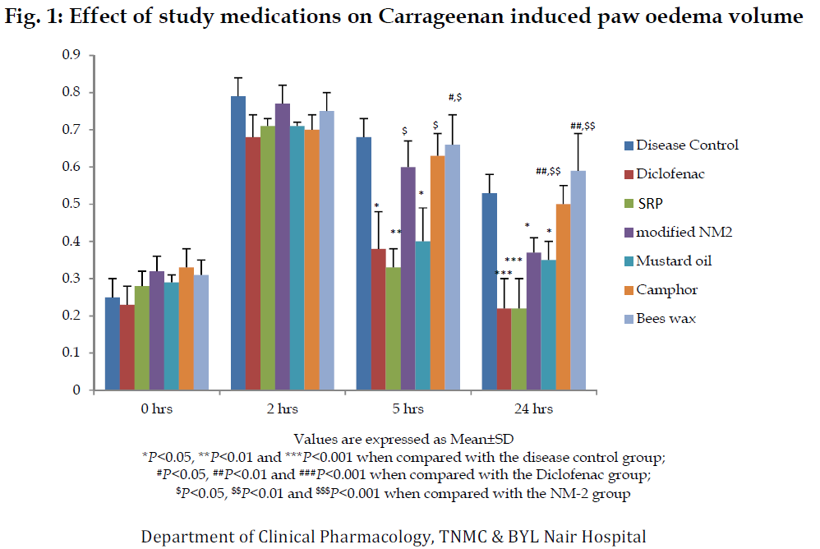
SRP HAS ECLIPSED THE COMPETITION IN PAIN-RELIEF
Diclofenac is the most commonly used ingredient in most of the pain relief creams available in the market
SRP has shown much higher efficacy when compared with Diclofenac based Pain-relief cream during Clinical study and as per testimonials of actual users

Slide 7
APPLYING SRP
GENERAL INSTRUCTIONS
Gently massage 2-4 grams of SRP on pain-sensitive & surrounding areas till the ointment is absorbed & dried in the skin
Feel the pain-relief initiation within 30 seconds & maximum relief within 2-3 minutes
ADDITIONAL POINTERS
For maximum effect, clean & dry the affected area before ointment application
Hand-wash after application is optional as SRP contains herbal & safe ingredients

Slide 8
INSOMNIA & STRESS PATIENTS ARE SEEKING AN AFFORDABLE, SUSTAINABLE SOLUTION
FACTS
2 major means of treatment: Drugs (99%): Devices (1%)
Key revenue-netters
  Developed world: Patented drugs
  Developing world: Branded Generics
TIMELY OPPORTUNITY
An economical, patented OTC solution can capture immense market share while maintaining advantageous Gross Margin!
KEY DRIVERS
Extremely price-sensitive consumer
Highly fragmented market relying on old unpatented formulations (generic drugs)
Key R&D being carried in devices rather than drugs
Source: Grand view research

Slide 9
SN SEEKS TO DISRUPT THE FRAGMENTED MARKET
Source: Grand view research
Market Share (%)- World
.015
.054
.089
.692
1.55
2.64
ADVANTAGE SHASVI NIGHT (SN)
Insomnia is a nascent market with many solutions but no decided market-leader
Any newcomer with price advantage combined with ease of application can capture the market
Shashvi Night (SN) offers a first-of-its-kind patented ointment to treat insomnia
Dual market capture with a single drug: Insomnia & Stress-relief
  Potential 2nd market: Global anxiety, stress & depression medication market is valued at $7.6 bn

Slide 10
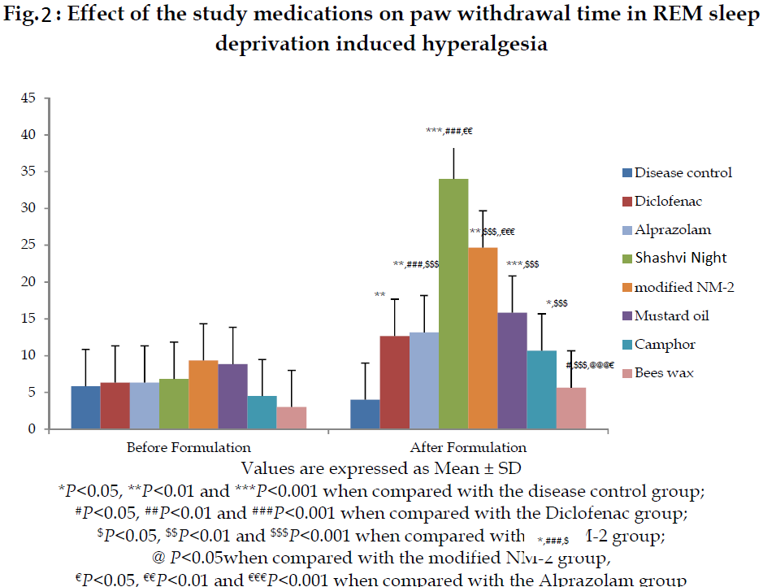
SN HAS BETTER SLEEP-INDUCING EFFECTS THAN IT’S SYNTHETIC COUNTERPARTS
Clinical trial using Hot plate methodology was conducted on 50 specimen administered with varying agents to counter insomnia
Shashvi Night far outshone other formulations as a clear indicator of its effectiveness to counter insomnia and stress.

Slide 11
APPLYING SN
TREATING INSOMNIA
  Massage your temple, forehead, nose for 1-2 minutes
  Thereafter, with aid of friend/family member, massage on both legs from sole to knees in an upward direction covering calf muscles for ~5-7 minutes
COMBATING STRESS & HIGH PULSE-RATE
  Massage temples, nose, forehead & upper lips for a few minutes

Slide 12
THANK YOU
Contact:
Ankit Kumar
E-Mail id: ankit@iiprd.com
K-16, Jangpura Extension, New Delhi - 110014, India.
Tel: +91-(011) 40079530

