Slide 1


Title of the Invention:
Alternative oxidase activity stimulating chemical composition and a method for reducing hypoxia in plants.
Inventor:
Mr. Burje Shrikant Kumar

Slide 2
Technical Field of Inventions
The present invention relates generally to the field of plant physiology and biochemistry.
More particularly it concerns chemical compositions, method related to stimulation of alternative oxidase enzyme activity.
The present invention extends to enhance survivability of and /or reduce damage to cells, tissues, organs and organism under stress induced hypoxic conditions in plant tissue culture.
Patent Status
Indian patent application No. 201821034088A
PCT Application No. PCT/IB2019/050380
Publication Date - 5th October 2018

Slide 3
Prior Art
While there exists many chemical compositions regarding to making plants hypoxic–anoxic tolerant in prior art , however they fail to provide an advanced chemical composition solution for achieving hypoxia tolerant plants in plant tissue culture.
Summary
Present invention provide technique for improvements as solution to hypoxia generated in conventional plant tissue culture practices.
Provides a chemical compositions when used in effective concentration will improve plants yield, hypoxic tolerance of plants micro propagated through plant tissue culture practice.
Chemical composition comprise high concentration of potassium nitrate, choline chloride, glutamine acid, L- Glycine, L-Cysteine, Adenine sulphate, D Ca- Pantothenate acid, Sodium silicate and succinic acid derivatives along with plant tissue culture medium and plant growth hormones.
Said chemical compositions may be added during multiplication stage, shooting stage and rooting stage along with plant tissue culture medium.

Slide 4
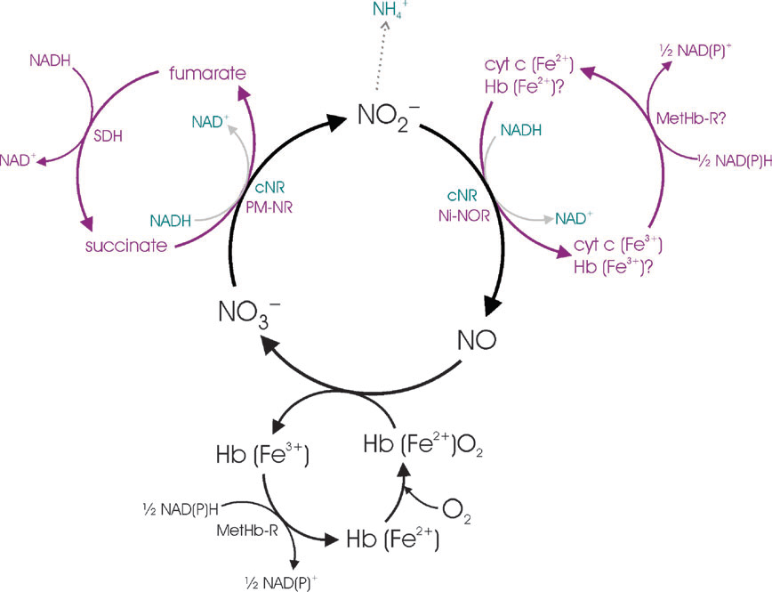
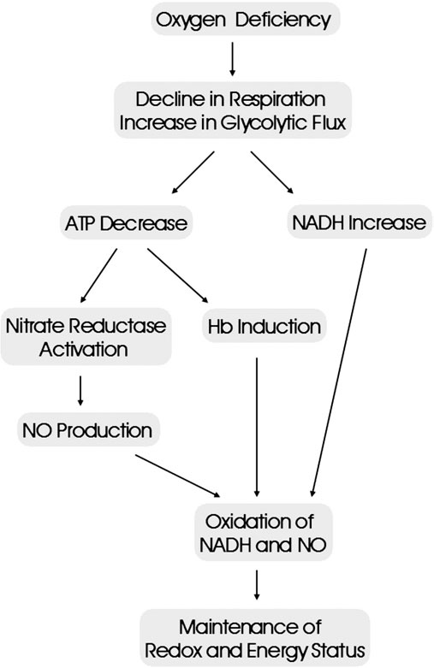
Figure
Hb/NO cycle participation during hypoxia
Role of Hb induction in NO scavenging, NADH recycling and ATP formation during hypoxia

Slide 5
Advantages
Better plant shoot formation/multiplication ratio per subculture.
Maximum survival rate of primary harden plants due to better adaptation to primary hardening conditions.
Due to high nitrate reductase enzyme activity plant yield more.
Due to high succinate dehydrogenase enzyme activity better adaptation to abiotic and biotic stress.
Low variation.
Plants show better response to fertigation.
Abstract
The present invention encompasses chemical composition in an effective concentration to stimulate alternative oxidase and hypoxic adaptation of plant tissue, plant organ, plant cells micro-propagated through plant tissue culture medium. The disclosed chemical composition comprises succinic acid or its methyl ethyl ester or combination of succinic acid and its derivatives, choline chloride, glutamine acid, adenine sulphate, D Ca pantothenate acid, L-glycine, L-cysteine, high nitrate concentration in the form of potassium nitrate and sodium silicate as basic solution for PH adjustment at effective concentration. The disclosed chemical composition can be added to plant tissue culture media either during multiplication stage or during shooting stage or during rooting stage along with growth hormones such as Auxins and Cytokinins.

Slide 6
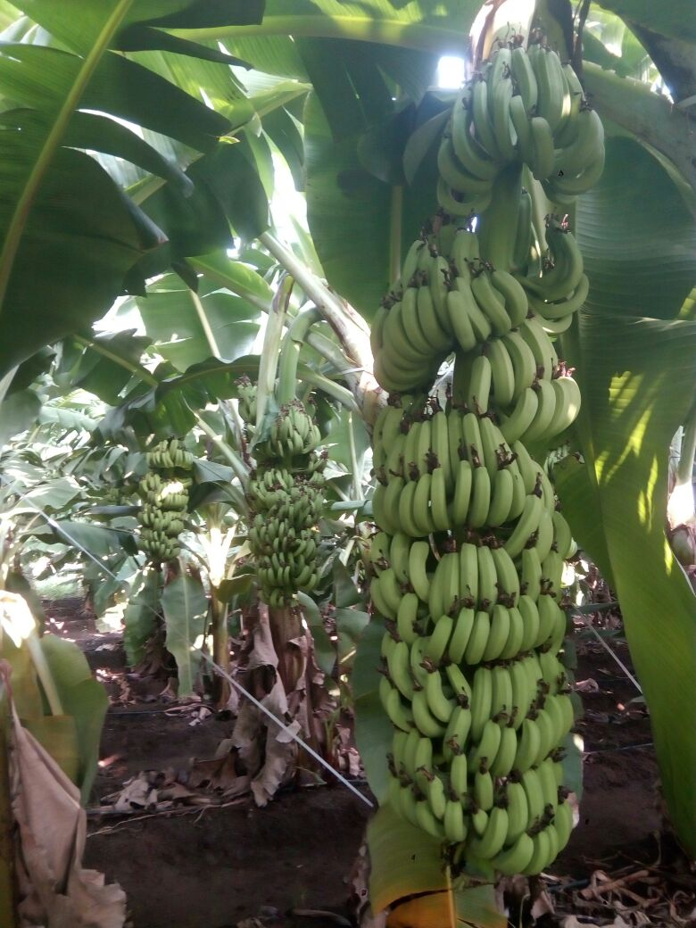
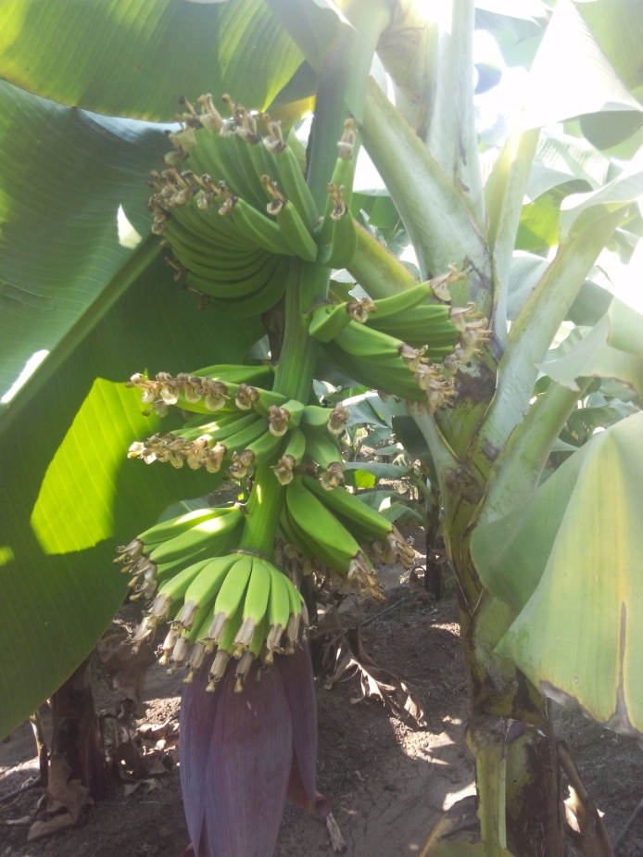
Results
Effective concentration of chemical composition plant tissue culture medium
Conventional plant tissue culture media

Slide 7
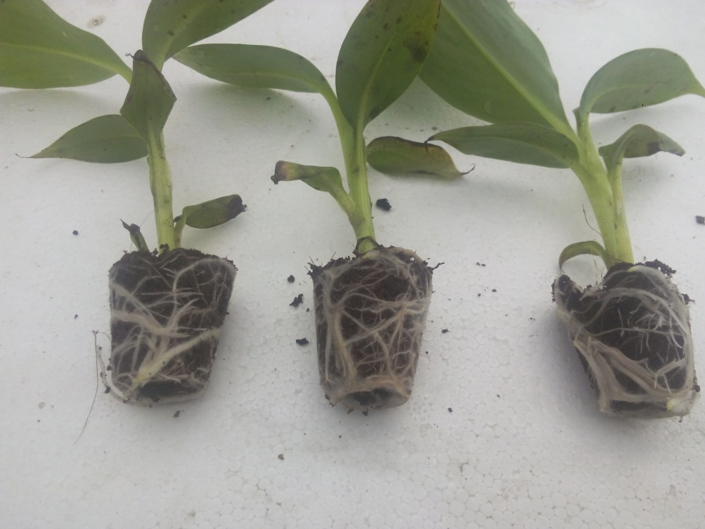
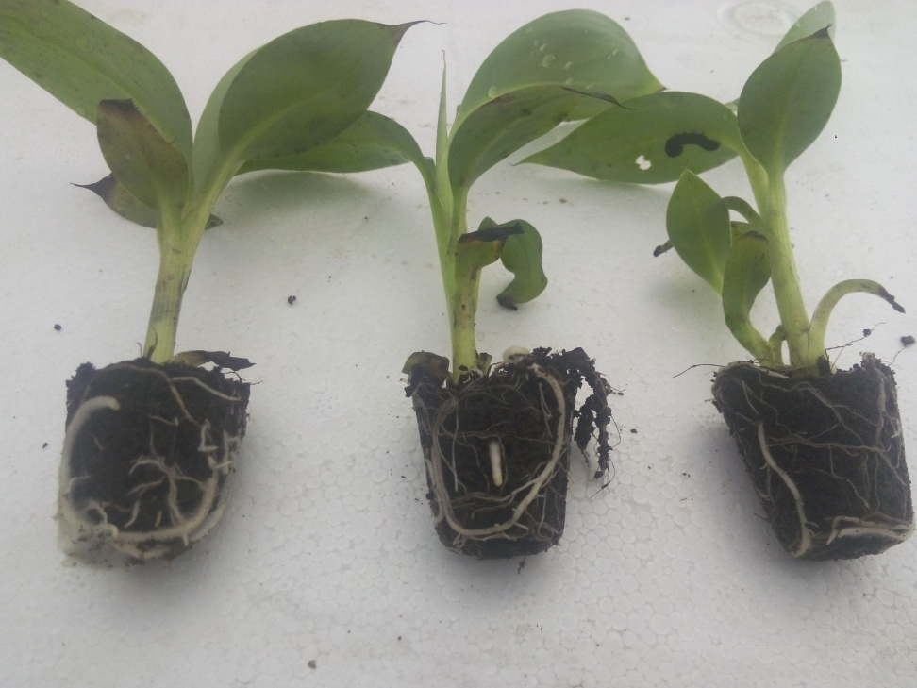
Primary Harden Plant Roots
In effective concentration of chemical composition
In conventional chemical composition

Slide 8
Application
This technology can be used to commercially micro-propagate hypoxia tolerant and high yielding plants through plant tissue culture.
Commercial Expectations
Technology Transfer Fees and Royalties.
References
Cytokinin inhibition of respiration in mitochondria from six plant species. ( Carlos o. Miller/Proc.Natl.Acad,Sci.USA.Vol.77. No.8. pp-4731-4735.1980.
Cytokinin modification of mitochnodrial function . Carlos o Miller/ Plant Physiol. 1982.69, 1274-1277.
Biotechnological approaches to creation of hypoxia and anoxia tolerant plants. B B Vartapetian/ Acta Naturae. Vol.6. No.2(21) 2014.
Reactive nitrogen species in mitochnodria and their implications in plant energy status and hypoxic stress tolerance. K J Gupta/ Front.Plant.Sci 7:369. 2016.
A discrete role for alternative oxidase under hypoxia to increase nitric oxide and drive energy production. A Vishwakarma/ Free radical biology and medicine 122. 2018. 40-51.

Slide 9
THANK YOU
New Delhi Office
K-16, Jangpura Extension, New Delhi - 110014, India.
Tel: +91-(011) 40079530
E-Mail id: iiprd@iiprd.com
Greater Noida (NCR) Office
E-13, UPSIDC, Site-IV, Behind-Grand Venice, Kasna Road, Greater Noida - 201310, UP, National Capital Region, India.
Tel: +91-(120) 4296878, 4909201, 4516201
Fax: +91-(120) 4516201
E-Mail id: iiprd@iiprd.com
Bangalore Office 1
A-001, Nitesh Central Park, Near Bagalur Crossing, Off Bellary Road, Bengaluru - 560064, India.
Tel: +91-(080) 66123903
E-Mail id: iiprd@iiprd.com
Pune Office
Office No. 203 + 204, 2nd Floor, Citymall, University Road, Ganesh Khind, Shivaji Nagar, Pune - 411007, Maharashtra, India.
Tel: +91-(020) 66201041
E-Mail id: iiprd@iiprd.com
Mumbai Office
FA27, Lake City Center, Kapurbavdi Circle, Thane (W), Greater Mumbai - 400607 Maharashtra, India.
Tel: +91-(022) 41002054
E-Mail id: iiprd@iiprd.com
Bangalore Office 2
CH-6, Natasha Golf View, 100 Feet Rd, Intermediate Ring Road, Domlur Layout, Bengaluru, Karnataka - 560071, India.
Tel: +91-(080) 41147035
E-Mail id: iiprd@iiprd.com
Indore Office
62, Malgunj, Bhagat Singh Marg, Biyabani Main Road, Jawahar Marg, Indore - 452002, Madhya Pradesh, India.
Tel: +91-(120) 4296878, 4909201, 4516201
E-Mail id: iiprd@iiprd.com
Hyderabad Office
Regus Business Centre, Krishe Sapphire, Level 7, South Wing, Hitech City Main Road, Madhapur, Hyderabad - 500081, India.
Tel No:+91- (040) 6717 2040
E-Mail id: iiprd@iiprd.com
Jalandhar Office
A2-905, Jal Vayu Vihar, Jalandhar, AFNHB,
Punjab - 144008, India.
Tel: +91-(120) 4296878, 4909201, 4516201
E-Mail id: iiprd@iiprd.com

