Slide 1

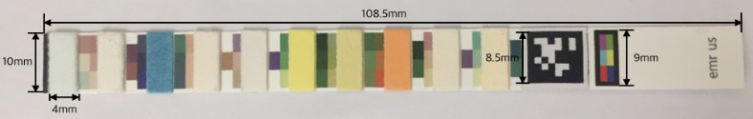
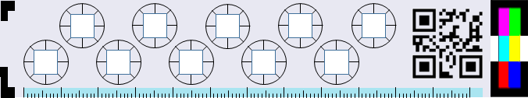
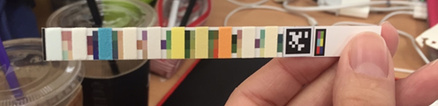
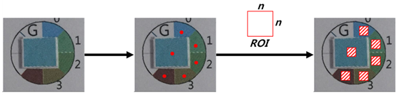
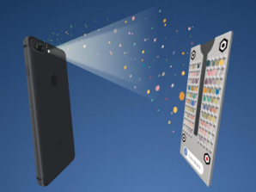
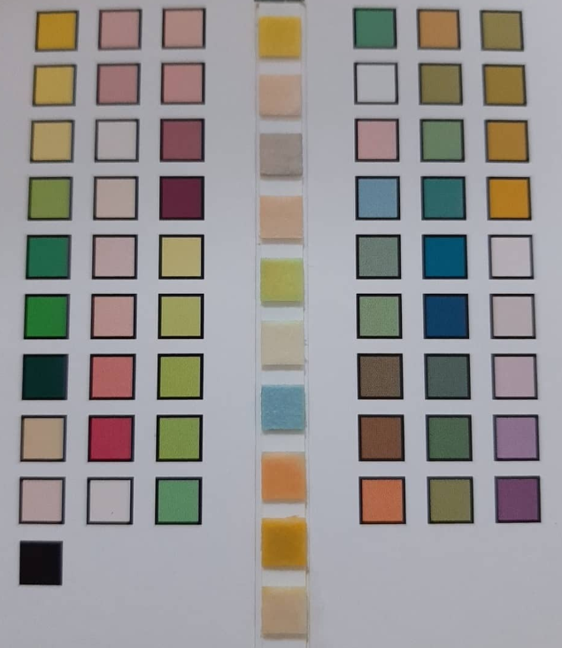
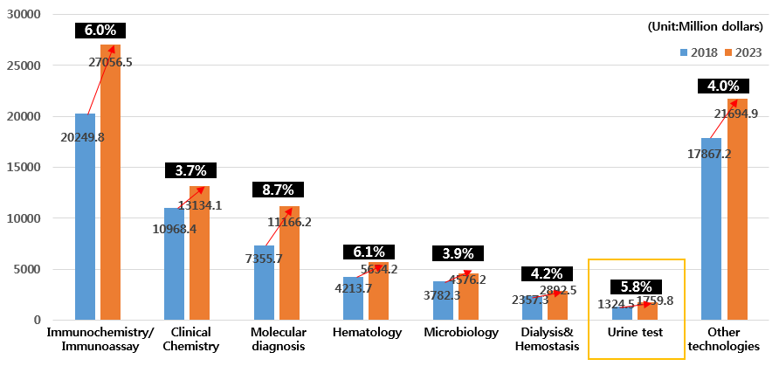
Urine test strip including timer, and method of detection and method of analysis for urine test strip
Researcher | Professor Hui Yul Kim
Application Field | Diagnostic kit
Technology Overview
Advantages of Technology
Material: Urine test strip which is necessary to test urine based on the application
Usage: A method of detecting a urine test strip from a photographed image of the urine test strip. Urine testing can be easily performed using a cellphone capable of running an application
The top and bottom markers of the urine strip allow for correction of the position of the strips that vary from one shoot to another time
Urine testing can be easily performed using a cellphone capable of running an application without purchasing additional equipment
Results of urine tests can be checked accurately and quickly regardless of the surrounding lighting environment
By using timer, you can check the exact analysis time of the urine test strip
[Strip design]
[Indicators for the elapsed time of urine immersion
through a timer]
[When the user proceeds to shoot(sample)]
Superiority Compared to
Existing Technology
Issues of Conventional Technology
[Interest Area for obtaining color information of
reagent pads and surrounding colorimetry]
☑ In order to know the results corresponding to the colorimetric table, the user must have a separate manual.
☑ User should visually observe and compare the colorimetric table and the reagent pad separately, and compare the instructions with the manual to predict the results.
Applied Product and Market Trend
Application field: App-based urine test system
Solutions
☑ Attach the QR code/April tag to the urine test strip, the application compares the colors of the reagent pads and colorimetric tables that change on the strips to allow the user to know the results.
☑ A timer that can be used as an indicator for urine immersion time is provided to information about the time during which urine tests can be done accurately.
Global market size of In Vitro Diagnostics(IVD):
Urine test 1,759 million dollars (as of 2023, CAGR 5.8%)
Patent List
No. | Patent Number | Patent Name
1 | EP 3557231 | URINE TEST STRIP COMPRISING TIMER, AND METHOD FOR DETECTING AND ANALYZING URINE TEST STRIP
2 | CN 110226085
3 | KR 10-2016989
4 | WO 2019-107666
Inquiry
Email : patent@hanyang.ac.kr

