Slide 1


Improvement in Automotive Locks
Inventor
Mr. PRASHANT PARASHURAM SATHE

Slide 2
Technical Field of Invention
The invention relates to a completely novel automotive locks having two innovative and revolutionary technologies, novel electro-mechanical encryption system and retractable pin based unbreakable handle/steering lock system. The invention helps in achieving greater security and encryption standards as Compared to conventional mechanical locks or software based electronic locks. The invention being highly secure also manages to enhance cost-efficiency, reliability and simplicity of automotive locks.
IPR Status:
Application Number: 201821020739
Patent Pending
Key Advantages of Investing in Early Stage:
Investing in the initial stage of such an exceptional technology is an opportunity to get licensing rights at an extremely cost efficient price and at more favourable terms.
It provides flexibility for the modification as per requirements.
Involvement of investor's Research and Development expertise, would further enhance the quality of product.

Slide 3
The problem we are solving?
It is an inevitable truth that the automobile theft are at their historical peak at present times, expert deduce many reasons like high spare costs, lack of secure parking spaces as compared to number of automobiles and further high unemployment among educated youth is leading to boost in number of hi-tech thefts. In today’s time the automotive locks can be classified into two basic categories that are mechanical locks & software based electronic encryption systems, our electro-mechanical encryption technology have taken a middle path of both of these to ensure negatives of both the technologies are eliminated and hence establish an benchmark in encryption systems.
Going through actual theft videos will further clarify the understanding about the shortcoming of present lock technologies, please find the YouTube video links of bike/car theft videos below:-
https://youtu.be/RBBxZxUeXjQ (bike theft India)
https://youtu.be/h0mPNpODc3w (key making for theft)
https://youtu.be/HuLKormzWE4 (BMW theft USA)
https://youtu.be/4_bo_uYPP4Q (Software based theft explained in detail)
Notes:
Prevention or Cure?
Which is better?
To find your stolen vehicle? or
To safeguard your vehicle against theft?
Is it possible to provide better protection to your vehicles?
HOW?

Slide 4
Shortcomings of present conventional technologies of automotive locks
Mechanical locks | Software based electronic encryption systems
1) Mechanical locks have inherent shortcoming that they provide mechanical feedback to thieves which is further utilised by them to calculate/determine key pattern. It takes not more than 5 minute for key maker to make a key for given automotive lock. | 1) Through EBD port the ECU and immobilizer can be reprogrammed easily to accept any other key.
2) Keyway of mechanical lock is forcefully rotated by thieves to break lock’s internal lever mechanism easily. | 2) Software based theft have become simpler than ever before because of ready made availability of cracking devices having special software’s for theft of cars. There are incidences when cars like BMW, Mercedes are taken away in 180 seconds.
3) Mechanical locks no matter how complex they will always provide mechanical feedback to thieves and hence can be cracked. | 3) Pure software based encryption system can’t be made 100% secure ever especially when every time car receives passkey through wireless mode.
4) Present application- Bikes and low end cars. | 4) Present application- High end bikes and cars.
Notes:
Conventional Lock
Two functions
Electrical switch
Handle lock
Failure in Conventional Locking System
Electrical switch: Bypass
Handle lock: Angular torque
Electronic authentication – Prone to HACKING !!!
Need: Increase theft resistance of vehicles

Slide 5
Diagram Key
NO. | DESCRIPTION | NO. | DESCRIPTION
102 | CHASSIS | 218 | HIGH TENSION SPRING
104 | CHASSIS INTERLOCKING ELEMENT | 220 | SECOND METALLIC PLATE
106 | AUTOMOTIVE LOCK | 222 | LOW TENSION SPRING
108 | PATH OF ROTATION OF LOCK | 400 | MECHANICAL KEY
110 | LOCK INTERLOCKING ELEMENT | 402 | KEY EXTRUSION POINTS
200 | LOCK AUTHENTICATION ELEMENT | 404 | CYLINDRICAL PIN
202 | ELECTRICAL WIRES | 406 | ELECTRICALLY INSULATED TIP OF 404
204 | LINEAR SOLENOID ACTUATOR | 408 | ELECTRICAL SWITCHES
205 | ACTUATING ROD FOR 204 | 410 | EXTERNAL POWER SOURCE
206 | RING PHYSICALLY JOINED TO 210 | 412 | KEY WAY
208 | SLOTTED PIN ATTACHED TO 502 NOT JOINED WITH 210 | 414 | IGNITION SOURCE
210 | MECHANICAL CAM | 500 | UPPER COVER OF CASING
212 | SOLID CAM SUPPORT | 502 | HAND ROTATED MANUAL KNOB
214 | SOLENOID PIN | 504 | PATH OF ROTATION OF LOCK
216 | THICK METTALLIC PLATE | 506 | DIRECTION OF MOTION OF 110 DURING WEDGING ACTION

Slide 6
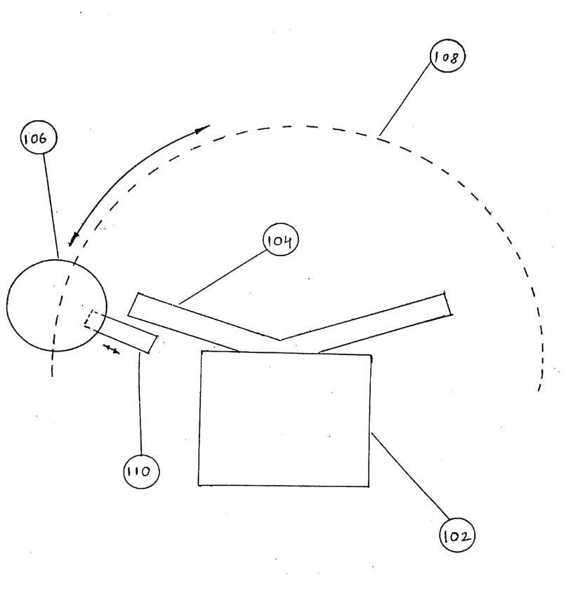
Detailed Technical description
The exemplary illustration shows the general anatomy of the locking system of automobiles. The automotive lock 106 consist of encrypted switch system and handle/steering lock mechanism. The path 108 is a path followed by an automotive lock when handle/steering are rotated about their axis. The automotive chassis 102 have fixed interlocking element 104 permanently attached to it. When handle/steering lock is enabled the lock’s interlocking element 110 protrudes out from lock’s casing and gets interlocked with fixed interlocking element 110 of chassis. Due to this interlocking the movement/rotation of automobile’s handle/steering is restricted. During theft the thieves apply huge rotational torque on handle/steering which breaks either of the interlocking elements 110 or 104 to enable easy theft of automobile. The invention have overcame this short coming by providing for spring coupled retractable lock’s interlocking element.

Slide 7
Detailed Technical description
This illustration shows the configuration of Novel automotive lock when handle lock is disabled. Now for understanding purpose we will go with the procedure to enable handle lock. Assuming the electro-mechanical encryption (refer slide 9 for it’s working) system 200 has been already authenticated by appropriate key. Once the lock is authenticated the solenoid actuator 204 will get actuated pushing actuator pin 205 outwards. The rotation will be induced manually on slotted pin 208 which is coupled with a knob outside lock’s opaque and sealed casing. During rotation as soon as the slot of pin matches the solenoid pin they will get interlocked, now the rotation imparted manually on knob will be forwarded to cam 210 as solenoid is fixed cam. Further as cam rotates in anti-clockwise direction it will push metallic plate 216, which further pushes high tension springs 218, which further ultimately pushes the lock’s interlocking element 110 out of the lock’s casing. This further leads to interlocking of lock’s and chassis interlocking elements 110 & 104. It is to be noted that the high tension spring’s 218 will not go under any type of compression only low tension spring 222 will undergo compression. Please see the illustration in next slide to get the configuration of novel automotive lock when handle lock is enabled.

Slide 8
Detailed Technical description
Now this illustration shows the configuration of lock when handle/steering lock is enabled. Now let’s consider a situation when thief tries to break the handle/steering lock by applying huge rotational torque on handle/steering, the interlocking elements 110 & 104 will slide by each other by way of wedging action. There will be huge axial force applied by 104 acting on interlocking element 110 by virtue of taper of 110. This would result in instantaneous retraction of interlocking pin 110 into lock’s casing by simultaneously compressing high tension springs 218. Further the rotational torque applied by thief continues to act the interlocking elements will slide pass by each other. As soon as they pass by each other the interlocking element 110 will again protrude out by virtue of springs 218 and hence will continue to obstruct the free rotation of handle/steering (maintaining non drivable status of automobile). It is to be noted that the springs 218 are of very high spring constant and need very huge force to get compressed. Hence it is impractical to think that thief can apply huge force (in range of 120-200kg ) on every slight turn on roads to navigate vehicle swiftly after theft. Also always there will a huge instantaneous jerk experienced by thief after wedging/sliding process which will make the driving on road very dangerous and practically impossible for thief when handle lock is enabled.

Slide 9
Detailed Technical description
This illustration shows configuration of an novel automotive lock having an innovative electro-mechanical authentication system, the novel electro-mechanical authentication system consist of various "normally open" and "normally close" miniature electrical switches arranged in series configuration in automotive lock which itself act as a "normally open" switch in automobiles ignition circuit. These switches in automotive lock circuit ( which further is part of automobile's ignition and electrical utility circuit) are configured such that only "normally open" switches are required to get actuated by mechanical action of key having unique physical pattern to authenticate lock. The "normally closed" miniature switches should remain undisturbed for successful authentication of the lock. The arrangement of NO & NC switches is random and complex and is enclosed in sealed and opaque casing. Hence impossible for thieves to guess key pattern. It is also observable that as the number of switches increases in encryption circuit the encryption strength will increase, for a size of average key at least 30 micro miniature switches can be configured in lock’s key way which means total no. of possible key varieties would be 2^30=1073741824 (more than 1 billion key combinations). This huge amount of key combination was never offered by any mechanical lock manufacturer.

Slide 10
Technical Advantage
Encryption strength- There is no way the key can be guess for the novel automotive lock as there is no feedback (mechanical, electrical or software based) available for thief by help which he can guess the key pattern of the lock.
Unbreakable (here means to maintain non drivable status of vehicle) handle/steering lock mechanism.
Reliability- The average life of miniature tact switches are 1 million actuating cycles. Also the whole mechanism of lock is simple and robust.
Cost efficiency- The cost of miniature tact switches are less than 1 rupees ($0.015) if procured
in huge quantity.
Wireless functionality- The concept is also compatible with wireless functionality with some modifications. (due to complexity reasons description of wireless functionality has not been added here but would be explained by inventor in person)

Slide 11
Commercial advantage
IP protected technology hence unmatchable competitive advantage.
Reduction in insurance cost of automobile in countries like USA where insurance cost depends on encryption strength of automobile.
Lower product development time due to simplicity of design.
Huge creation of value if product goes successful considering the present behemoth size of global automotive market.
Huge scope of technology not only in automotive market but also in big market of safety lock, vault, storage industry and many more where encryption capability is of prime importance.

Slide 12
Inventor’s suggestions for implementation of technology
In cars, the encryption circuitry and ECU can be combined into a strong casing such that the electro-mechanical encryption system will act as switch between power source and ECU. Only after appropriate authentication power will be permitted to ECU. Further this whole casing can be arranged somewhere in dashboard such that user can easily insert authenticating key into it. OR simply just the connection between ECU and components important for engine starting can be electrically encrypted.
Electro-mechanical encryption system can also act as encrypted switch for immobilizer module of automobile. This will provide for extra security cover over immobilizer’s electronically coded encryption.
For almost 80% of bikes in India having simple mechanical lock, technology can be implemented in whole.
Further brain storming during product development can make way for many more techniques to implement technology to enhance automobile security.

Slide 13
Expectations:
Licensing
Technology Transfer royalties
Funding and investment for manufacturing setup
Target Industry:
Automotive industry.

Slide 14
THANK YOU

