Slide 1

Rotary Vane Reciprocating Compressor
Patent Application No. 5624/CHE/2014
ISRF Proprietary - Patent Pending -

Slide 2
Rotary Vane Reciprocating Compressor
Positive displacement compressors handle less mass flow rate at high pressure ratio
Aerodynamic compressors handles high mass flow rate at less pressure ratio
RVR is a trade off between positive displacement and aerodynamic compressors which provides higher mass flow rate and pressure ratios
Efficiency is estimated to be better than aerodynamic compressor
Rapid prototype model has been made
Addressed stress, centrifugal forces, lubrication, mechanical losses etc.,
Working on vibration and vane tip optimization
Several possible configurations have been covered in patent application
ISRF Proprietary - Patent Pending -

Slide 3
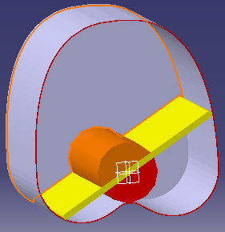
Rotary Vane Reciprocating Compressor
Air Intake 2
Casing length
Vane length
Vane
Rotor
Outlet
Air Intake 1
ISRF Proprietary - Patent Pending -

Slide 4
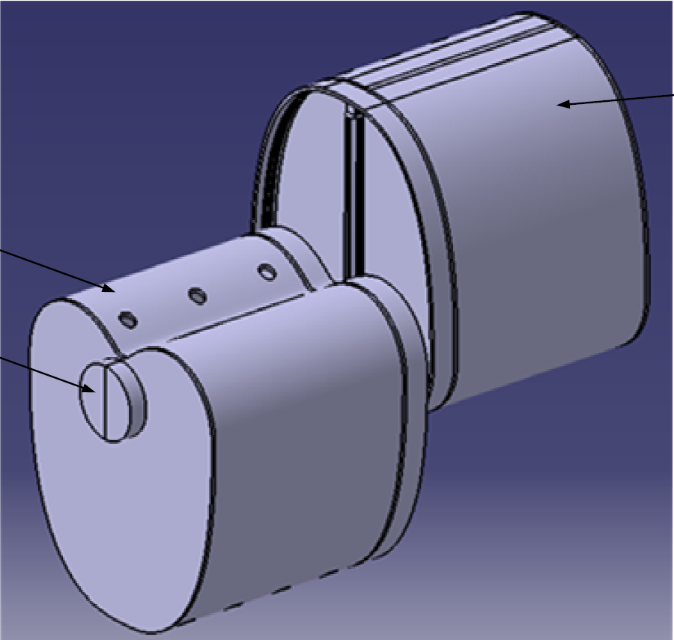
Rotary Vane Reciprocating Compressor
Casing
Intake
Rotor

Slide 5
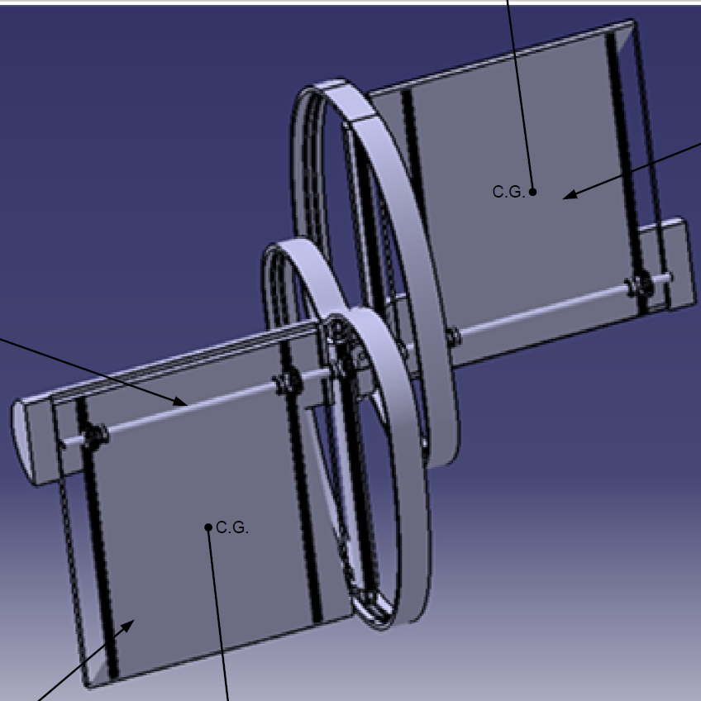
Rotary Vane Reciprocating Compressor
Shaft
Vane

Slide 6
Business Potential
Unique design
Significantly lower size and cost compared to the existing positive displacement compressors with similar mass flow and pressure ratio
Can cover large applications including Food industry, Tool Industry, Chemical Industry, Refrigeration , Central Air conditioning etc.,
Huge Indian and International market
ISRF Proprietary

